Slide 1
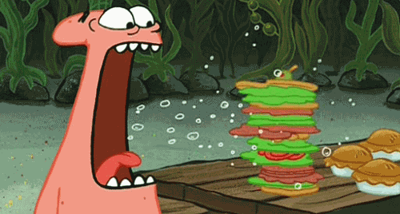
Food for Life
Science 14: Chapter 10

Slide 2
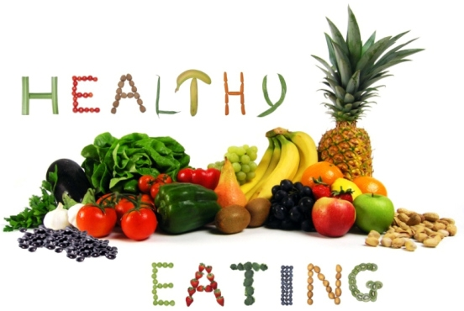
Today’s Class
Nutrition
Diets
The Rock Diet Challenge

Slide 3
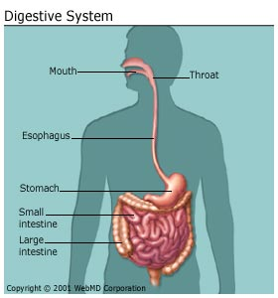
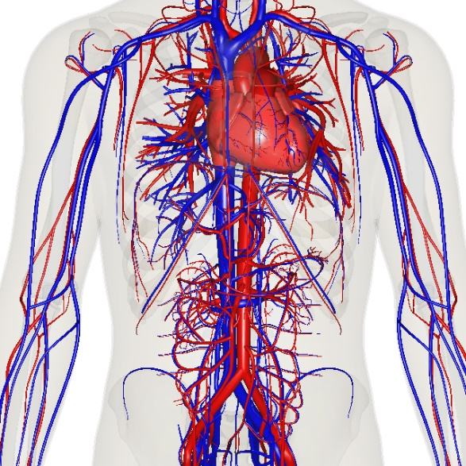
Review
Systems required in transportation of food/energy through body?
1. Digestive system
2. Circulatory system
We will continue to examine these systems through this chapter ☺

Slide 4
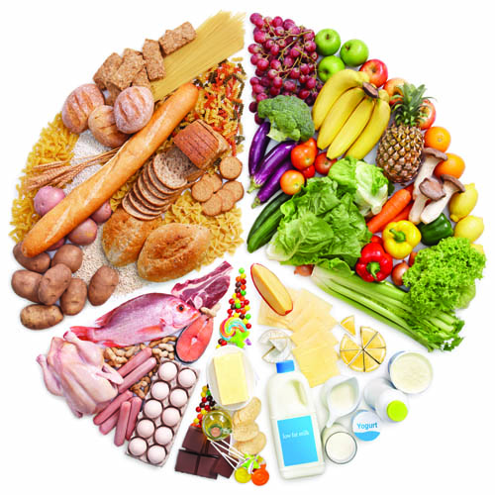
Nutrition
Study of foods and how the body uses them
Develop lists of daily nutrient requirements
Nutrients are substances found in foods that provide nourishment to the body
Help to maintain proper health and growth

Slide 5
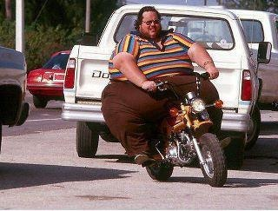
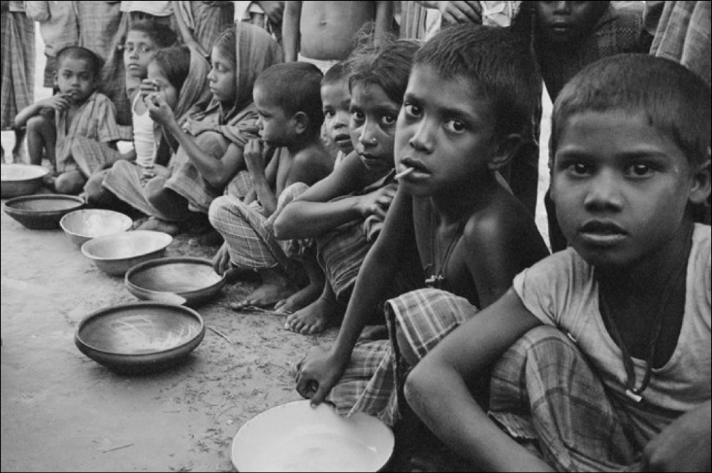
Malnutrition
Lack of proper nutrition, caused by not having enough to eat or not eating enough of the right things.
Often leads to high levels of sickness and shorter life spans
Notes:
Both pictures are cases of malnutrion

Slide 6
So What Does Your Body Need?
Your body requires the following 6 nutrients
Carbohydrates
Fats
Vitamins
Proteins
Water
Minerals

Slide 7
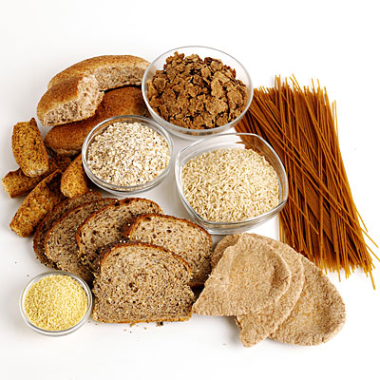
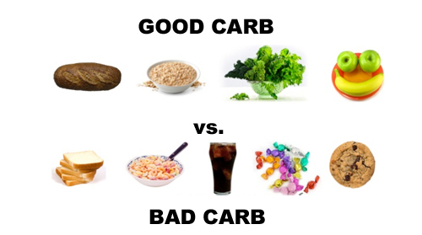
Carbohydrates (Carbs)
Mostly in the form of sugars and starches
Primary sources of energy for the body
Examples?

Slide 8
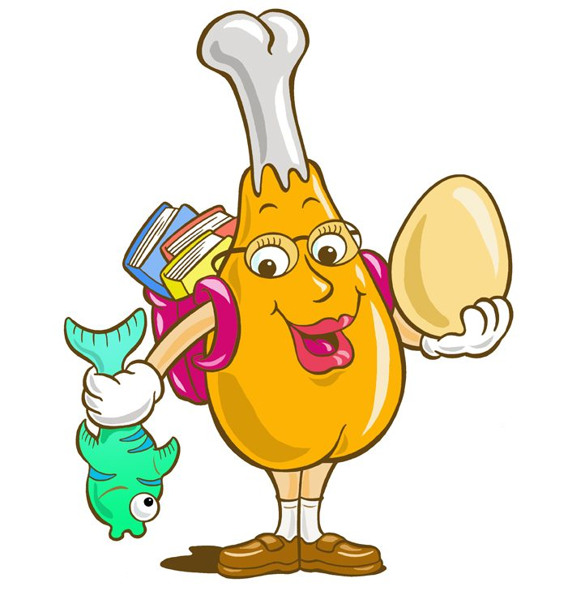
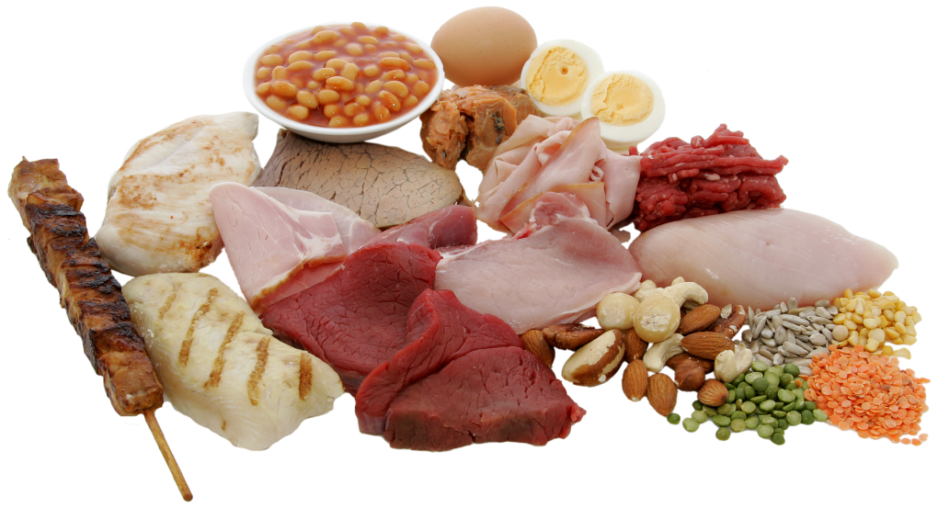
Proteins
Build body tissue and provide energy when carbs or fats aren't available
Essential in muscle formation

Slide 9
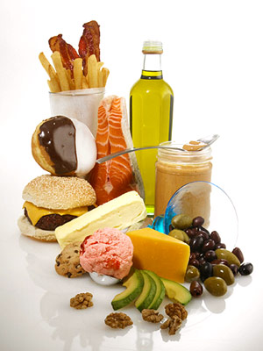
Fats
Stored in the body to be used as an energy source when carbs are in short supply
Can be bad or good
Help insulate, enable cell function, and are a structural component of nerve and brain tissue

Slide 10
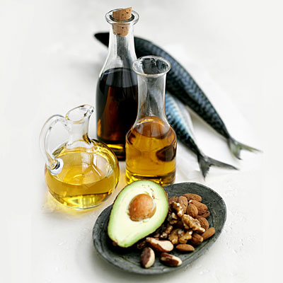
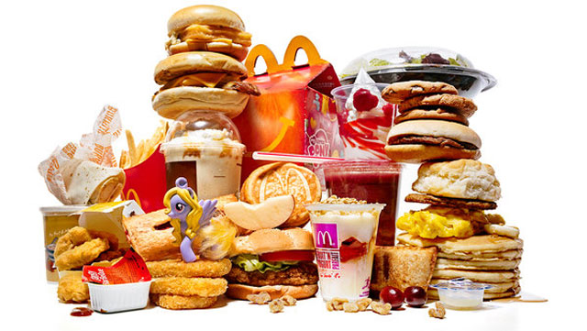
Fats – Good vs. Bad
Good – Unsaturated – help reduce heart disease, lower cholesterol, and keep you healthy
Bad – saturated fats – raise risk of heart disease, raise cholesterol

Slide 11
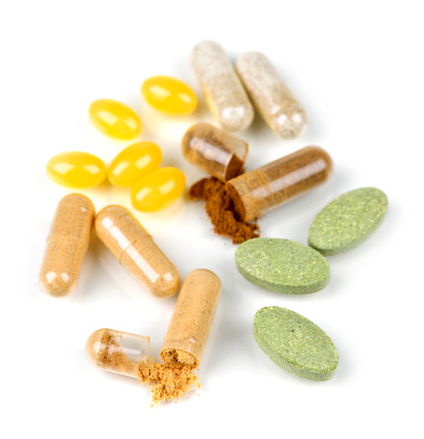
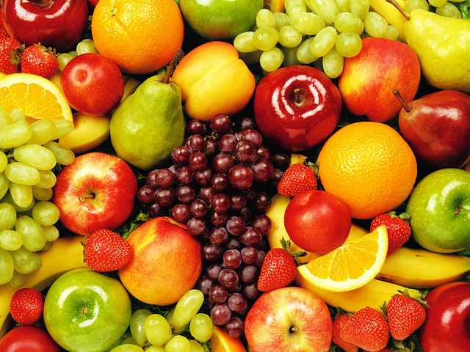
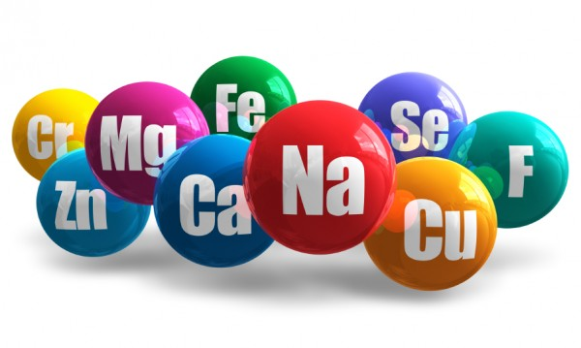
Vitamins and Minerals
Vitamins help carryout life functions such as reproductions and growth e.g. A, B, C, D, E, K
Minerals help carry out life functions. structural component of body tissue e.g.iron, calcium, iodine, potassium, etc.

Slide 12
Water
Essential to life
Helps dilute and dispose of waste/toxins
Helps move nutrients
Regulates body temperature
You should drink at least 2 litres of water everyday!!

Slide 13
Diet
Refers to the amount and type of food you eat
Depends on age, body size, fitness, and gender
Vegetarians – do not eat meat
Vegans – eat no animal products: meat, eggs, dairy products, etc.
Vegetarians and vegans may miss out on some important nutrients and may have to take extra measures to get the associated

Slide 14
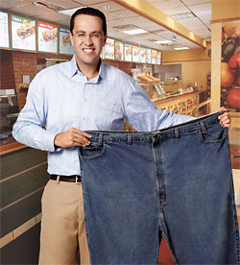
Fad Diets
New crazes about how and what people should eat
Usually associate with weight loss, but many not be healthy long term, some may be dangerous

Slide 15
Recommended Daily Intake
For average adult
Nutrient | Quantity per Day
Calories | 2,600
Protein | 50 grams
Fat - Unsaturated | 70 grams
Fat - Saturated | 24 grams
Carbohydrates | 310 grams
Sugars | 90 grams
Sodium (salt) | 2.3 grams
Fibre | 30 grams

Slide 16
Canada Food Guide

Slide 17
Nutrition Facts
Chocolate milk

Slide 18
The Rock Diet
The Facts:
Size: 6ft 4in
270 pounds

Slide 19
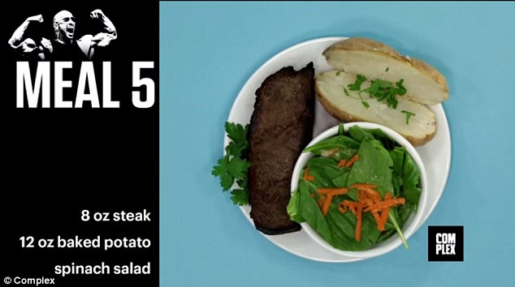
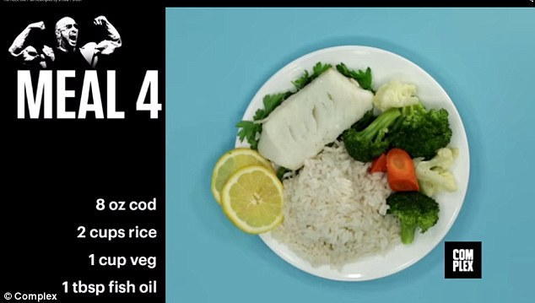
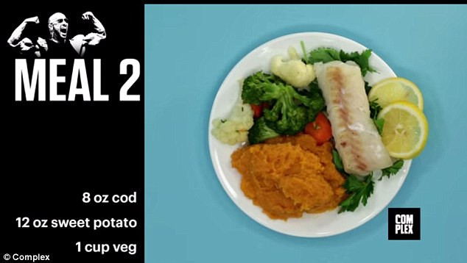
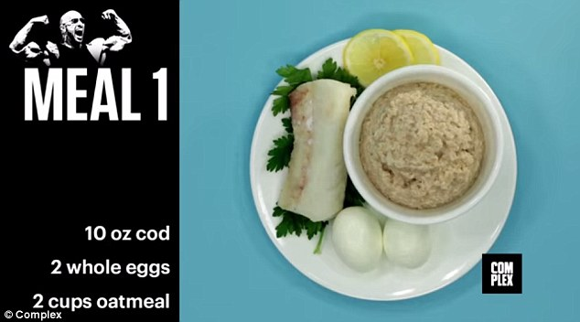
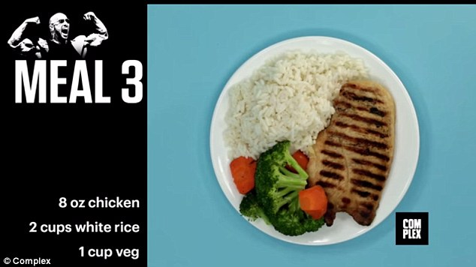
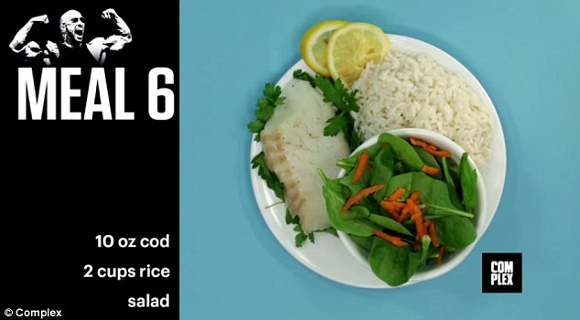
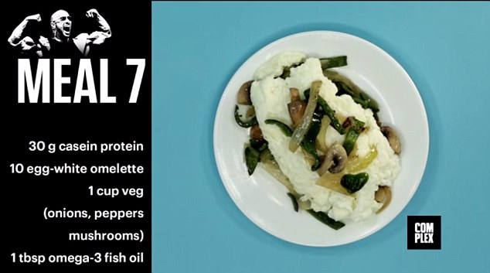
The Rock Diet
Average male → 2600 calories/day
The Rock → 5,165 calories/day
7 meals with a total of 10 pounds

Slide 20
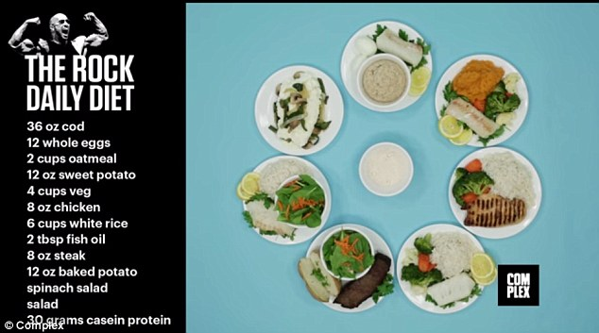
Total

Slide 21
10.3 Digestive System: Mining Nutrients

Slide 22
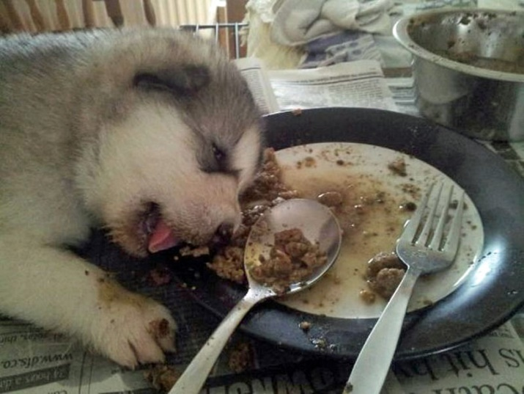
Analyzing your Diet
“Too much of a good thing”
Consuming too many fats can cause problems
Body has to work harder to digest them
Excess fat can cause you to feel uncomfortable or nausea
Raises cholesterol
Can cause fatigue and lack of energy
Cause weight gain over time
Excess of any of the nutrients we have mentioned may have negative health effects

Slide 23
Mechanical Digestion
Physically breaking food into smaller pieces
Performed by the mouth and stomach

Slide 24
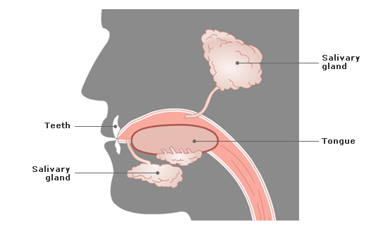
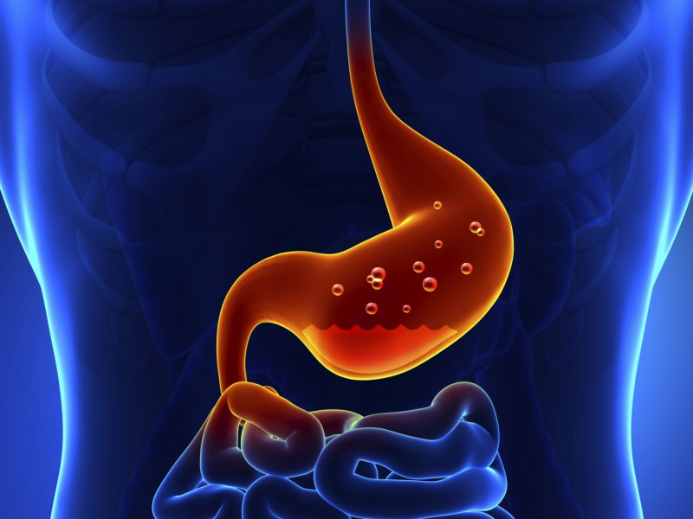
Chemical Digestion
Breaking food into simpler forms that can be absorbed by the body
Happens in the stomach and the mouth through salivary glands

Slide 25
Absorption
Molecule-sized products of chemical digestion move into the bloodstream
Occurs in the small and large intestine

Slide 26
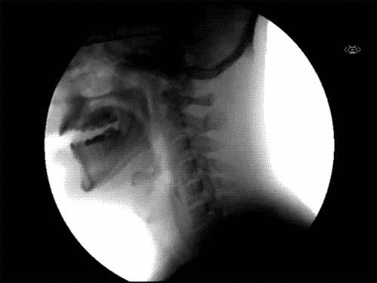
Mouth
Mechanical Digestion – uses teeth to break up food
Chemical Digestion – salivary glands produce saliva , which aids in breaking down starch

Slide 27
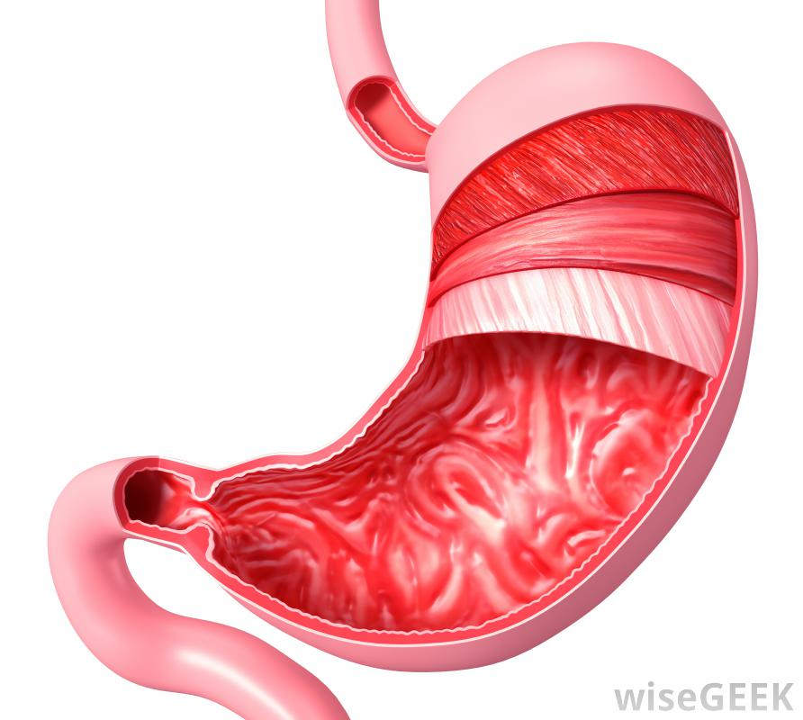
Stomach
Mechanical Digestion – uses muscles to mix and grind food
Chemical Digestion – produces gastric juices to turn food from solid into liquid

Slide 28
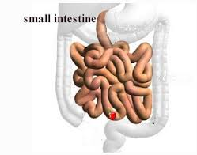
Small Intestine
Chemical Digestion – uses fluids created by the liver and pancreas to further digest food
Absorption – Responsible for the absorption of 80-90% of nutrients in the forms of carbohydrates, protein, and fats
6 to 7 meters long

Slide 29
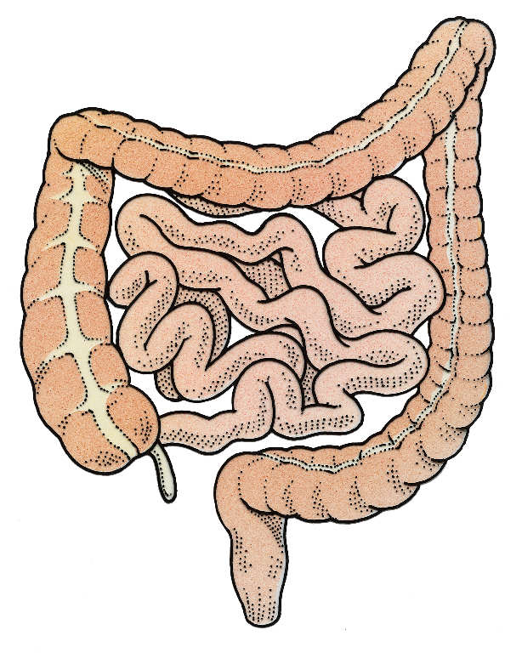
Large Intestine
Absorption – Absorbs water, minerals, and vitamins into the blood stream
Also stores and transmits useless waste material from the body
About 1.5 meters long
Small Intestine

Slide 30
I Can’t Believe it – T-Pain (Digestive Remix)

