Slide 1
Chapter 9: Life Functions
Sci. 14

Slide 2
Life Functions
To be considered alive, organisms must perform a series of life functions:
Transportation – moving the organism, its parts, or its internal material
Growth & Repair – ability to grow, develop, and repair body parts
Reproduction – making new cells or a new organism

Slide 3
Life Functions
To be considered alive, organisms must perform a series of life functions:
Nutrition – producing or obtaining food (via photosynthesis or hunting, scavenging, foraging, etc)
Regulation – body can respond to changes in their surroundings (for body temp, blood sugar, etc)
Metabolism – breathing, digesting, and eliminating waste
Synthesis – directing cell activities to create needed substances

Slide 4
Photosynthesis and Cellular respiration
plants and animals do not use raw materials “as is” for energy. Instead, they convert these materials into useable molecules for energy.
there are 2 processes to convert raw materials into useful energy:
photosynthesis
cellular respiration

Slide 5
Photosynthesis
carried out by plants only
Requires chloroplasts (specialized organelles) and chlorophyll (pigment molecule that absorbs sunlight)
uses (intakes) carbon dioxide, water, and energy (from the sun) to produce glucose (useable food molecule) and oxygen.
CO_{2(g)} + H₂O_{(l)} + energy C₆H₁₂O_{6 (s)} + O_{2 (g)}

Slide 6
Cellular respiration
performed by plants and animals
organelle responsible is the mitochondria
uses (intakes) glucose and oxygen to produce carbon dioxide, water, and chemical energy.
Opposite process of photosynthesis!
C₆H₁₂O_{6 (s)} + O_{2 (g)} CO_{2(g)} + H₂O_{(l)} + energy

Slide 7
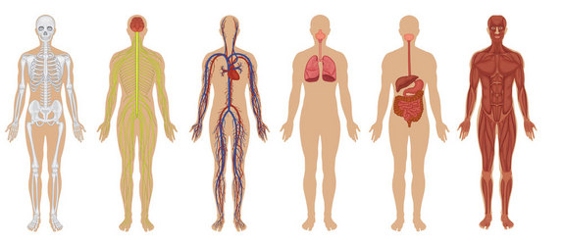
Today’s Class
9.3 Human Organ Systems
9.4 Keeping an Eye on Life Functions
Then continue on workbooks

Slide 8
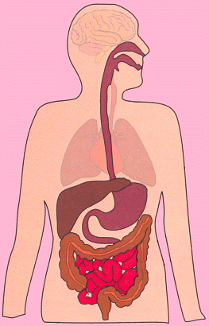
Digestive System
Breaks down and digests food
Rids body of solid waste
The role is to change the food you eat into simple chemical compounds that can be used by our bodies

Slide 9
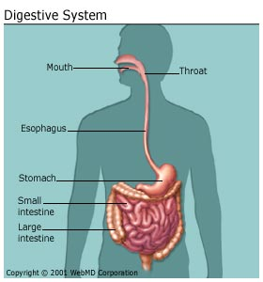
Components of the digestive system
Esophagus – pushes food to stomach through wave-like contractions
Stomach – muscles contract to mix food: release enzymes that dissolve food into liquid form
Small Intestine – absorbs nutrient from food with digestive juices
Large intestine – absorbs vitamins, minerals, and water
Anus – discharges solid mass (feces)

Slide 10
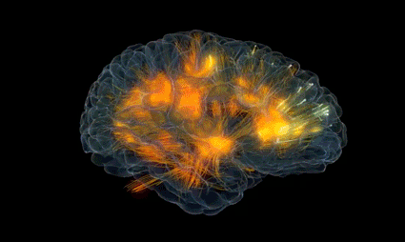
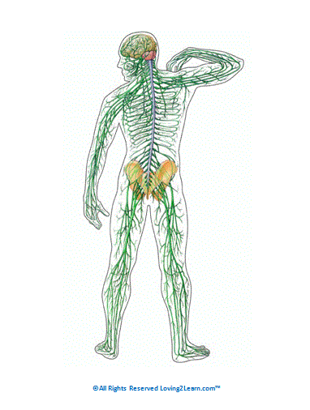
Nervous system
Provides and communication network
Regulates life functions
Components: brain, nerves, spinal cord

Slide 11
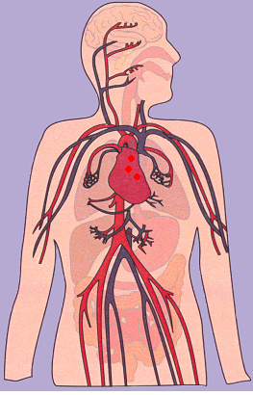
Circulatory system
Uses blood to transport
Food Molecules (nutrients)
Oxygen
Carbon Dioxide
Wastes

Slide 12
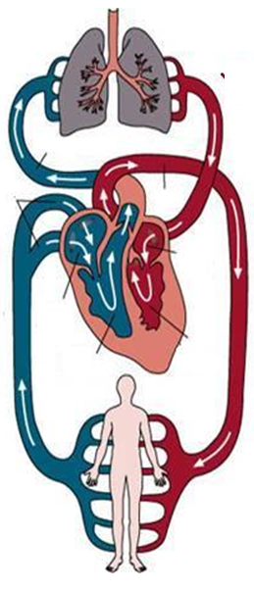
How it works
Uses: Heart, Veins, Arteries, Capillaries
Blood becomes oxygen rich in lungs
Heart receives oxygenated blood
Arteries take blood to body tissues
Veins return blood to lungs
Blood is reoxygenated
Repeat
Capillaries are super small vessels that connect veins and artieries

Slide 13
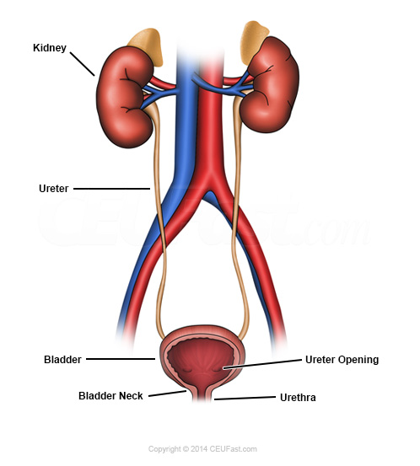
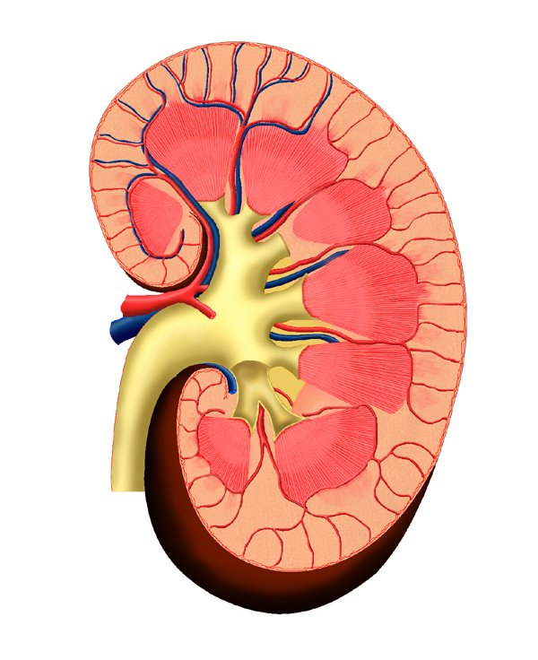
Urinary system
Kidneys filter blood for waste, and transport it to the urinary bladder
Urinary bladder holds waste until they are excreted

Slide 14
9.4 Keeping an eye on life function
Click me for video!

Slide 15
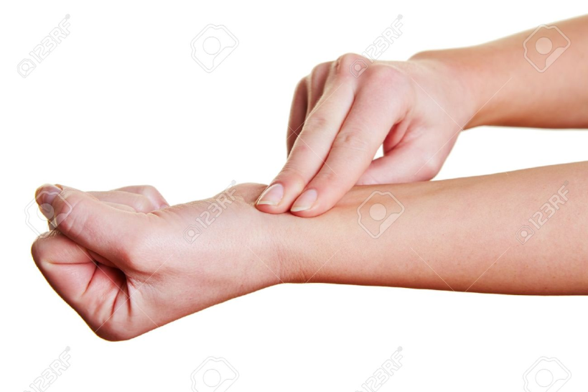
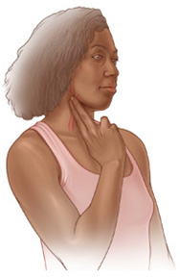
Blood Pressure
Your heart pumps blood through your body and causes your arteries to expand
You can feel these pressure waves by putting your fingers under your jaw or on your wrist
Blood pressure is usually 2 numbers
e.g. 120/80 – this shows your blood pressure at 2 different points of your hearts cycle
120 – systolic
80- diastolic

Slide 16
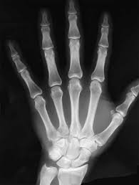
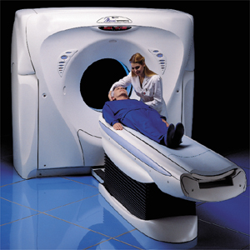
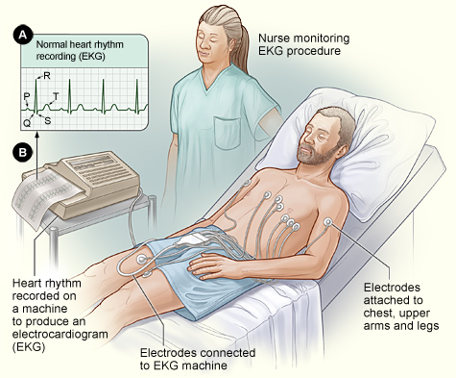
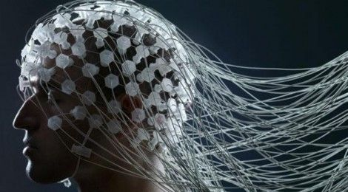
Many different machines
X- Rays – show damage to any bones
CAT Scan – x-ray pictures of your brain
EKG – examines rate and pattern of heart
EEG – studies brain activity

