Slide 10
Slope Calculation:

Slide 23
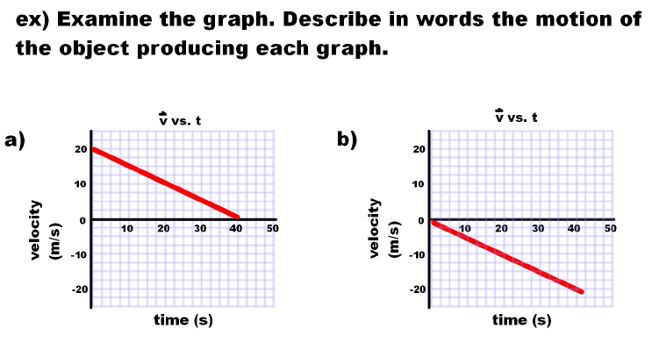

Slide 24
