Slide 1
Science 20 Unit B: Physics
Science 10
Physics Review Party!!

Slide 3
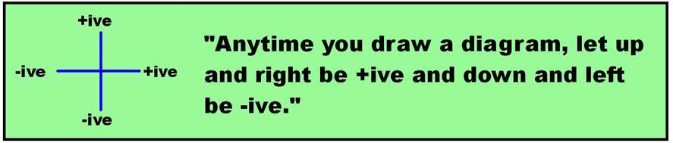
Fun Facts! from Science 10
Terms:
Scalar: have a magnitude only (ex: distance, speed, time)
Vector: have magnitude and direction (ex: displacement, velocity, force)

Slide 4

Vectors get a hat (harpoon)
ex) Mr. P walks 275 m east and then turns around and walks 425 m west.
What is the distance traveled?
What is the displacement?

Slide 5
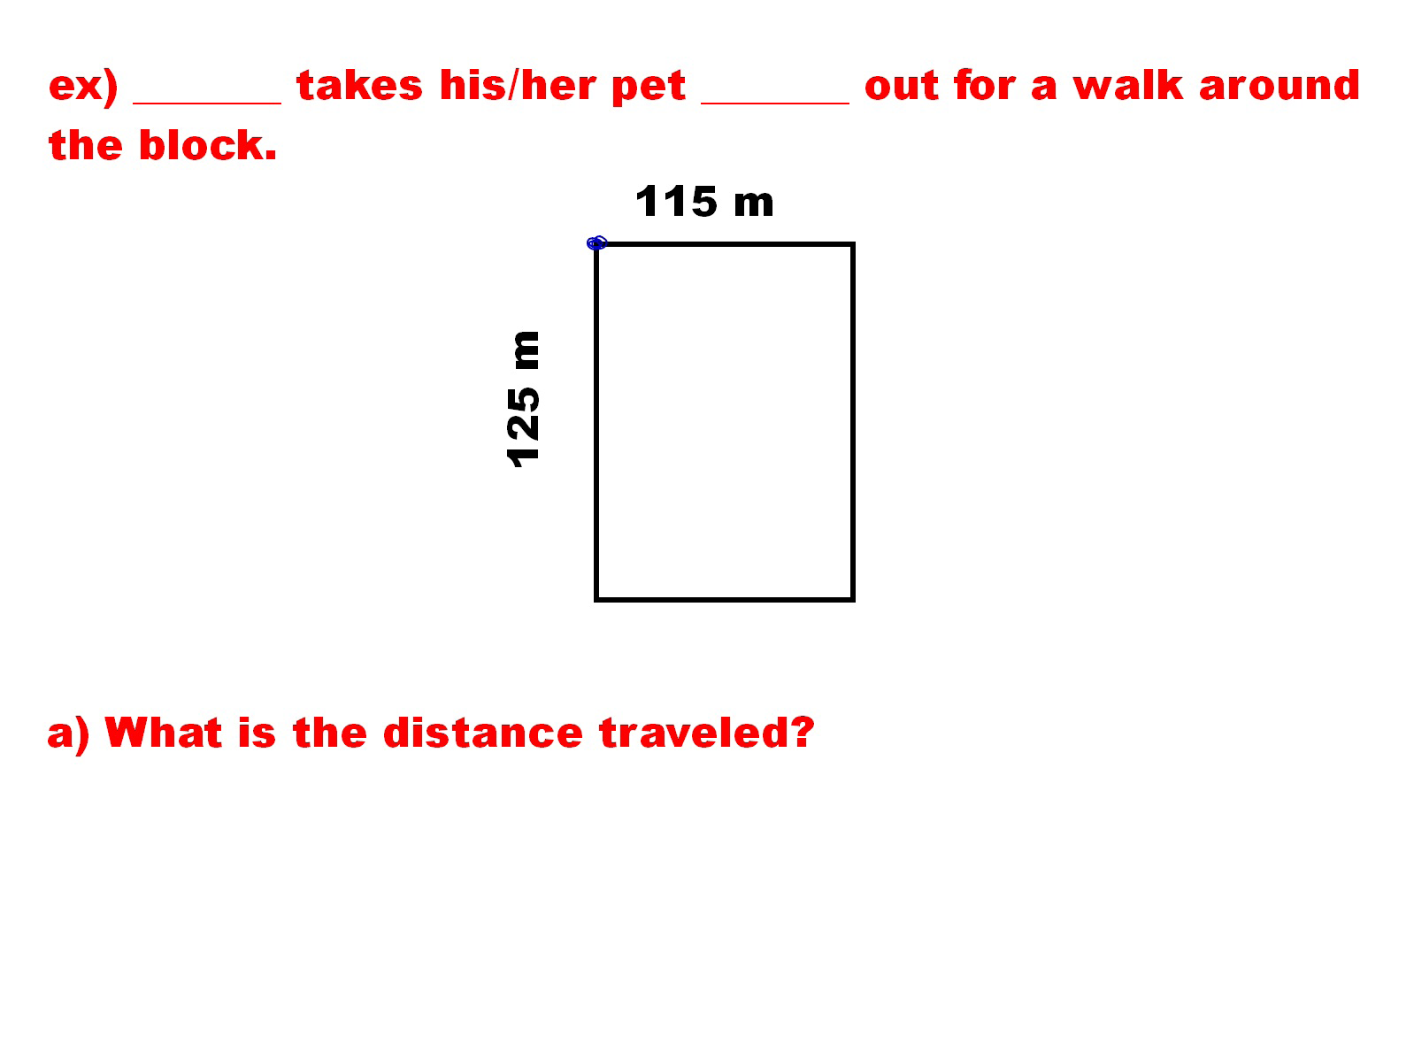


Slide 6
Units!

Slide 7
Formula Time!

Slide 8
Mr. P’s Problem Solving Method:

