Slide 12
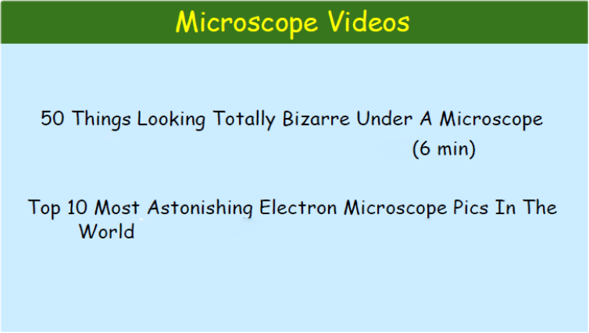
https://www.youtube.com/watch?v=gYnPeHU2wYI
https://www.youtube.com/watch?v=qWmwgY7iHmY

Slide 13
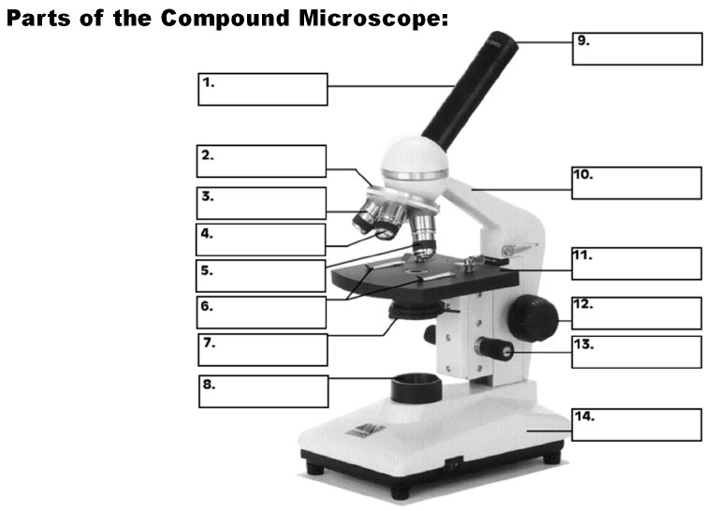

Slide 14
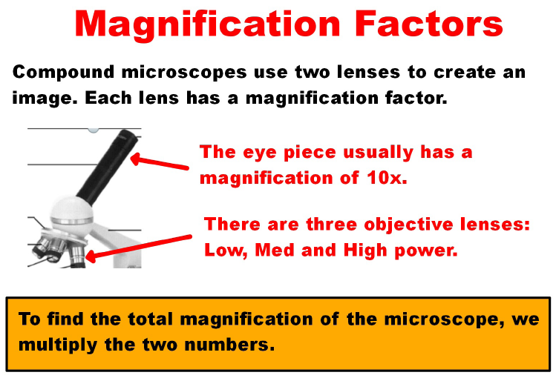

Slide 15
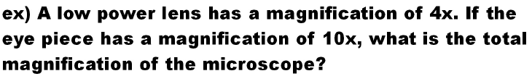

Slide 16
