Slide 1
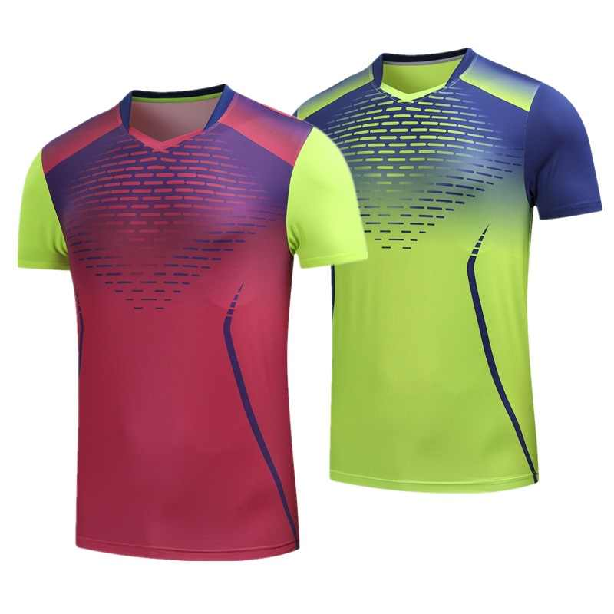
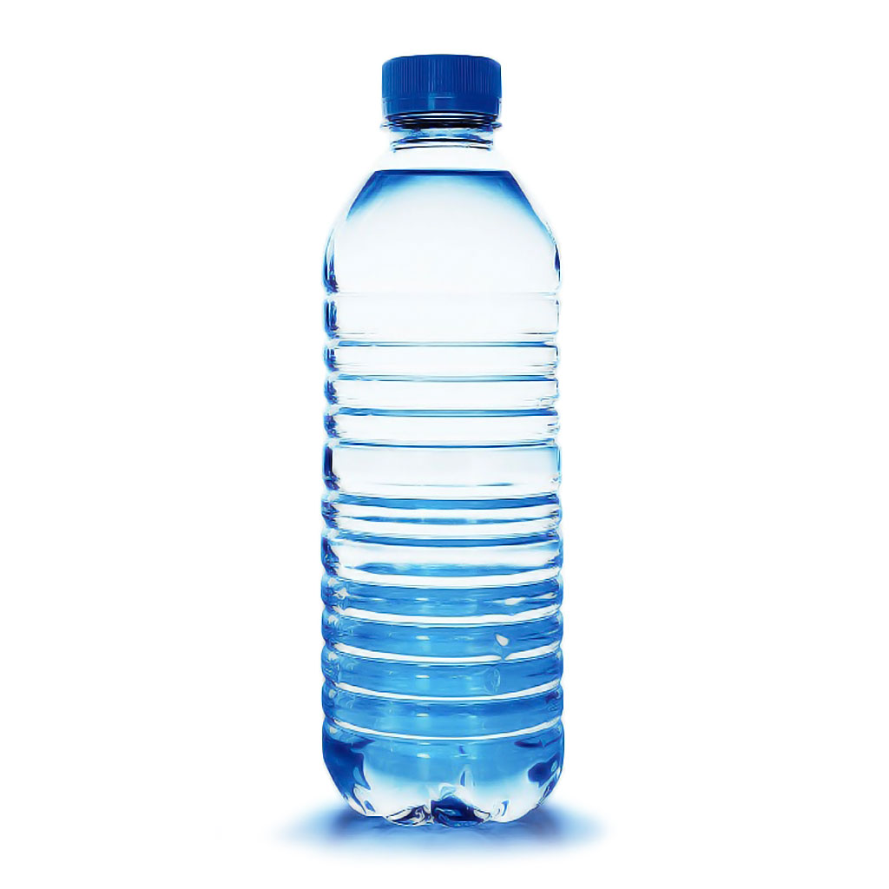
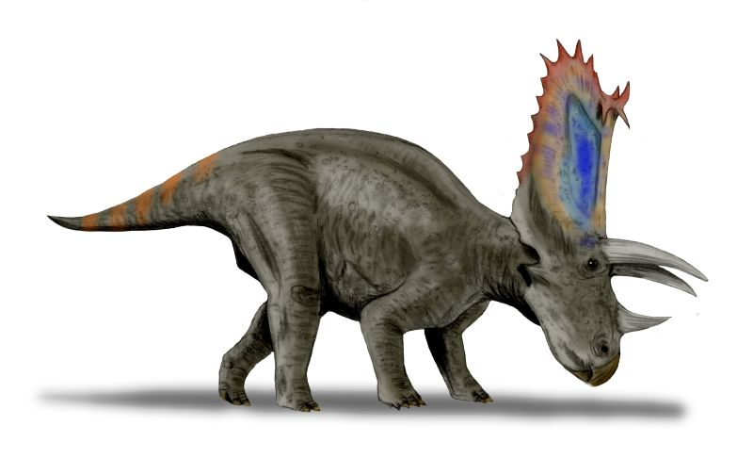

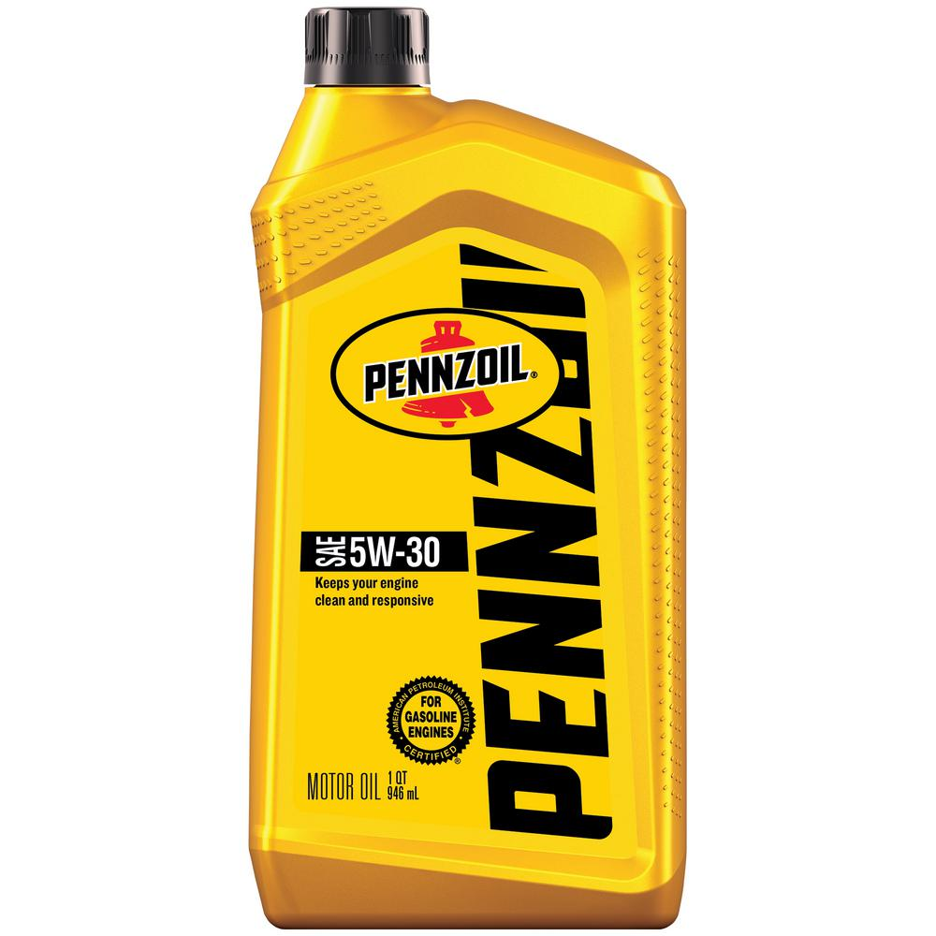
Science 20 Unit A: Chemistry
Intro to Organic Chemistry
+
=

Slide 3
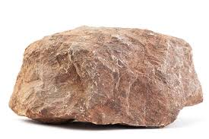
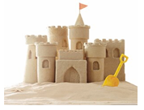
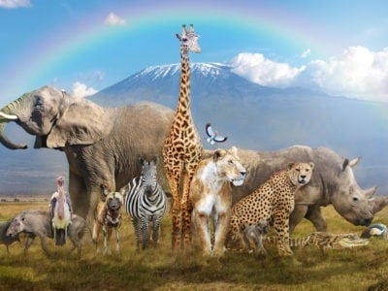
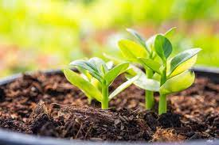
Organic Chemistry:
The things we find on Earth can be placed into two categories:
Inorganic: rocks, sand, metals, etc.
Organic: plant life, animals, plastics, etc.

Slide 4
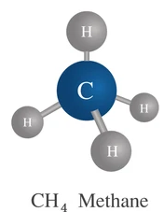
Hydrocarbons
Organic compounds are made from carbon and hydrogen atoms (with a few others thrown in).
The number of compounds
that can be formed from
carbon, hyrdrogen, and a
few other elements is huge!

Slide 5
Classifications of Hydrocarbons:

Slide 6
Classifications of Hydrocarbons:
Three main groups:
Aliphatics – straight chains of carbon atoms
Cyclic – rings of carbon atoms
Aromatic – double bonded rings of carbon atoms

Slide 7
The straight chain aliphatics are broken into three other categories:
Alkanes – single bonded chains
Alkenes – double bonded chains
Alkynes – triple bonded chains

Slide 8
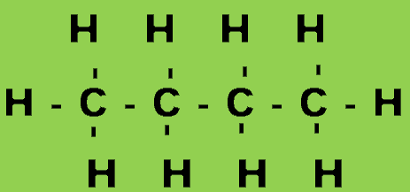
Types of Formulas
There are 3 types of formulas used to represent hydrocarbons:
Molecular Formula: only shows the number of each type of atom in a compound.
Condensed Formula: shows the number of hydrogens on each carbon atom.
Structural Formula: shows how the compound is put together (dashes indicate chemical bonds)
ex: butane: C₄H₁₀
ex: butane: CH₃ – CH₂ – CH₂ – CH₃
ex: butane:

Slide 9
Nomenclature of Alkanes
Organic compounds are named chiefly on how many carbons they possess in their chain. The number of carbons corresponds to a prefix, as shown below (also found on page 6 of your data booklet):

Slide 10
When naming an alkane, we start by counting the number of carbons in the longest chain in the compound. We then match the number of carbons to a prefix, and add the suffix “ane”, indicating we have an alkane (single bonds only).
Ex) Name the following compound:
This compound has 4 carbons in it. It must have a prefix of “but”. Since all of the carbons are single bonded, it must be an alkane. So the name of this compound is “butane”

Slide 11
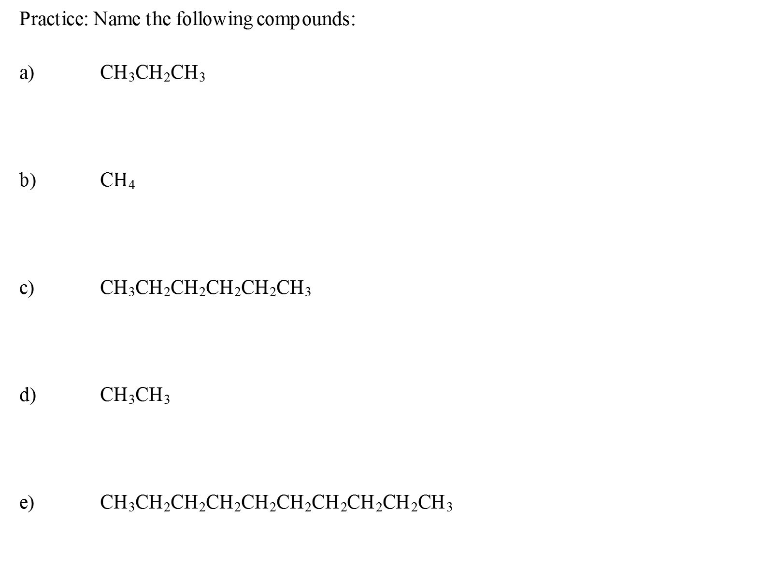

Slide 12
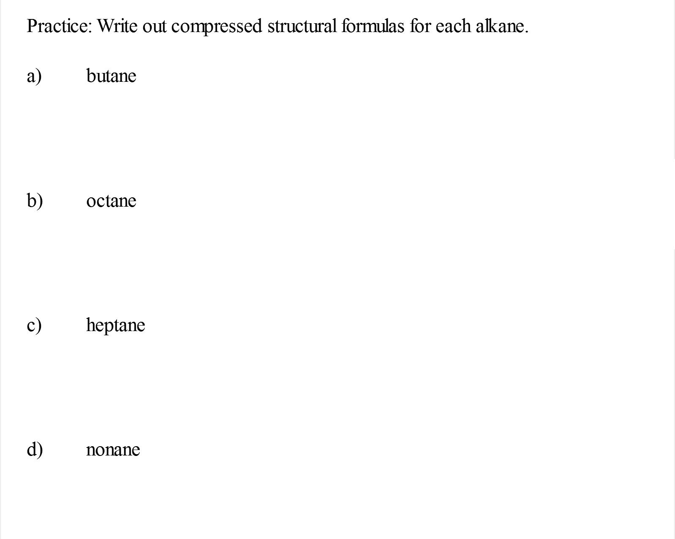

Slide 13
Sometimes, alkanes do not form a perfectly straight chain. When there are branches off the chain, we must name the longest (parent) chain first – and then name the branches in front of the parent chain in the name:
Ex)
A compound like this has a main chain made up of four carbons. It also has an extra branch with one carbon in it.

Slide 14
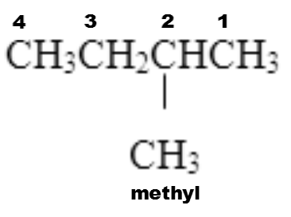
We name the main chain butane, because it has 4 carbons in it.
We name the branch a methyl branch because there is only one carbon in the branch (branches get a –yl suffix)
We will also use the number 2 in the name, to indicate the methyl group is on the second carbon in the main chain.

Slide 15
So the name of this compound is 2-methyl butane.
**Note how hyphens separate the numbers and the methyl group**
**Also note how the main chain carbons are counted in a way to name the branches with the smallest numbers possible**

Slide 16
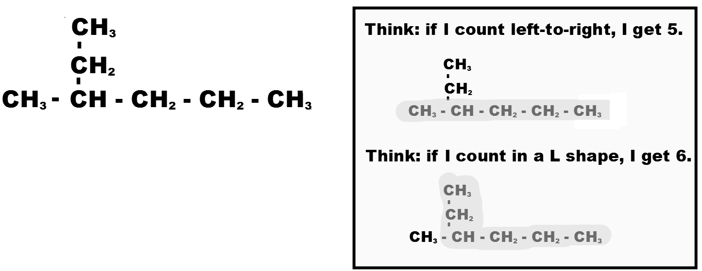
Be careful!
Sometimes you won’t count in a straight line to find the longest chain!
Ex) How many carbons in the longest chain?

Slide 17
