Slide 1
Heat Transfer Technologies
Science 14 -

Slide 2
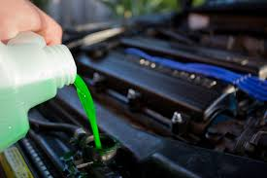
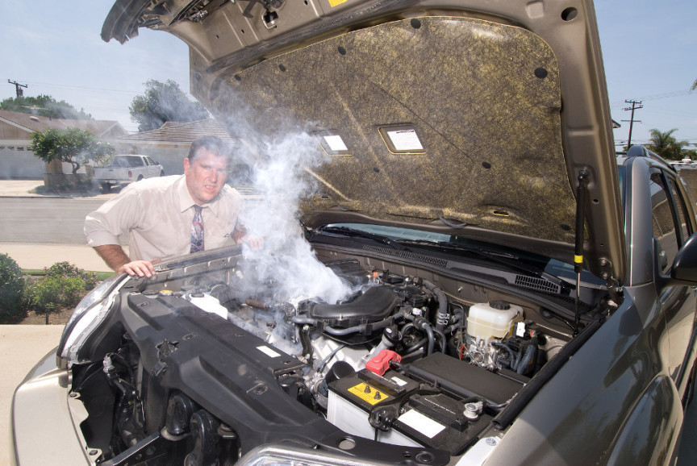
Getting Rid of Heat
For many technologies, thermal energy must be removed to prevent overheating.
Combustion of fuel inside an engine, for example, produces large amounts of heat. The engine is protected by a liquid coolant, which is pumped through the engine block to the radiator. Through the process of convection, heat from the engine is transferred to the air.

Slide 3
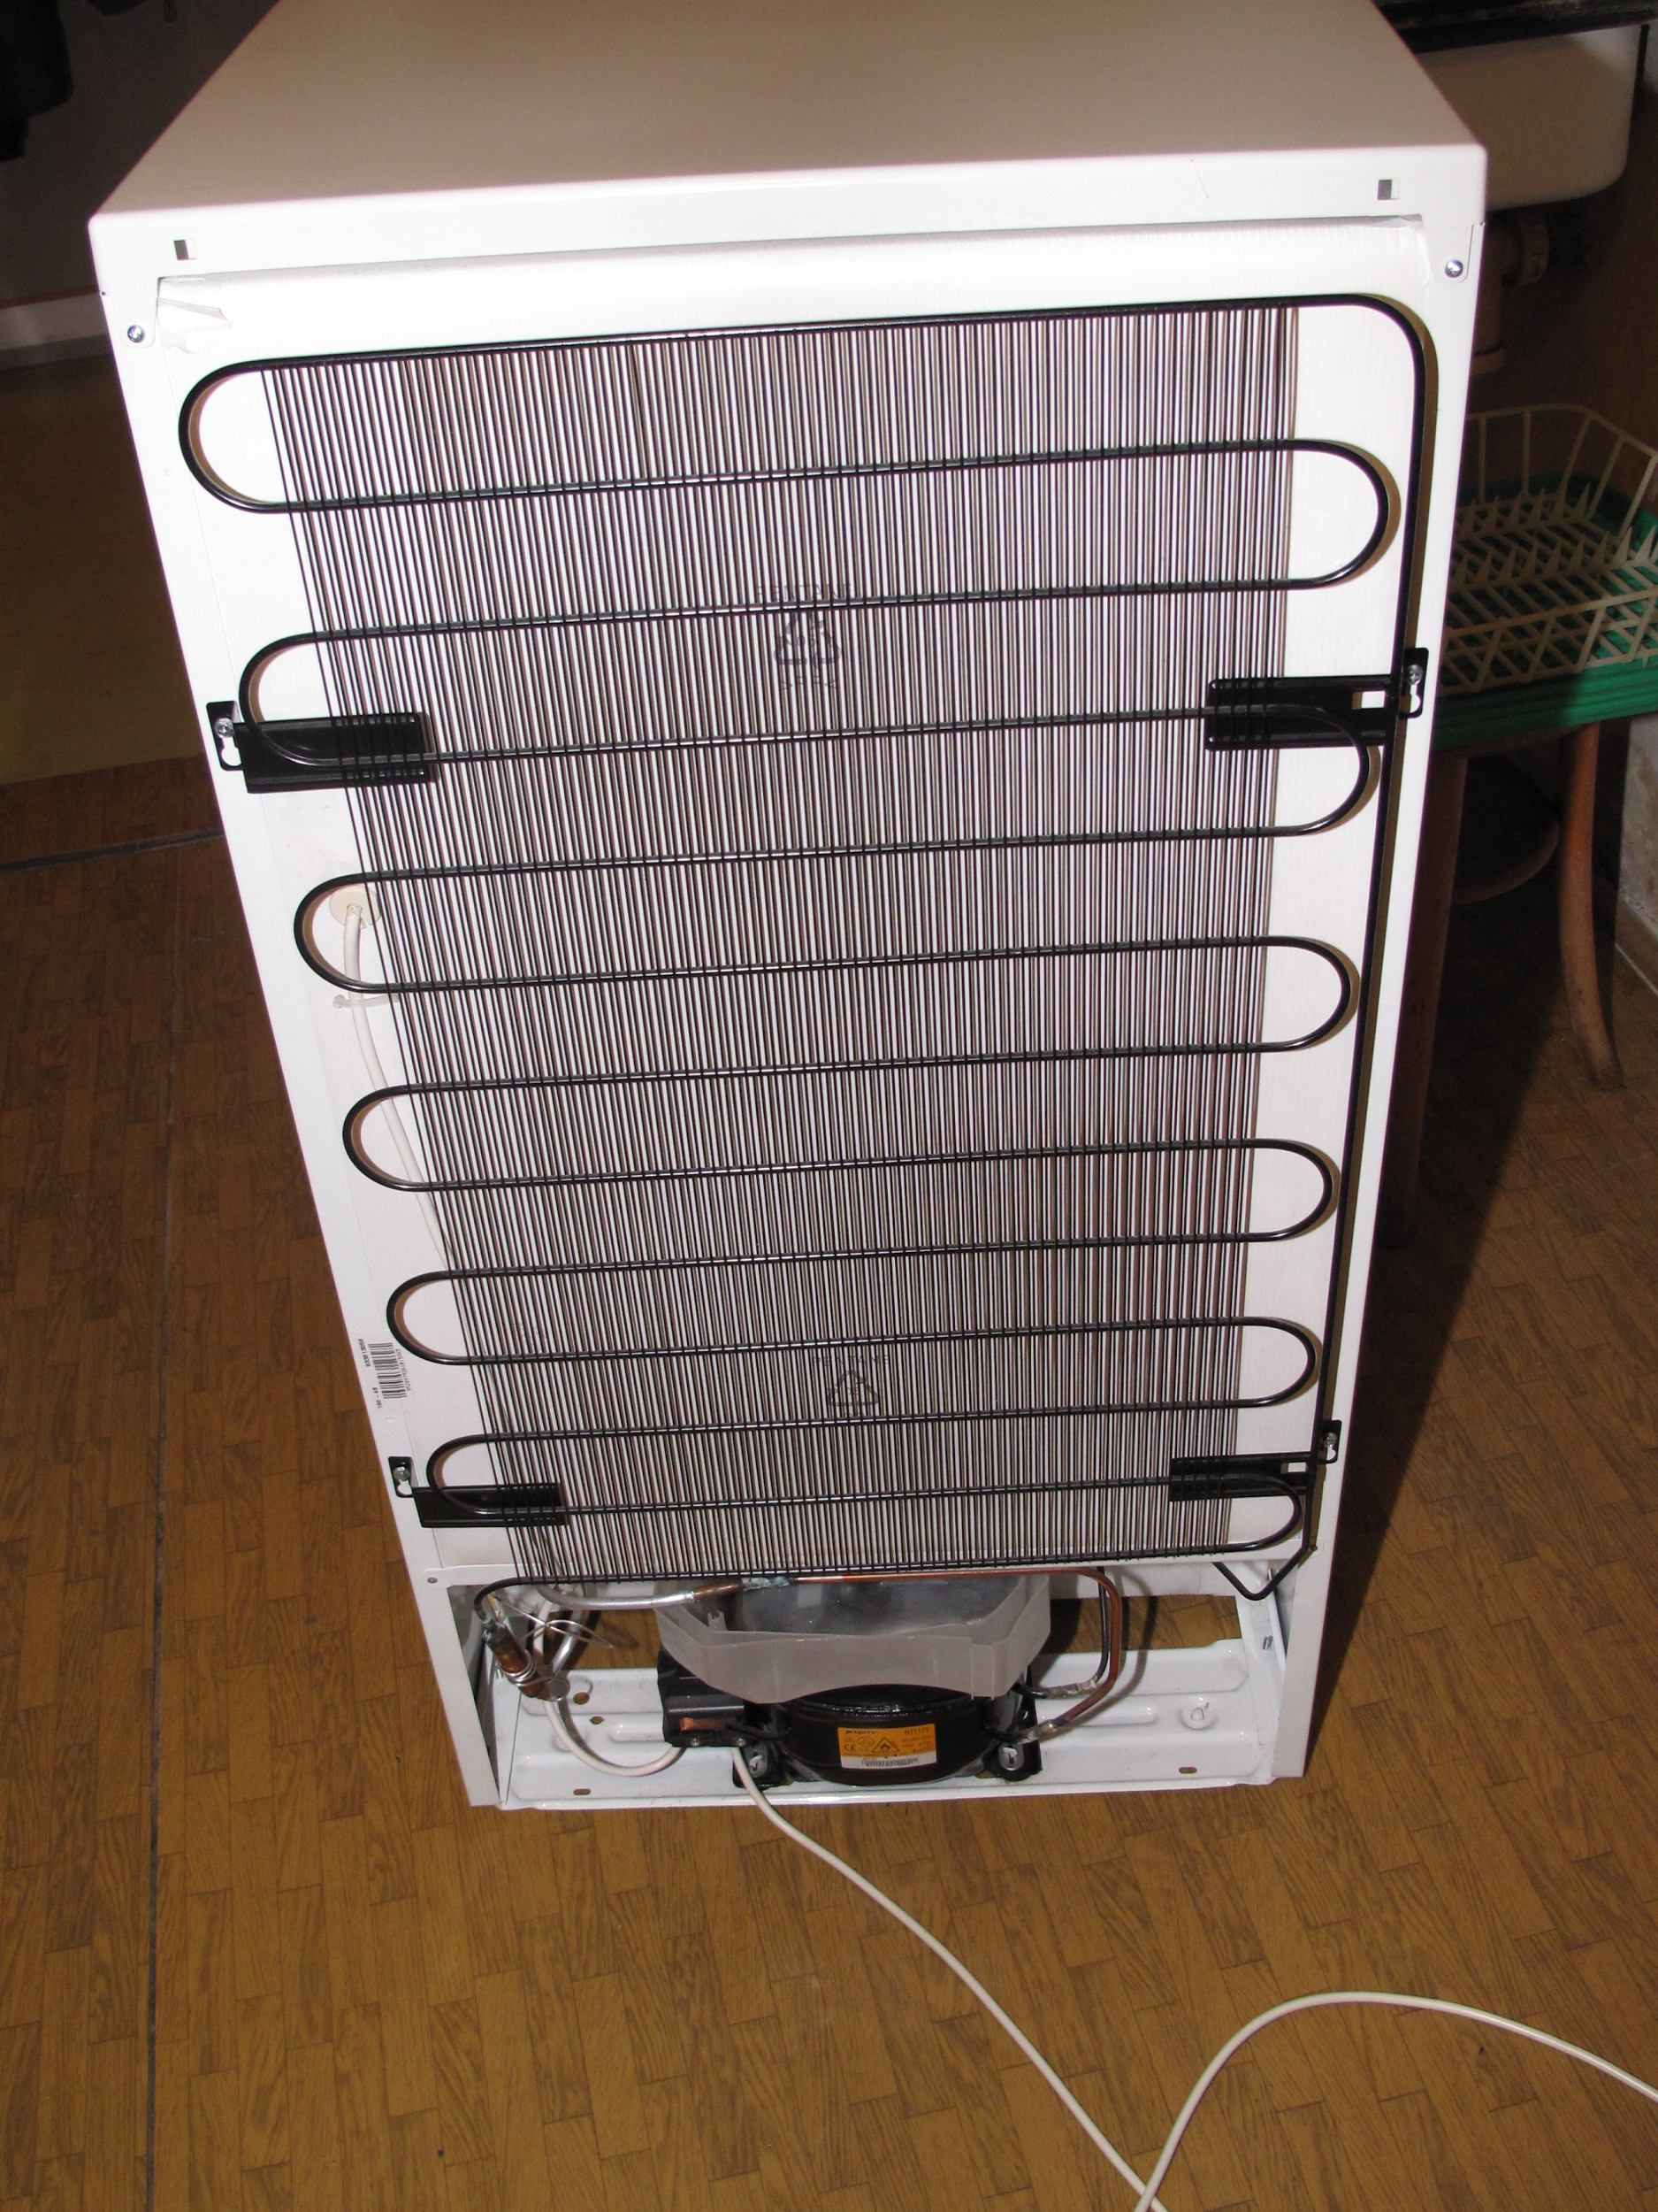
cooling through Evaporation
When you sweat, water produced by sweat glands helps cool your skin through evaporation; thermal energy is transferred from your skin to the water via conduction.
This notion of cooling through evaporation is used in refrigerators as well. A fluid coolant circulates through the pipes of the fridge, and heat from the food transfers to the cooler air surrounding it.

