Slide 1
Heat Transfer
Science 14 -

Slide 2
Forms of Heat Transfer
Heat always flows from hot substances to cold substances. This transfer of heat continues until both objects are at the same temperature.
Heat is transferred in three ways:
Conduction
Convection
Radiation
Heat transfer explains why your hot cup of coffee gets cold so fast...

Slide 3
conduction, convection and radiation

Slide 4
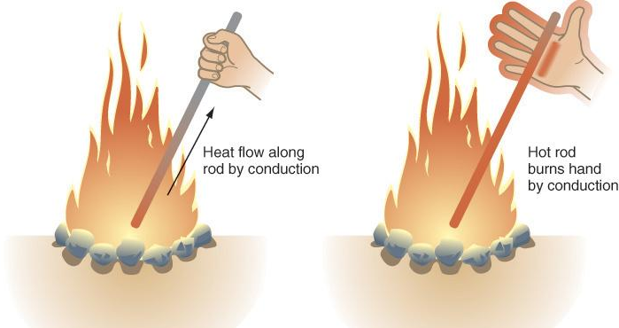
conduction, convection and radiation
Conduction
Heat transfer by contact between two substances
E.g. contact between a pot of water and oven burner causes the pot to heat up, which then causes the water to heat up
Conduction explains why we burn ourselves when we touch hot objects...

Slide 5
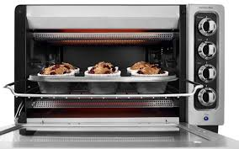
conduction, convection and radiation
2) Convection
Heat transfer through air currents
E.g. convection allows us to heat our homes; heat from a heat source is distributed throughout the room, causing the entire room to heat up
Convection ovens allow us to cook things evenly by distributing heat throughout the entire space...

Slide 6
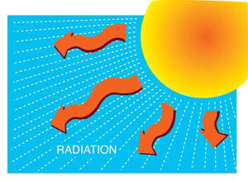
conduction, convection and radiation
3) Radiation
Heat transfer through electromagnetic waves
E.g. we can warm our hands on a fire because of radiation; radiation is produced by the vibration of electrons, which vibrate more rapidly when heated
Our entire solar system is heated by radiant energy from the sun

Slide 7
Heat Transfer in Nature
Because particles that are cool tend to be more compact, cold air is more dense than warm air. This causes cold air to sink, while warm air rises.
The circular movement of air that results from the rising and sinking of air leads to convection currents. The wind you feel is simply a convection current.

Slide 8
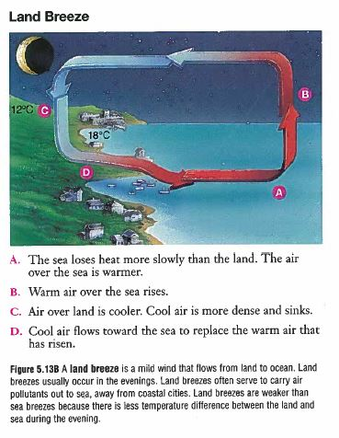
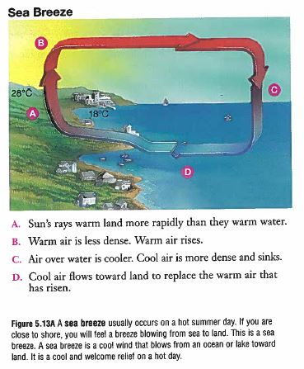

Slide 9
Heat Transfer in Nature
Because oceans are able to store large amounts of thermal energy, they actually help to moderate the climate of land areas near them. This means that they prevent the area from becoming either too hot or too cold. Here’s how it works:
In cool weather, an ocean can release a great amount of heat without cooling much itself. Even during very hot or cold days, the temperature of oceans remains constant.
As the sun warms air above the ocean, that flows from the air into the water, cooling the air. When the temperature of the air above the ocean cools, heat flows from ocean to air and warms the air.

