Slide 1
Simple Machines & Energy Transfer
~ Science 14 ~

Slide 2
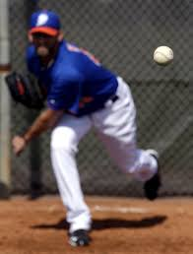
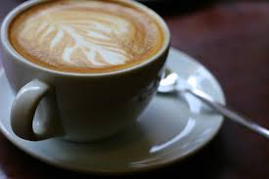
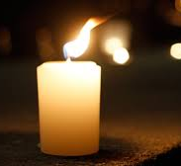
What is Energy?
So far, we have discussed energy mostly in terms of fuel; energy from fuel is used to power our vehicles, heat our homes, and provide light. Energy itself, however, is actually a much broader term…
does a baseball thrown towards home plate have energy?
do the atoms that make up your cup of coffee have energy?
does the flame emitted from a lit candle have energy?

Slide 3
Energy & Work
Energy can be defined as the ability to do work. Anything in motion, or with the potential to gain motion, then, may be considered as having energy.
Before being thrown, a baseball has potential energy. After it is thrown, it has kinetic energy.
The atoms in your cup of coffee, or any atoms in general, are constantly in motion, so they have some amount of kinetic energy. Atoms may also react with other atoms, so they can also be said to have chemical energy.
Fire is the product of a chemical reaction called combustion, so initially, the candle has chemical energy. Once the candle is lit, the flame emits heat, so it is a source of thermal energy.

Slide 4
What is Work?
Work is done when a force (a push or a pull) acts on an object. The amount of work done can be measured by multiplying the force applied on an object (in Newtons) by the distance it travels as a result (in meters):
Work = force x distance
or
W = Fxd
The resulting unit of work is “Newton-meters”, otherwise known as joules. Work is thus measured in joules (1 newton-meter = 1 joule)

Slide 5
Conditions for Work
There are 3 conditions which must exist for work to occur:
Force must be applied on an object
The object must travel a distance
The force applied and the distance travelled must occur in the same direction
E.g. If you push against a wall and it does not move, you are not doing any work on that wall

Slide 6
Simple Machines
A simple machine is a mechanical device that is used to change the direction or magnitude of a force. In general, they use the leverage of one particular movement to multiply force. There are six types of simple machines:

Slide 7
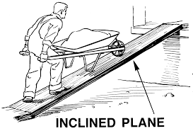
The Inclined Plane
The inclined plane or ramp is one of the oldest simple machines. It is used to move vertically with less effort.

Slide 8
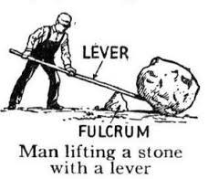
Levers
A lever is any bar that pivots on a fulcrum. The object the lever moves is referred to as the load, and the force required to move the object is referred to as the effort.
In general, a lever reduces the amount of effort required to move the load.

Slide 9
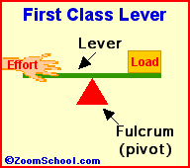
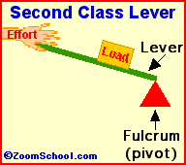
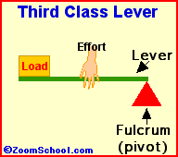
Types of Levers
Class 1
The fulcrum is placed between the load and the effort.
Class 2
The load is placed in between the fulcrum and the effort
Class 3
The effort is placed in between the load and the fulcrum

Slide 10
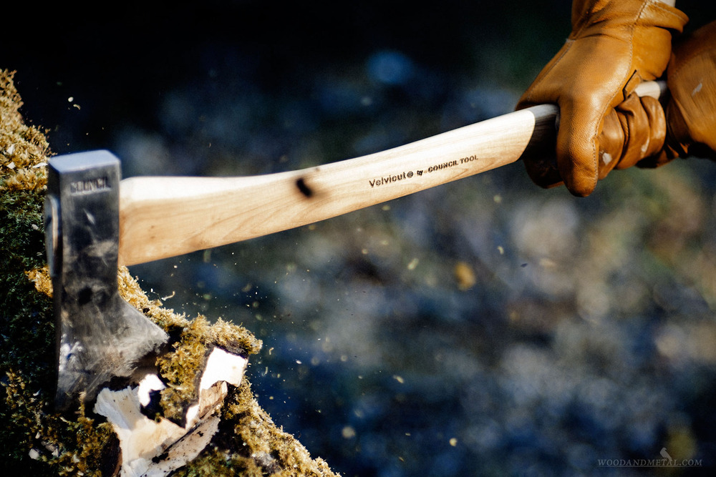
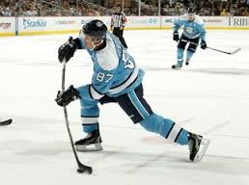
Distance Multipliers
Third-class levers such as fishing rods, axes and hockey sticks are examples of simple machines that work as distance multipliers.
A distance multiplier moves a load over a large distance with a very small effort distance
The longer the lever, the less effort that is required to move the object

Slide 11
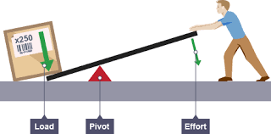
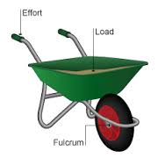
Force Multipliers
First and second class levers are force multipliers; simple machines which easily move a large load
A force multiplier applies a small force on the effort end of a lever to place a larger force on the load

Slide 12
Losing Energy
When a machine is used, it will lose energy through:
friction between any two moving parts that are in contact
heat that is given off by the cooling system or exhaust
poor combustion (if the machine uses fuel)
For any machine, the amount of work put in is ALWAYS greater than the amount of useful work you get out.

Slide 13
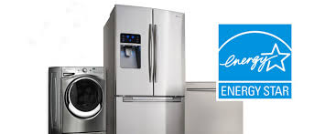
Efficiency
Efficiency is a comparison of the amount energy required to power a machine (energy input) with the amount of work the machine is able to do with that energy (energy output). No machine is 100& efficient because some energy is always lost, usually as heat.
energy efficient appliances convert more input energy to useful output energy (less energy is lost)

