Slide 1
Heat
Science 14 -

Slide 2
Heat & Friction
Friction is a phenomenon that has been well-understood for centuries. When two surfaces are rubbed together, the parts that touch resist movement, leading to the generation of heat. This resistance is know as friction.
Friction causes a lot of problems for machinery and living systems. However, we need friction for simple tasks like walking or creating fire...
A world without friction:

Slide 3
Heat & Brownian motion
Although the heat that is generated by friction can be a nuisance, we can also use it for a lot of things. But what exactly is heat???
Heat can be explained by something called Brownian motion. Particles are always moving around and colliding into each other; heat is simply the consequence of faster particle movement and more frequent collisions. That is, particles that have more energy exert more heat.
Brownian Motion Explained:

Slide 4
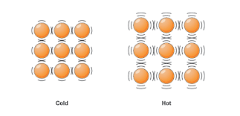
Heat, Kinetic Energy & Temperature
The energy associated with heat, or thermal energy, is therefore related to the motion of particles, or kinetic energy.
So, as the kinetic energy of particles increases, they move faster, and as a result have more thermal energy.
Particles of “cold” substances have less kinetic energy, because they move slower.
Particles of “hot” substances have more kinetic energy, because they move faster.

