Slide 1
Science 20: Unit A - Chemistry

Slide 2
Periodic Videos

Slide 3
POS Checklist
calculate the concentrations and/or volumes of diluted solutions and the quantities of a solution and water to use when diluting

Slide 4
Review:
A 250mL solution is prepared by dissolving 2.01g of iron (III) chloride, FeCl_{3(aq)} in water. What is the amount concentration of the solution?

Slide 5
Dissolving vs. Dilution
vs.

Slide 6
Many chemicals we purchase for the prep lab are already is solution form. They come in common molar concentrations of 1mol/L – 12mol/L. We have a very accurate measure of the concentration of these solutions: they are so called standard solutions.
Standard Solutions: a solution whose concentration is precisely known.

Slide 10
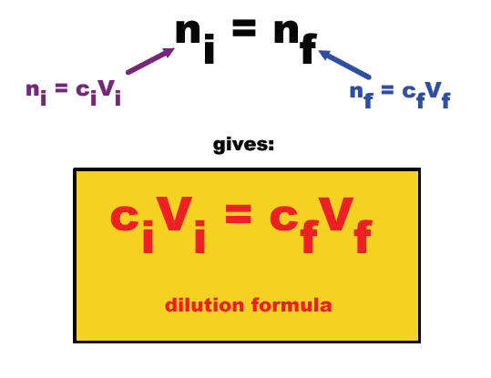
C
C

Slide 14
