Slide 1
Chemical Storage
and Disposal
~ SCIENCE 14 ~

Slide 2
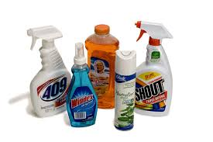
When using chemicals, you should always keep the following three questions in mind:
Does the substance have special handling or storage requirements?
How will it react with other substances?
How should it be disposed of?

Slide 3
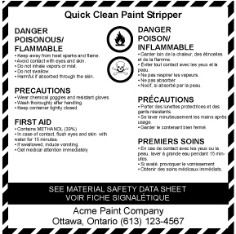
WHMIS & MSDS
WHMIS (Workplace Hazardous Materials Information System) provides detailed information on how to store, handle, and dispose of chemicals commonly found in the workplace. It also provides first aid information.
All hazardous materials have a WHMIS label, which summarizes safe handling procedures
This means that we do not have to memorize how to safely use and dispose of each chemical; we just have to understand what the symbols on the labels mean

Slide 4
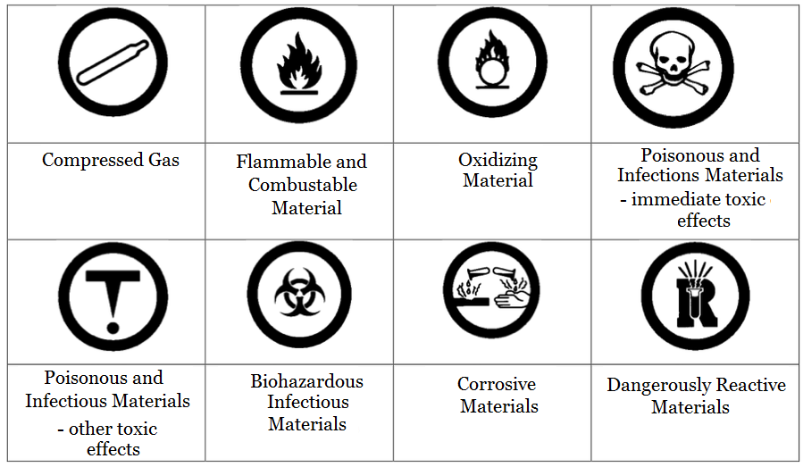
WHMIS & MSDS
WHMIS Symbols and Meanings:

Slide 5
WHMIS & MSDS
(You don’t have to do the quiz at the end)

Slide 6
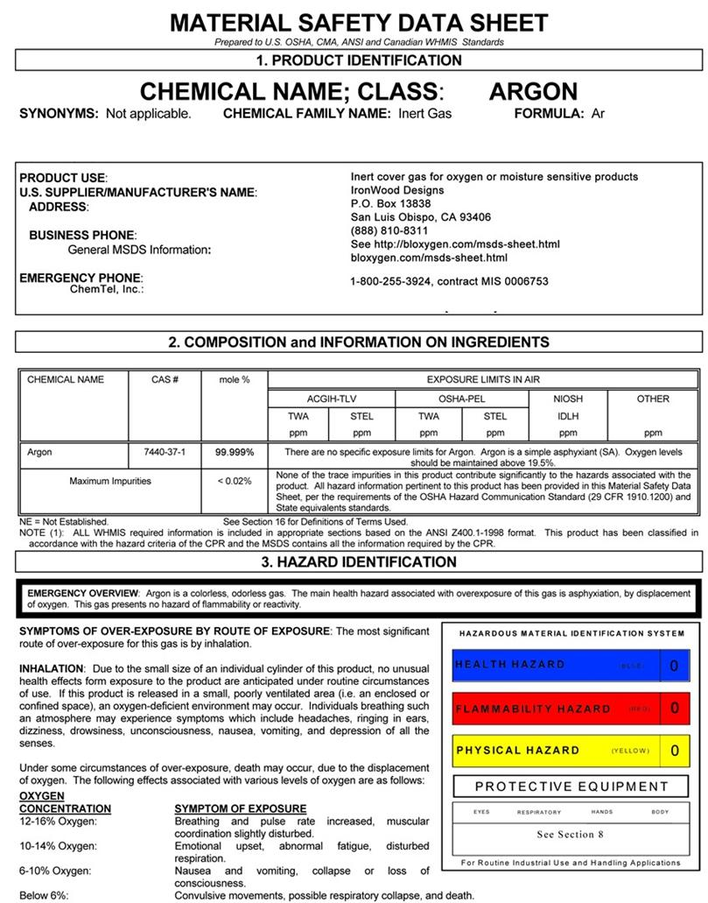
WHMIS & MSDS
MSDS (Material Safety Data Sheets) provide additional detailed information about each chemical. This includes the physical and chemical properties, safe handling, first aid, and disposal procedures.

Slide 7
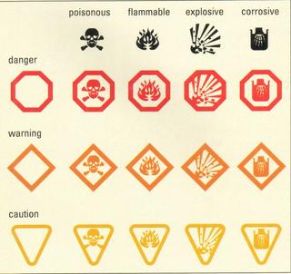
HHPS
Some products are more commonly encountered at home as opposed to the workplace, and thus require a separate system of symbols to represent the unique dangers they pose. The symbols on the products you use at home are called Hazardous Household Products Symbols (HHPS):
Unlike WHMIS symbols, HHPS symbols are designed to look like traffic signs. The symbols, colours, and shapes make them easy to understand.

