Slide 1
The Periodic Table
~ SCIENCE 14 ~

Slide 2
Periodic Table of Elements

Slide 3
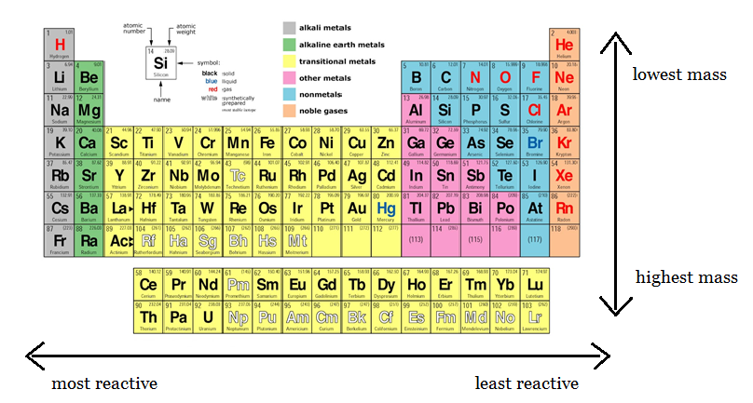
Periodic Table of Elements
Elements are arranged into columns (vertical) and rows
(horizontal) according to reactivity and mass. These columns are
referred to as groups, while the rows are called periods.
Reactivity decreases as you move left to right across each period, while mass increases as you move top-down through groups. Mass also increases from left to right.

Slide 4
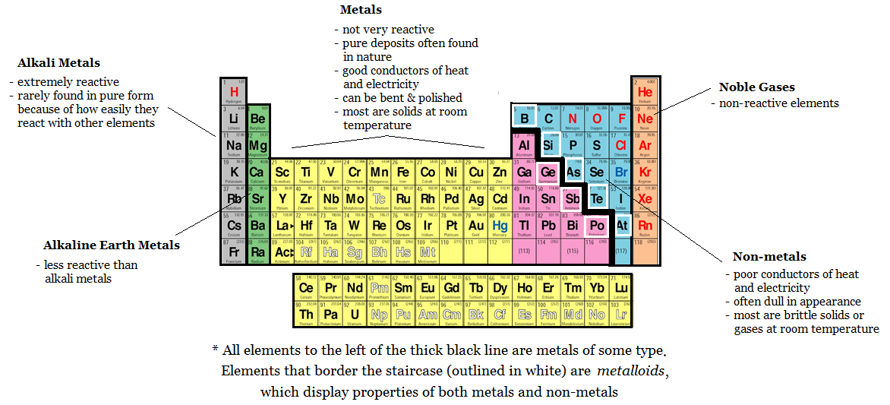
Periodic Table of Elements
Elements that are grouped together tend to have similar properties:

