Slide 1
Solutions
~ SCIENCE 14 ~

Slide 2
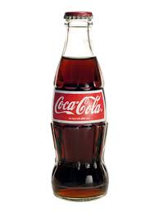
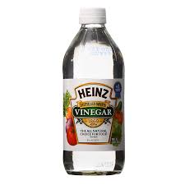
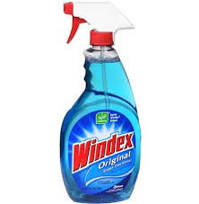
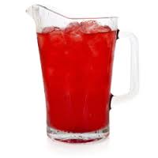
Solutions
A solution is made when two or more pure substances combine to form a mixture that looks the same throughout. In other words, a solution appears to contain only one kind of particle.
Many of the products we use are solutions

Slide 3
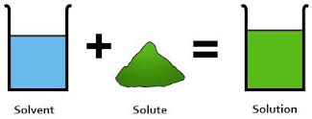
Parts of Solutions
Solutions consist of two parts:
The solute is the substance that dissolves
The solvent is the substance in which the solute dissolves
* There is usually less solute than solvent in a solution

Slide 4
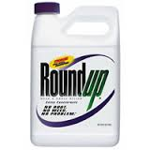
Concentration
Concentration refers to the amount of solute in a solution. It is usually expressed in grams of solute per litre of solvent, or g/L.
For example, Roundup is a solution of glyphosate and water. If the label states a concentration of 7.0 g/L, this means that there are 7.0 grams of glyphosate for every liter of the product
Glyphosate is the solute, while water is the solvent

Slide 5
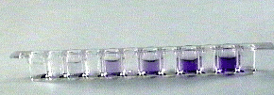
Concentration & Dilution
We can therefore increase the concentration of a solution by adding more solute…
In the example above, the ratio of solute to solvent increases as you move from left to right. That is, the solution becomes more concentrated.
The process of adding more solvent is referred to as dilution. In the example above, we would say that the solution on the left is more dilute than the solution on the right.

Slide 6
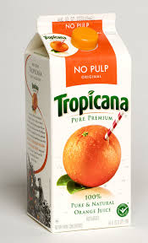
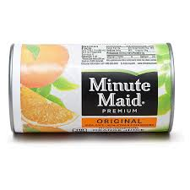
Concentrated Products
Concentrated products, such as frozen orange juice, contain a high solute to solvent ratio. This allows us to simply add water (solvent) to make large quantities of the product ready to use.
Concentrated products are beneficial in that they require less packaging than “ready-made” or dilute products:
vs

Slide 7
Solubility
Solubility describes how easily a solute will dissolve in a solvent to make a solution.
When a substance will dissolve in a solvent, we say that it is soluble
When a substance will not dissolve in a solvent, we say that it is insoluble
*** The solubility of a solute depends on the solvent it is being dissolved in***
E.g. these kids find out that skittles are soluble in some substances, but insoluble in others

Slide 8
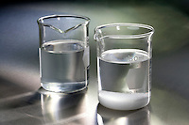
Solubility
The ability of a solute to dissolve often depends on how much solute is added to a mixture. Temperature and stirring also affect solubility.
For example, sugar dissolves in water up until a certain point. If too much sugar is added, it will no longer form a solution. This is referred to the saturation point of the solvent. However, by mixing the solution or even heating it, we can actually increase the saturation point:

Slide 9
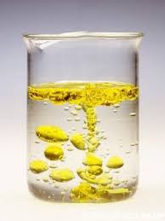
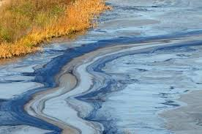
Solubility
Water is often referred to as the “universal solvent” because it is capable of dissolving most types of solute. Not all substances however, dissolve in water...
Oil and gasoline are both insoluble in water; this is why they are so harmful to the environment

Slide 10
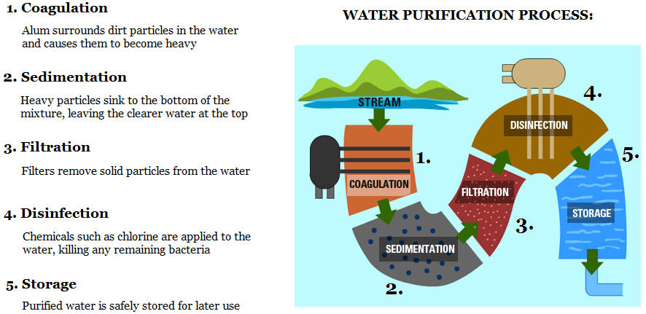
Separating Mixtures
Although solutions may look like pure substances, we know they are composed of more than one type of particle. We should therefore be able to separate any mixture into its individual components. This is especially useful for the purification of water:

Slide 11
Separating Mixtures
Water can also be purified through a process known as distillation. During this process, water is boiled and the steam is collected. As the steam cools, it condenses to form pure water. Anything that was dissolved in the water, such as salts, minerals, and harmful bacteria, is left behind.

