Slide 1
Compounds
~ SCIENCE 14 ~

Slide 2
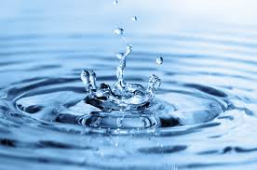
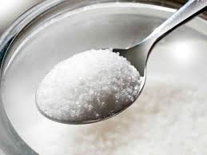
Compounds
The periodic table lists all of the elements known to man. A molecule made up of two or more different elements is known as a compound.
Most substances in our world are compounds...
Water (H2O)
Carbon Dioxide (CO2)
Sugar (C6H12O6)

Slide 3
Uses of Compounds
We use compounds every day without realizing it…
Methane, or natural gas (CH4), is used for heating
Citric acid, or lemon juice (C6H8O7), is used for flavouring
Absorbic acid, or Vitamin C (C6H9O6), is required by our bodies
Sodium chloride, or table salt (NaCl), is used in cooking
We exhale carbon dioxide (CO2)

Slide 4
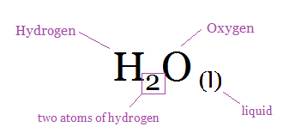
Naming Compounds
Just as each element has its own name, so does each compound. A chemical formula is used to represent the number and type of atoms in various compounds…
Letters tell you which elements are in the compound
Subscript numbers after each letter tell you if there are
more than one atom of that
element present (no subscript
indicates only one atom of that
element is present)
Subscript letters tell you the state of matter
This tells us that every molecule of water contains two hydrogen atoms and one oxygen atom, and is a liquid at room temperature.

Slide 5
Naming Compounds

Slide 6
Naming Compounds
Another example:
The chemical formula for monosodium glutamate, commonly referred to as MSG (a type of food seasoning), is NaC₅H₈NO₄ (s).
This indicates that 1 atom of sodium (Na), 5 atoms of carbon (C), 8 atoms of hydrogen (H), 1 atom of nitrogen (N), and 4 atoms of oxygen (O) are present. It also tells us that MSG is a solid at room temperature.
* In total, then, each MSG molecule is comprised of 19 atoms

Slide 7
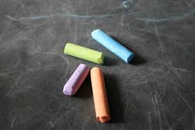
Naming Compounds
Compounds are generally named according to their chemical formula. However, common compounds also have “everyday” names:
Chemical Formula | Compound Name | Common Name
CaCO3(s) | calcium carbonate | chalk
NaHCO3(s) | sodium bicarbonate | baking soda

Slide 8
Decomposition Reactions
Because compounds consist of more than one element, they can theoretically be broken down into said elements. This is accomplished through a process known as a decomposition reaction.
One common way of separating the elements in a compound is through the application of electricity. This process is referred to as electrolysis.
Example: Water (H2O) can be broken down into hydrogen and oxygen via electrolysis (not the most exciting decomposition reaction, but one of the simplest to observe)

Slide 9
Decomposition Reactions
Other decomposition reactions occur with the aid of a catalyst (this one’s more exciting)...

