Slide 1
Acids and Bases
~ SCIENCE 14 ~

Slide 2
Properties of Acids & Bases
ACIDS | BASES
taste sour | taste bitter
change litmus paper from blue to red | change litmus paper from red to blue
react with metals | feel slippery
pH less than 7 | pH more than 7
corrosive | corrosive
neutralize bases | neutralize acids
conduct electricity | conduct electricity
* Substances that are neither acids nor bases are neutral. When an acid and base of equal strength combine, they cancel each other out, a process known as neutralization. Neutral solutions have a pH of 7.

Slide 3
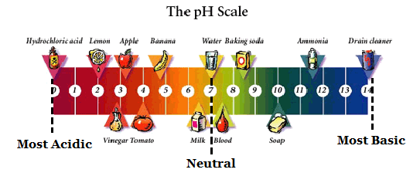
pH
pH (“potential hydrogen”) is a measurement of how acidic or basic a solution is. The pH scale ranges from 0 to 14:
Lemon juice, for example, has a pH of approximately 2. It is therefore considered to be acidic.

Slide 4
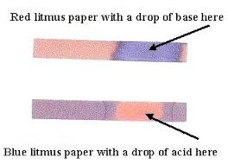
pH Indicators
pH indicators are substances that change colour in the presence of an acid or base. Litmus paper, for example, changes from blue to red when it comes in contact with an acid, and red to blue when it comes in contact with a base:
In a neutral solution, litmus paper would not change colour at all.

Slide 5
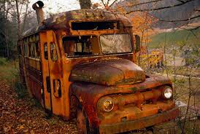
Corrosion
Solutions that lie near either end of the pH scale (very acidic or very basic) can be extremely dangerous due to their corrosive properties.
Corrosion is the wearing away of materials by chemical action
Often seen as rusting (oxidization) or acid rain
*** The corrosive effects of acids & bases are increased by warmer temperatures, humidity, and the presence of salt compounds ***

Slide 6
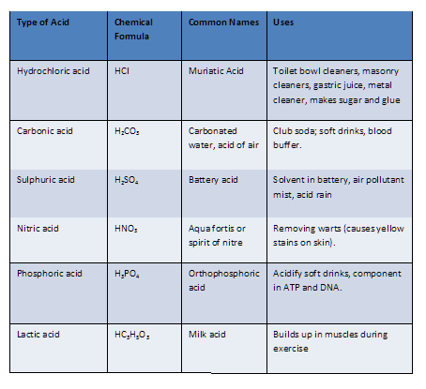
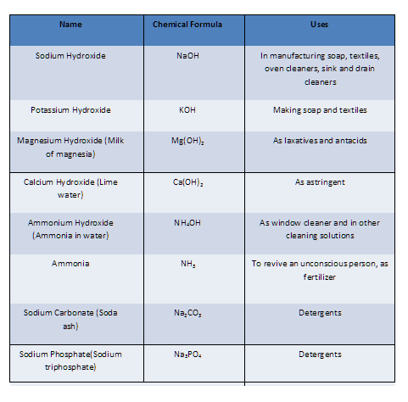
Uses for Acids & Bases

