Slide 1
Describing Matter
~ SCIENCE 14 ~

Slide 2
The Particle Theory of Matter:
All matter is made up of very small particles
All particles in pure substances are the same
There are spaces between particles; the amount of space varies depending on the state of matter
Particles are always moving. As particles gain energy, they move faster
The particles in a substance are attracted to one another

Slide 3
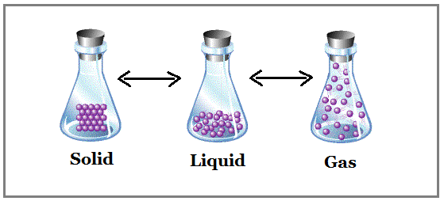
States of Matter
Matter may exist in three states, depending on how close together or far apart its particles are…
Matter does not exist in a fixed state. That is, solids can become liquids, liquids can become gases, and vice versa.

Slide 4
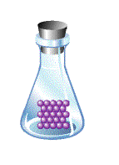
Solids
Particles are packed tightly together & move very little as a result
This causes solids to retain their shape
When particles gain energy (heat up), they expand (move apart), causing solids to turn to liquid (e.g. ice melts to form water)

Slide 5
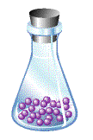
Liquids
Particles are slightly further apart, and are thus able to move around
This causes liquids to flow and take the shape of the container they are in
When particles gain energy (heat up), they expand even more (move apart), causing liquids to turn to gas (e.g. water is vapourized as it begins to boil)
When particles lose energy (cool down), they condense (come together), causing liquids to turn to solid (e.g. water freezes to form ice)

Slide 6
Gases
Particles are loosely packed and move freely
Gases thus disperse throughout the space they are in
When particles lose energy (cool down), they condense (come together), causing gases to form liquid (e.g. water vapour condenses to form water)

Slide 7
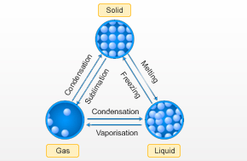
Converting Between States of Matter
Through the addition or loss of energy, matter can change states

Slide 8
Particle Theory also helps explain other properties of matter...
Physical vs. Chemical Properties

