Slide 1
Classifying Matter
~ SCIENCE 14 ~

Slide 2
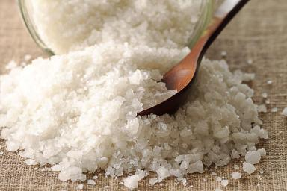
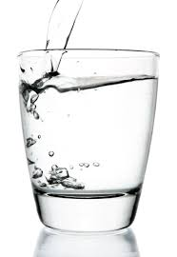
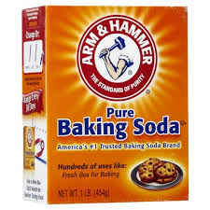
Pure Substances
Made up of one type of particle
All parts of a pure substance are identical
Has a defined chemical formula
Salt (NaCl)
Baking Soda (NaHCO3)
Water (H2O)

Slide 3
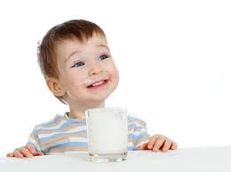
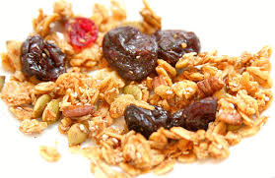
Mixtures
Made up of more than one type of particle
Different components may be visible to the naked
eye (e.g. salsa), known as mechanical mixtures, or
with a microscope (e.g. juice), known as suspensions
No defined chemical formula
Milk is a suspension mixture
Trail mix is a mechanical mixture

Slide 4
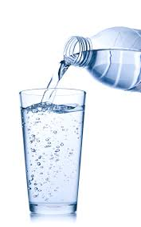
Determining whether substances are pure or mixed
Sometimes it can be difficult to tell whether substances are truly pure or mixed. We can examine their appearance, texture, and even density. However, it is often necessary to investigate their boiling and freezing points…
E.g. How do you know if the water you drink is pure?
Because they are composed of multiple substances, mixtures will boil and freeze at different temperatures than the pure substances that make them up

