Slide 1
Stellar Evolution

Slide 2
What properties of stars determine their life cycle?
Chemical composition is almost identical in all stars (Hydrogen & Helium)
Most obvious differences are Brightness (Luminosity) & Surface Temperature (Colour)

Slide 3
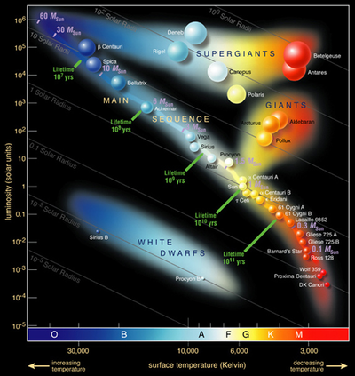
H-R Diagram
Hertzspring-Russell Diagrams plot Luminosity as a function of Surface Temperature (Colour)

Slide 4
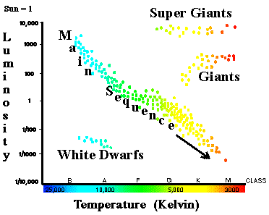

Slide 5
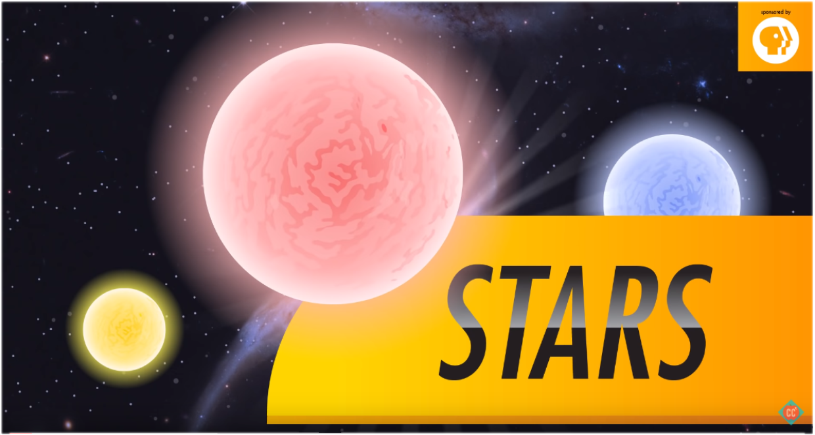

Slide 6
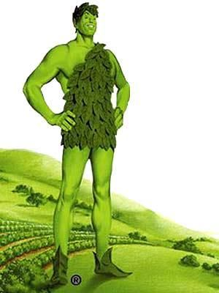
90% of stars stretch diagonally from top left to lower right. This band is called the Main Sequence.
Normal stars burning Hydrogen
Stars in the upper right are bright but cool. These are giants stars with a red colour; Red Giants
Supergiants are even bigger and brighter (1000 times the radius of the sun)

Slide 7
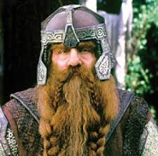
The bottom left have hot, dim stars.
Hot but small
White Dwarfs
No thermonuclear fusion
Brown dwarfs are in the lower right.
Dim, cool stars.
Failed stars (ex Jupiter)

Slide 8
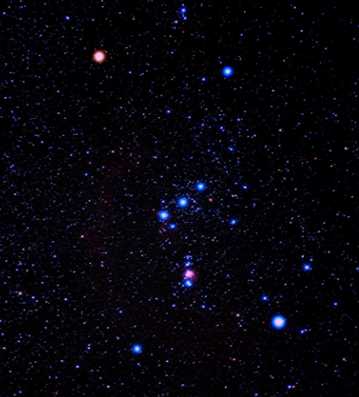

Slide 9
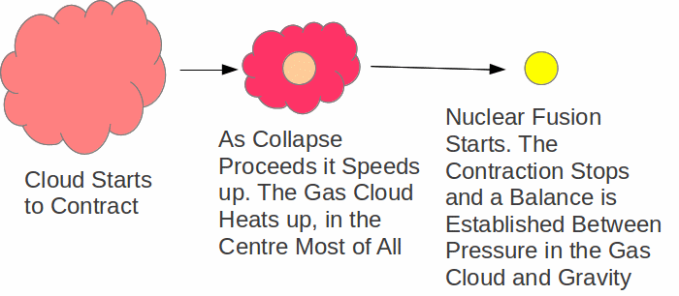
Star Birth
A protostar becomes a Star when its temperature and density are high enough to begin nuclear fusion.

Slide 10
Main Sequence
For most of its life, stars turn Hydrogen into Helium to produce energy.
Time spent depends on mass.
Star | Time spent on Main Sequence
Sun | 10 Billion Years
Red Dwarf | 2.5 Trillion Years
Hypergiants | 5 Million Years

Slide 11
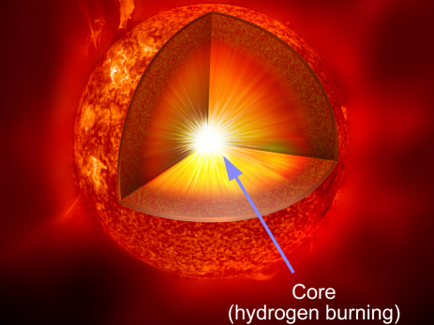

Slide 12
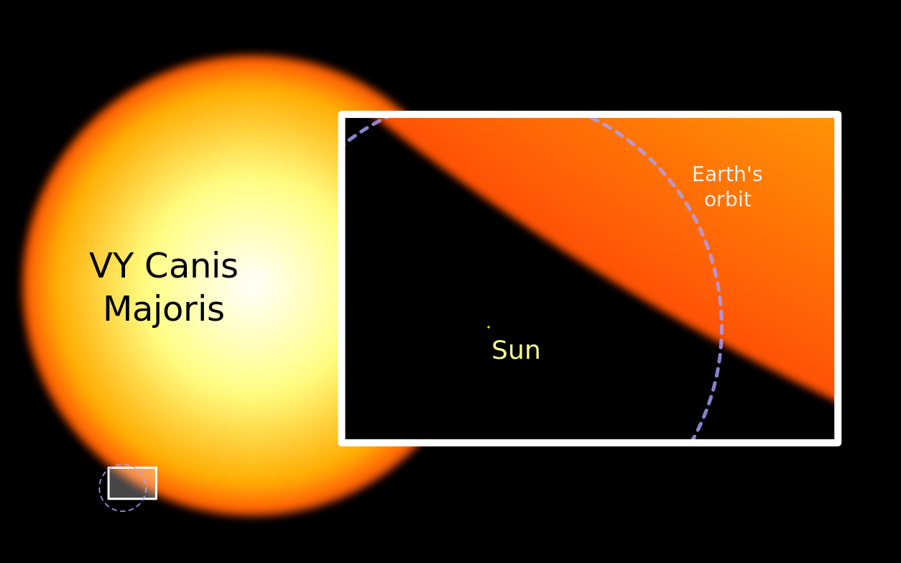

Slide 13
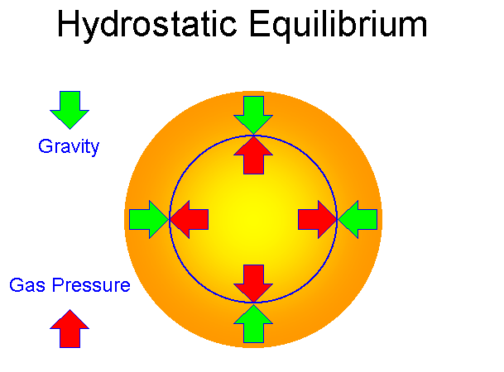
Death of Stars
When a star runs out of Hydrogen it no longer has sufficient energy to maintain Hydrostatic Equilibrium.

Slide 14
Fusion of Helium to form Carbon provides energy for a short period of time.
Heavier elements are quickly fused until Iron is produced.
No more energy can be produced by Iron Fusion.
Bad stuff happens really quickly!

Slide 15
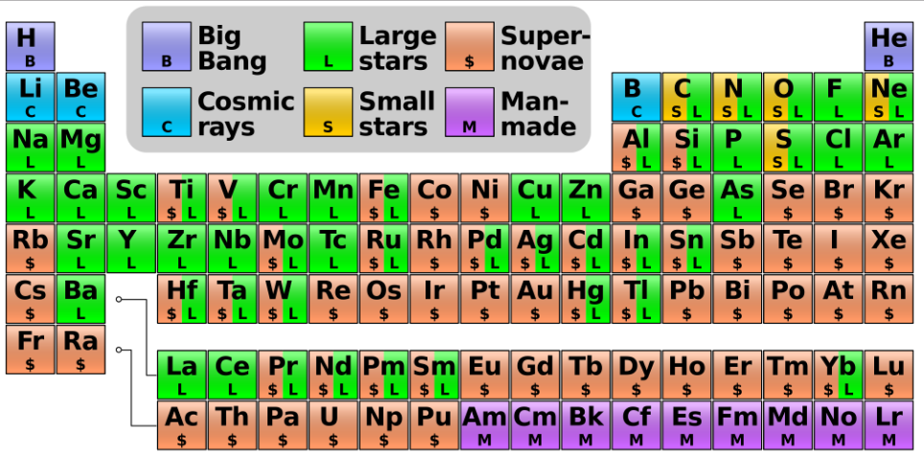

Slide 16
Death of Stars
When a star runs out of fuel 3 things can happen
Small – Moderate sized stars (0.08 - 8) form White Dwarfs
Large Stars (8 - 20) form Neutron Stars
Very Large Stars (greater than 20) form Black Holes

Slide 17
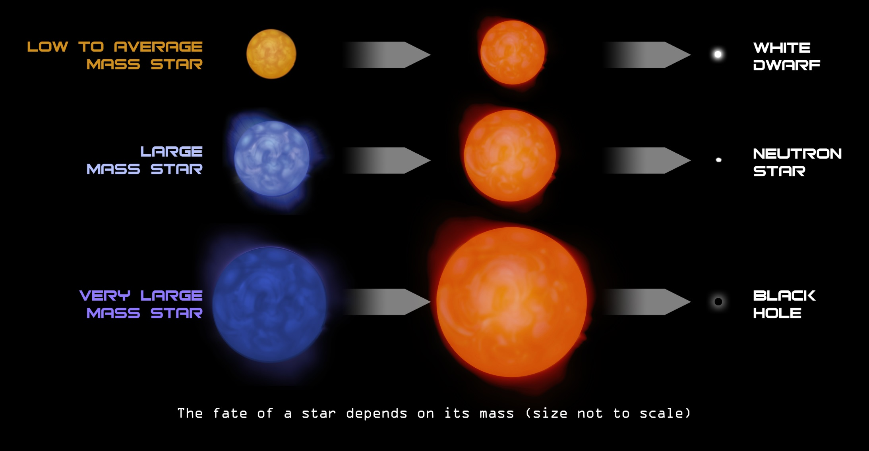

Slide 18
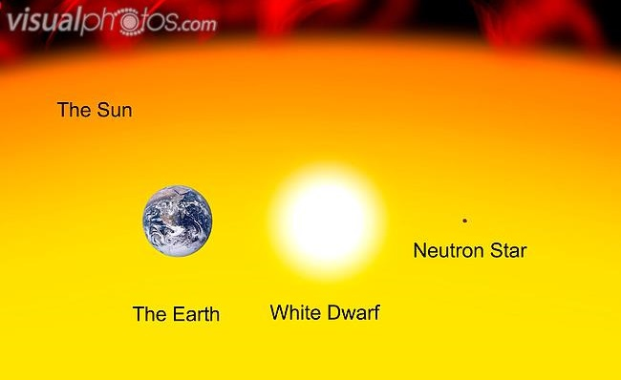

Slide 19
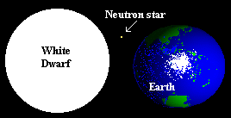
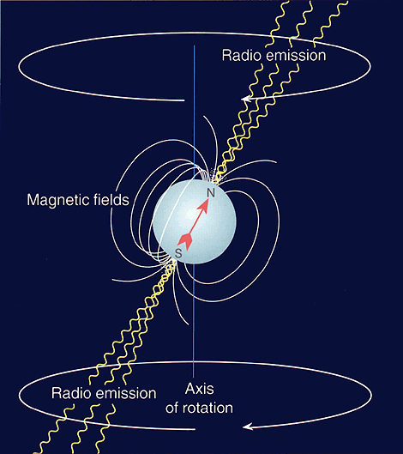

Slide 20
Black Holes

Slide 21
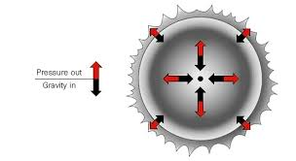

Slide 22
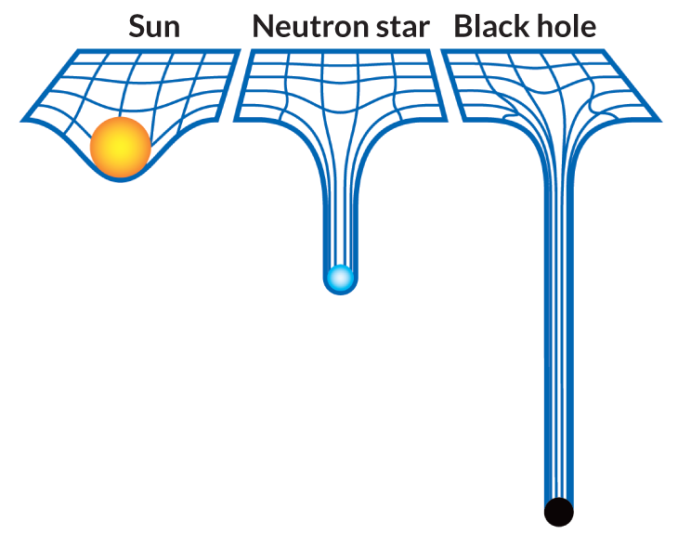

Slide 23
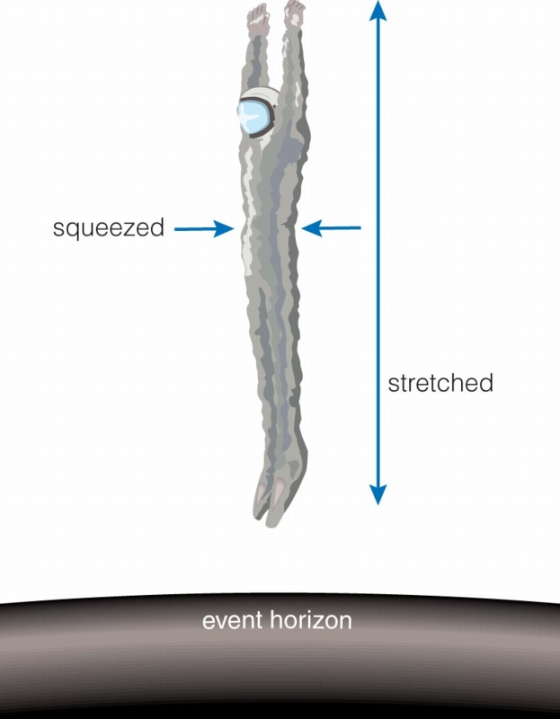

Slide 24
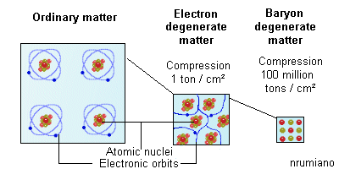

Slide 26
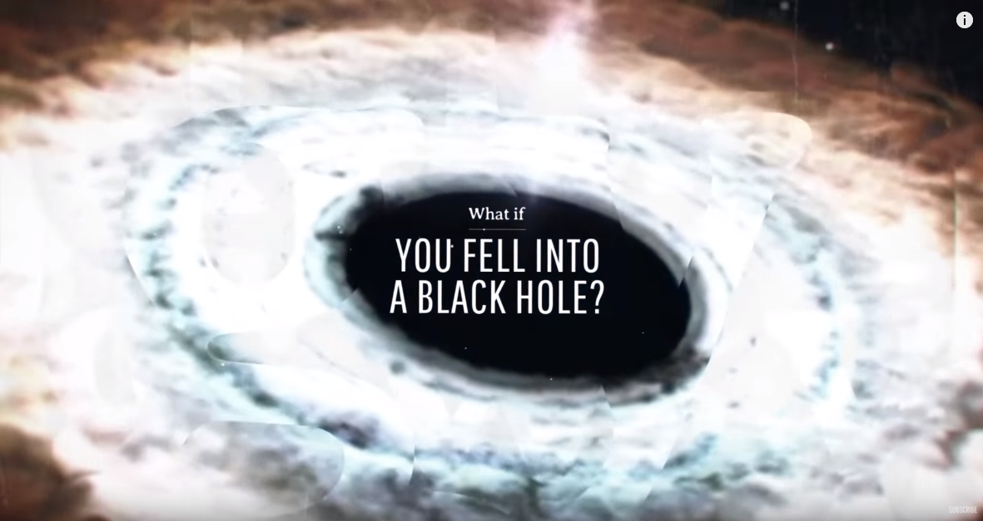
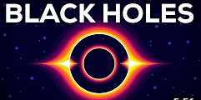

Slide 27
Write a biography of the Sun that explains the different ages and stages of a typical stars life.

