Slide 1
What is the Universe?

Slide 2
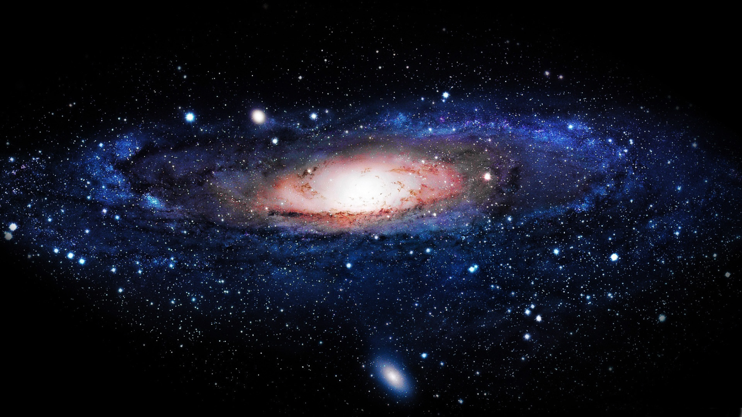
What we see
Light from shining matter (luminous matter)
Stars, Nebulae

Slide 3
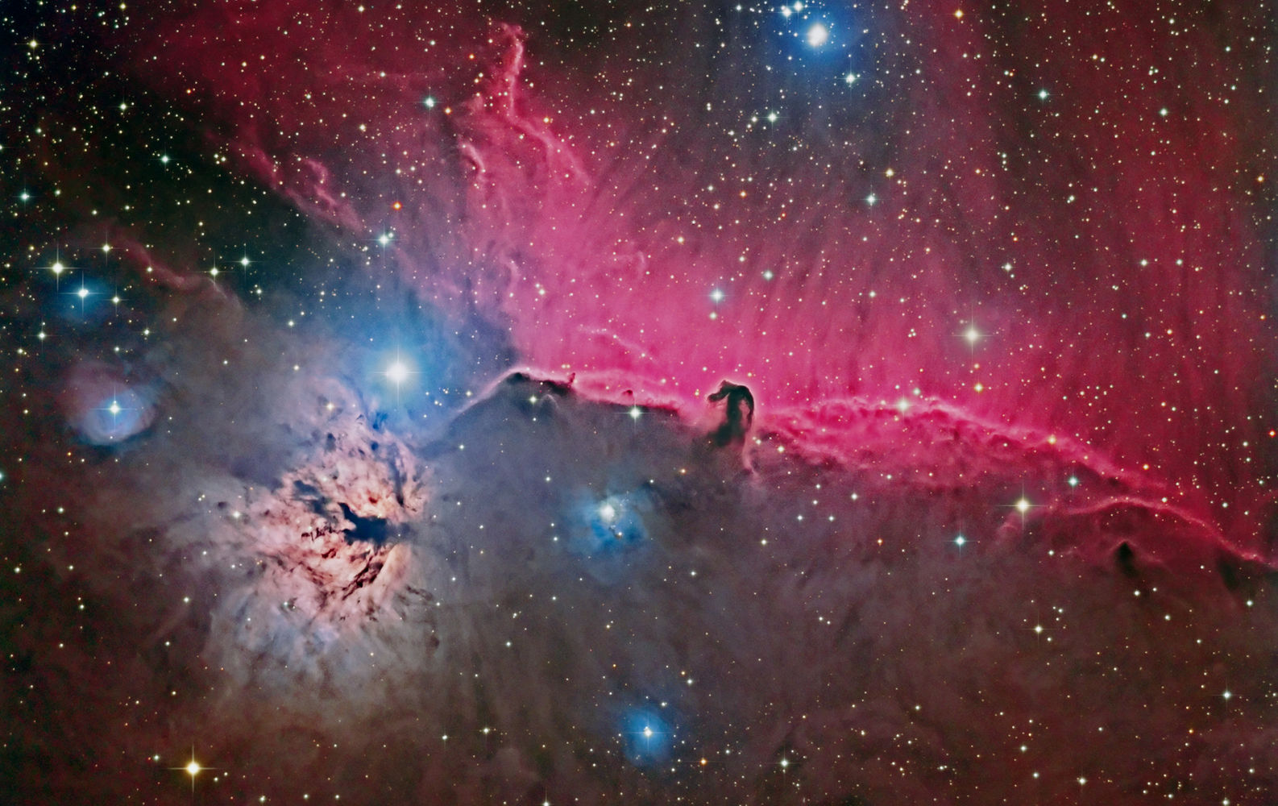
Non-luminous matter
Blackholes, planets, cold gas & dust

Slide 4
Made up of Protons, Neutrons & Electrons
Effected by Gravity, Electromagnetism & Nuclear Forces
Is there anything else?!?!

Slide 5
A Guide to the Dark Side

Slide 7
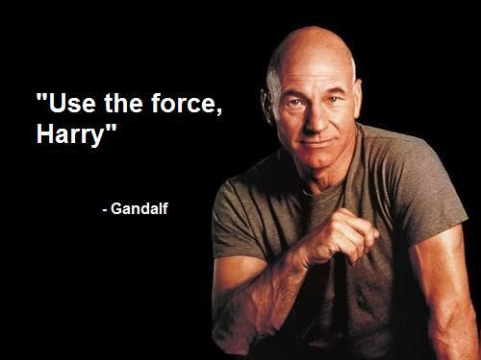

Slide 8
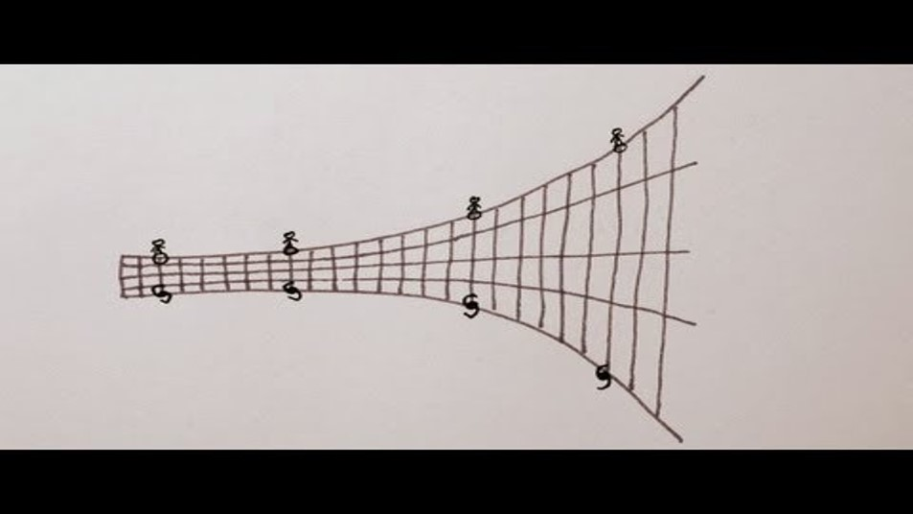

Slide 9
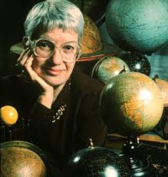
In the 1950s Vera Rubin measured the rotation speeds of stars in other galaxies.
Kepler & Newton’s laws predicted that rotational speed should decrease with distance.
Greater distance means less gravity.
Rotation rates did not decrease.

Slide 10
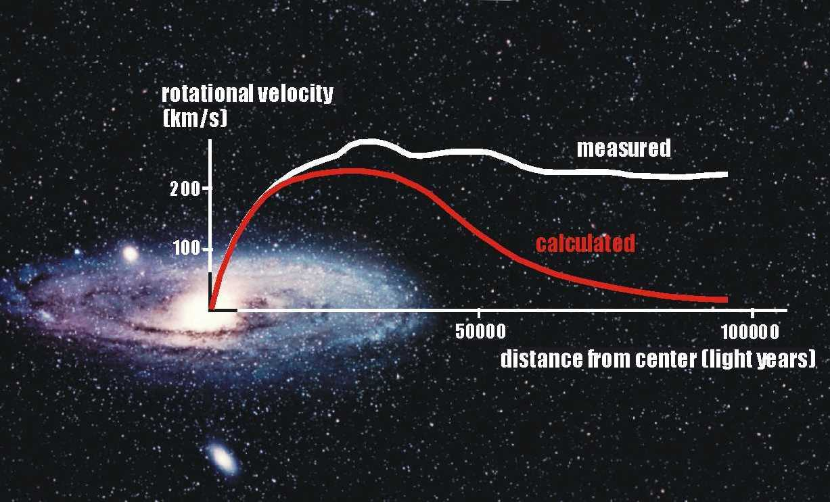

Slide 11
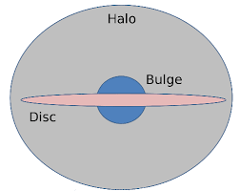
Unseen mass must be pulling on the stars.
Dark Matter

Slide 12
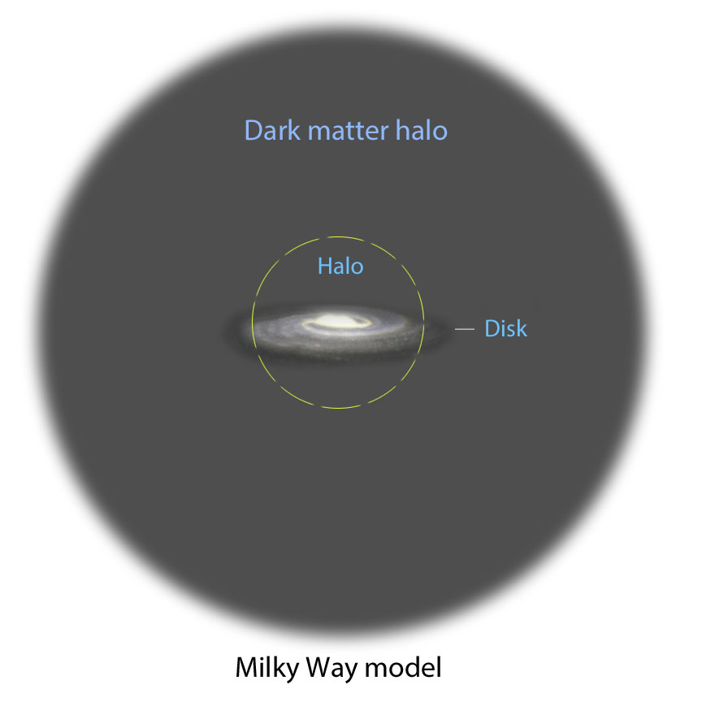

Slide 13
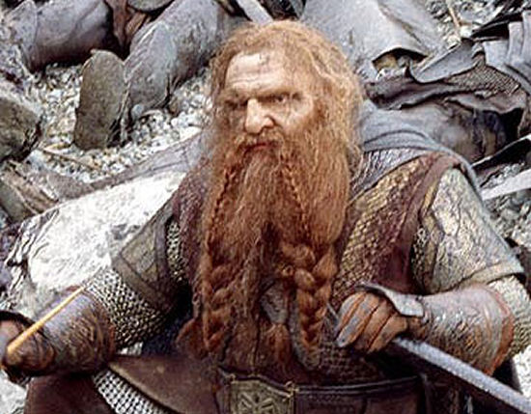
What is Dark Matter
Massive Compact Halo Objects
MACHOs
Brown dwarfs, black holes, rogue planets, asteroids
May make up a small percentage of Dark Matter but can’t be all of it.

Slide 14
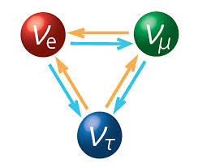
Weakly Interactive Massive Particles
WIMPs
Particles that don’t feel electromagnetic forces
Subatomic particles
Don’t reflect or produce light
Aren’t affected by magnets or charges
Example: Neutrino
Most likely candidate

Slide 15
Recent calculations show that there is about 5 times as much Dark Matter as Normal matter in the universe.
Is there anything else?

Slide 16
The universe is expanding.
The expansion is accelerating.
It takes energy to accelerate something.
Dark Energy is the energy required to accelerate the expansion of the universe.

Slide 17
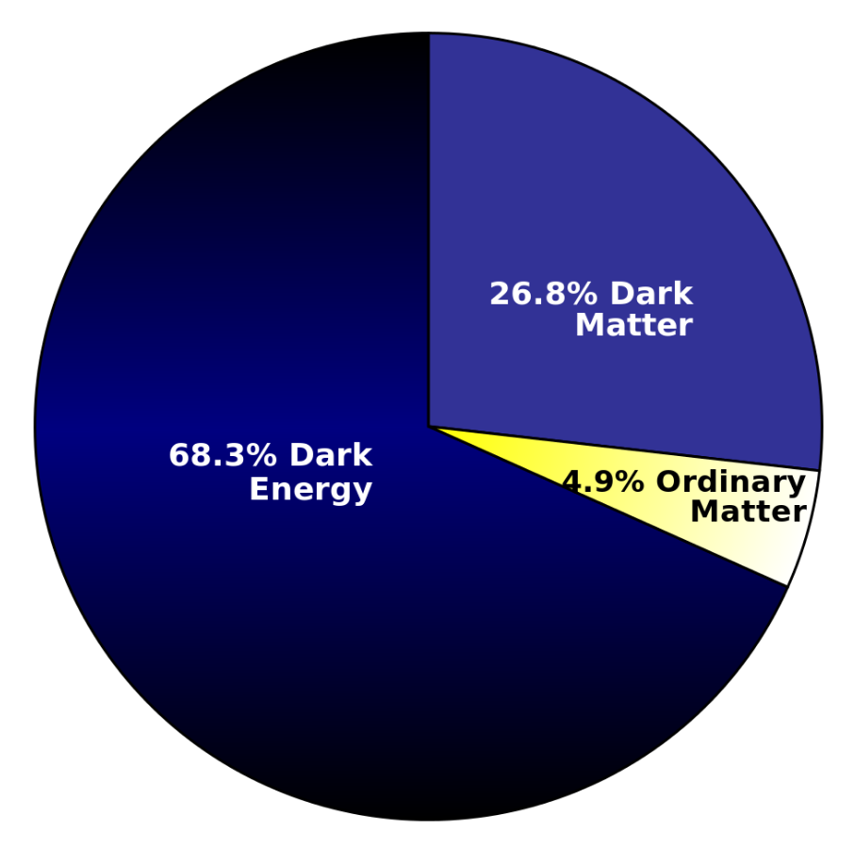

Slide 18
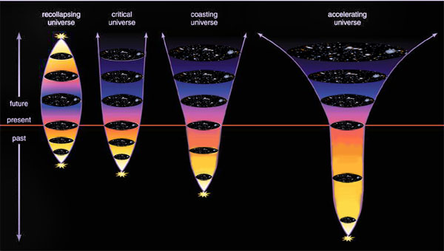

Slide 21
Explain the difference between Dark Matter and Dark Energy.
Despite not being able to see Dark Matter, why do Astronomers believe it exists?
Do you believe the universe will continue to accelerate? Why or why not?

