Slide 1
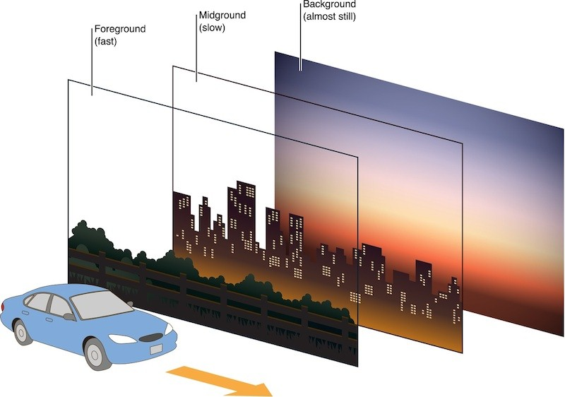
Determining Distance

Slide 2
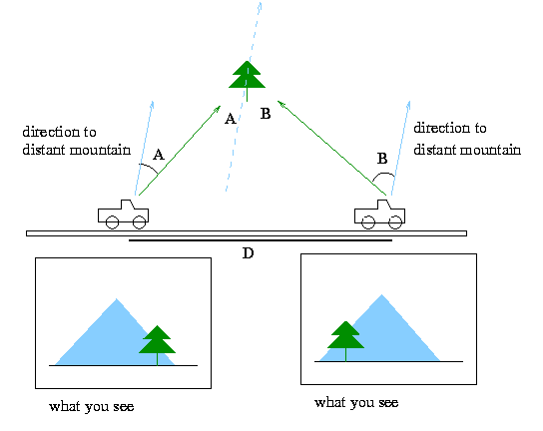

Slide 3
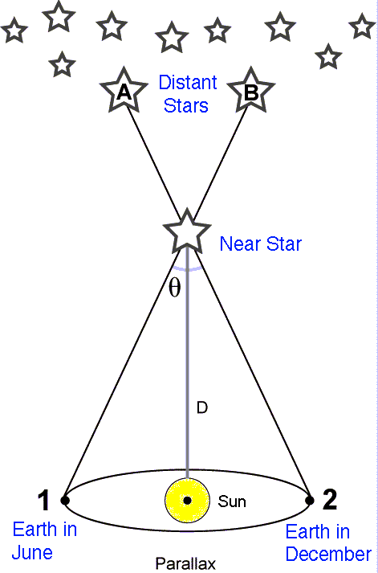

Slide 4
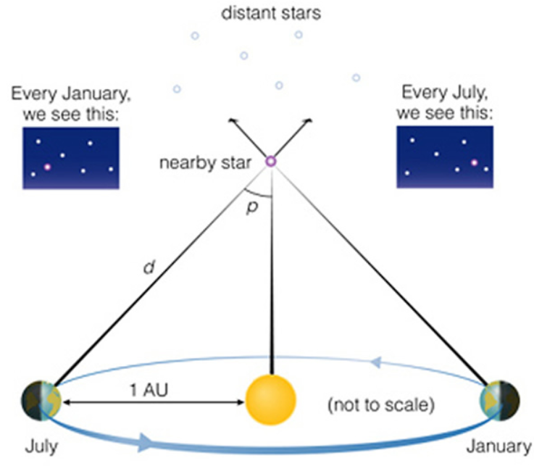
Parallax
Distance to stars can be determined by how much it move when viewed from different positions.
Background stars (stars VERY far away) don’t appear to move.
Closer stars are seen in one position in July and a different position in January.

Slide 5
Baseline is measured in AU (1 AU = 1.49 x 10¹¹ m)
Angles are measured in arcseconds
1º = 60’ (arcminutes) = 3600” (arcseconds)
1” = 0.000278º
Distance is measured in Parsecs
One parsec is the length of a side of a triangle with an angle of one arcsecond, where the other side is 1 AU long
1 parsec = 3.26 light years
$$distance=1/angle$$
Parsec
Arcseconds

Slide 6
Example
The star with the largest Stellar Parallax is Alpha Centauri. The angle measure is 0.7687”. How far away is Alpha Centauri?
ANS: 1.3 Pcs

Slide 7
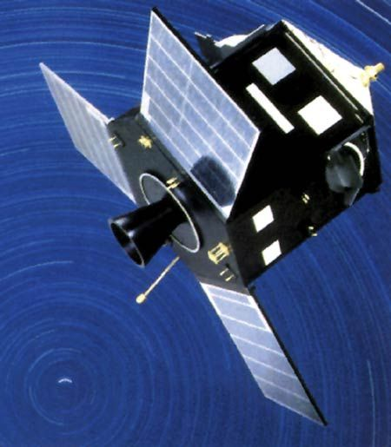
Because of the small angles involved, Parallax only works for stars within about 300 parsecs (~1000 light years).
All parallax angles are so small they were impossible to measure until the 19th century.
Until then, the lack of parallax was seen as support for a Heliocentric universe
Hipparcus satellite launched in 1998 is designed to measure parallax angles.

Slide 8
Example
A star is 100 parsecs from Earth. What parallax angle does it have?
Sirius is 8.62 light years from Earth. What parallax angle does it have?
How many light years from Earth is a star that has a measured parallax of 0.223”?

