Slide 1
Nebulae & Variable Stars

Slide 2
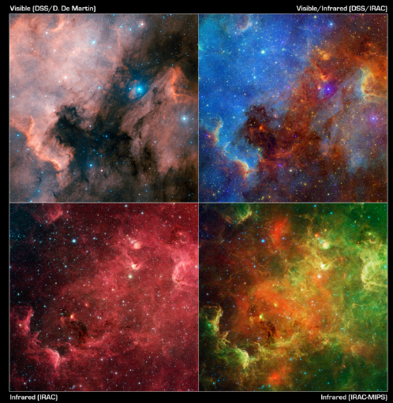
Nebulae
Huge clouds of dust and gas.

Slide 3
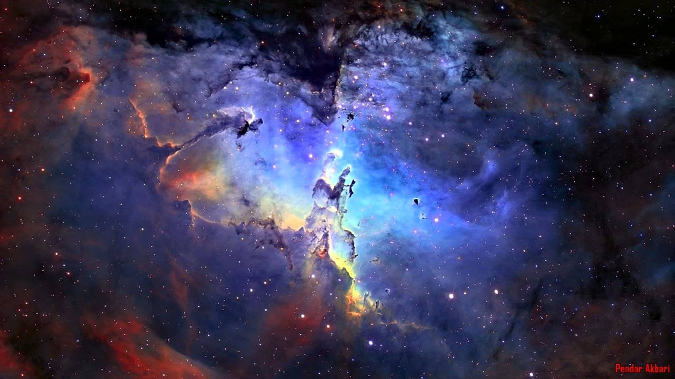

Slide 4
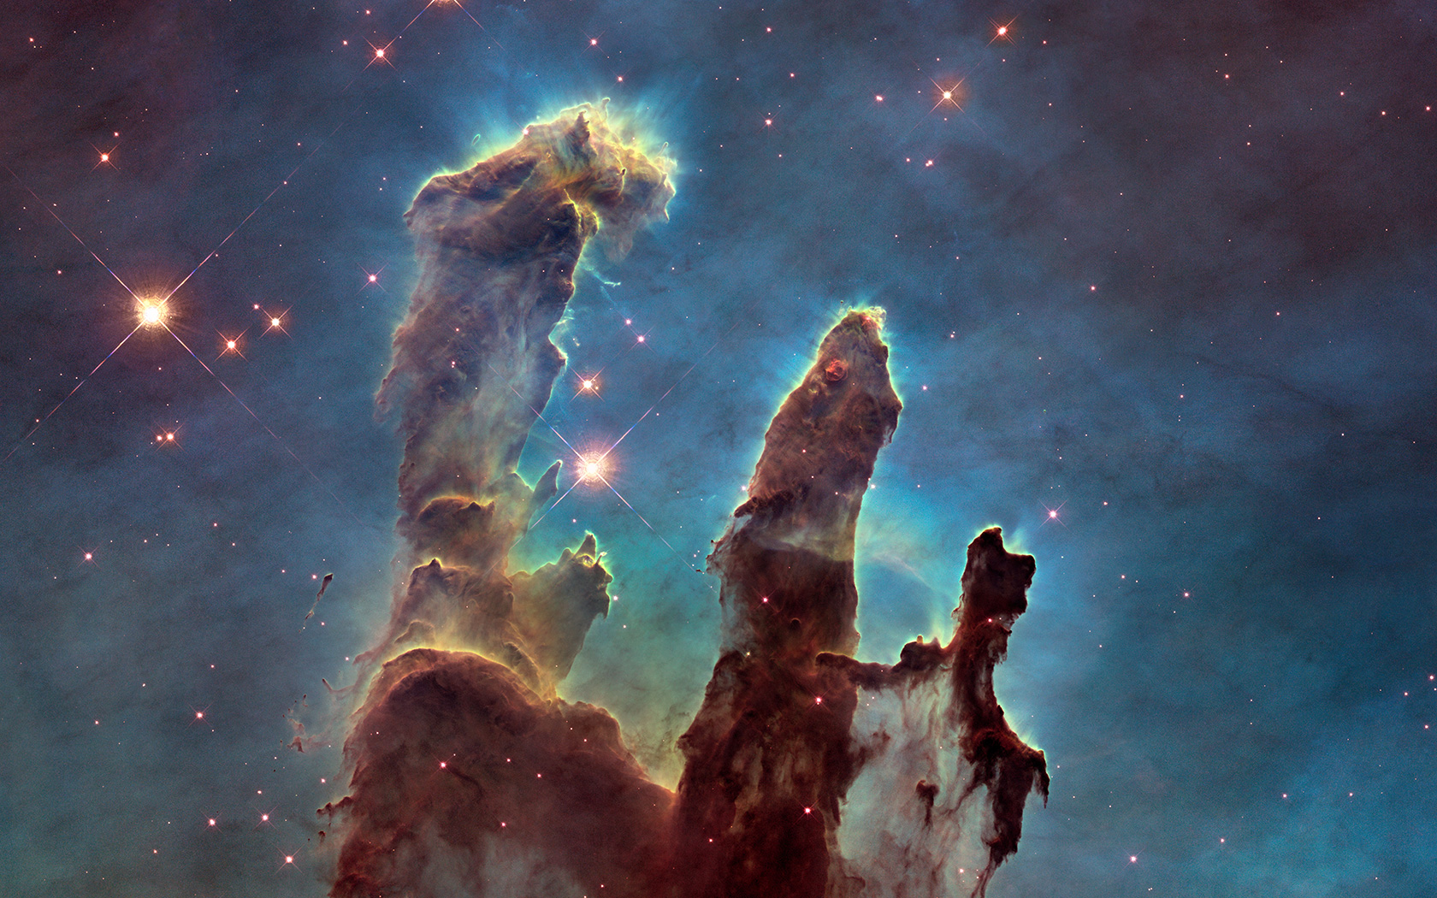

Slide 5
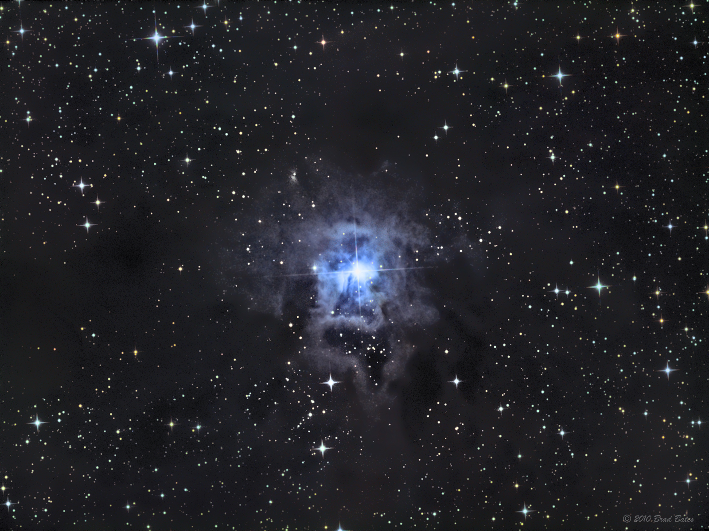

Slide 6
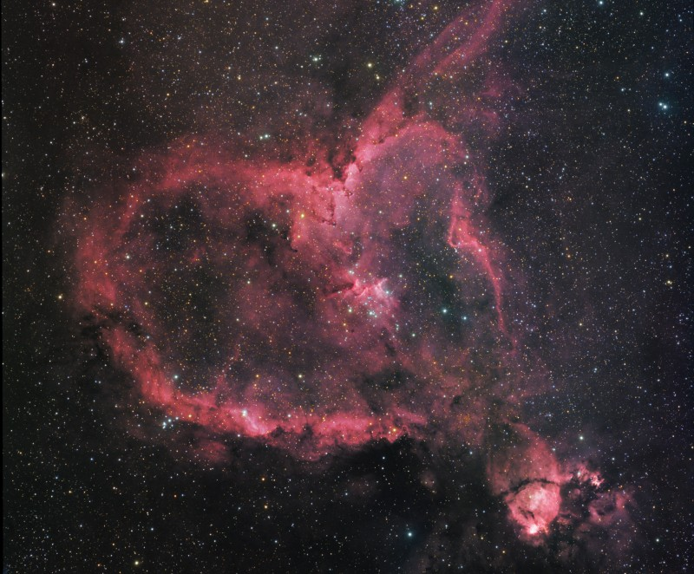

Slide 7
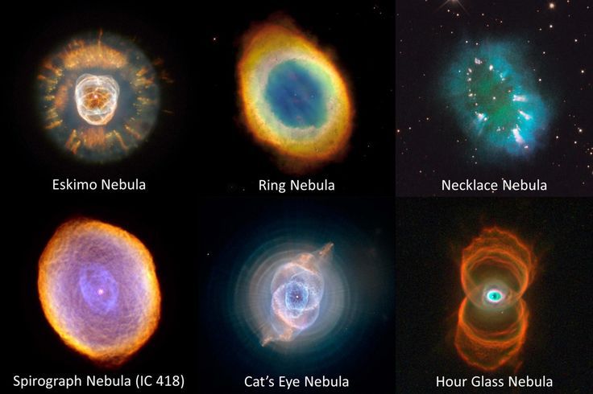

Slide 8
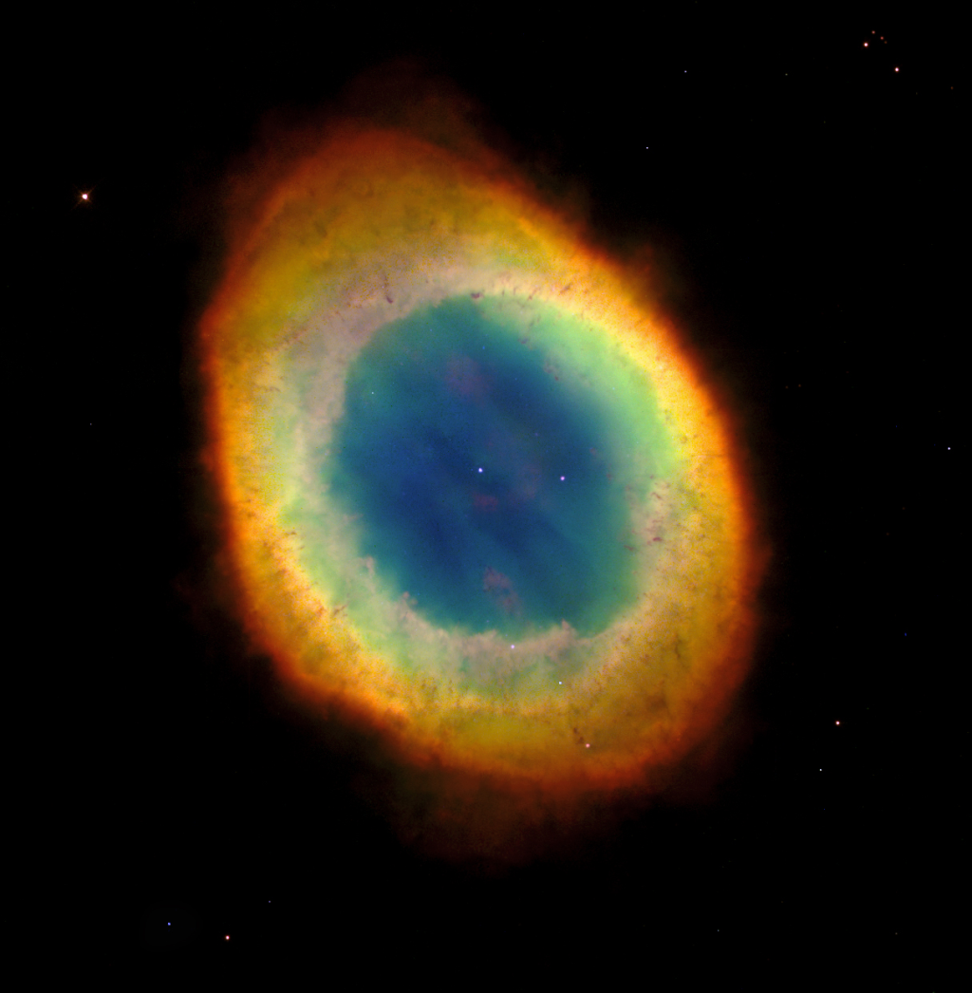
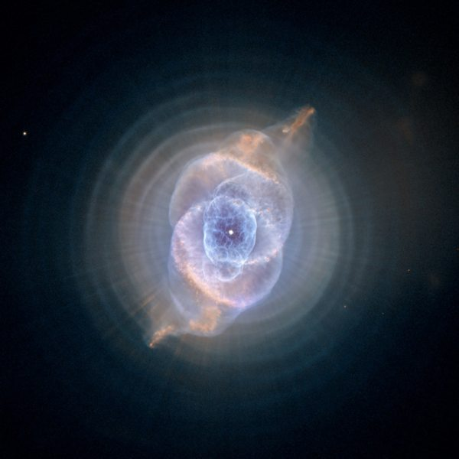
Types of Nebulae
Planetary Nebulae
Dense clouds of gas, blown off of stars towards then end of their life.
Mostly ionized hydrogen

Slide 9
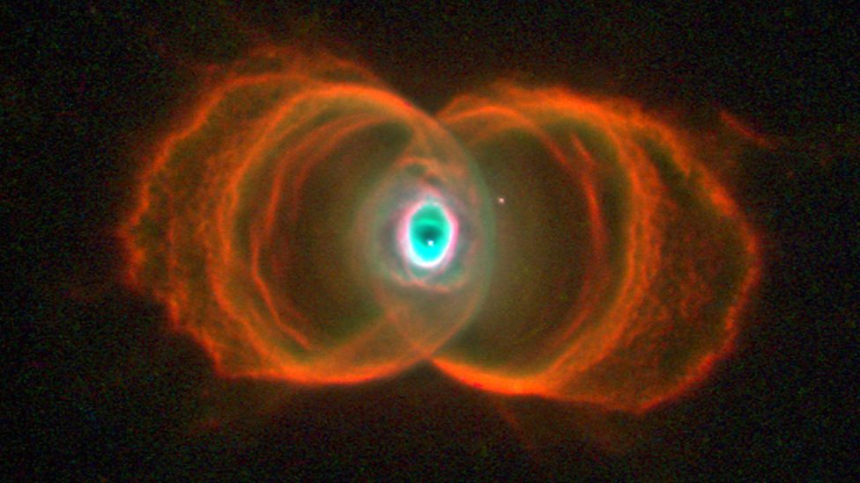
Planetary Nebulae appear very small and were originally mistaken to be planets.
They are clouds of expanding materials from the central star.
The exist for 10s of thousands of years before they expand too far to be seen

Slide 10
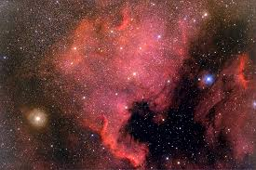
Diffuse Nebula
Extended clouds of dust and gas (mostly ionized Hydrogen) with no obvious boundaries.
Size can vary but usually quite large.

Slide 11
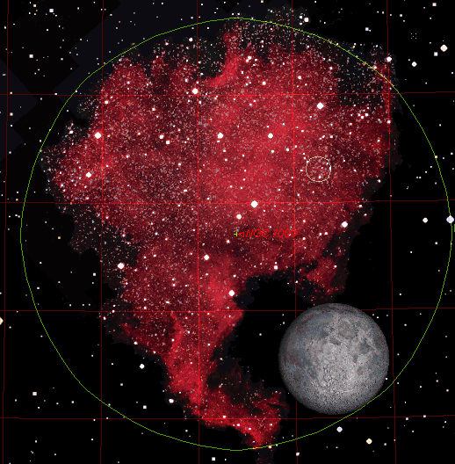

Slide 12
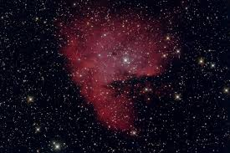
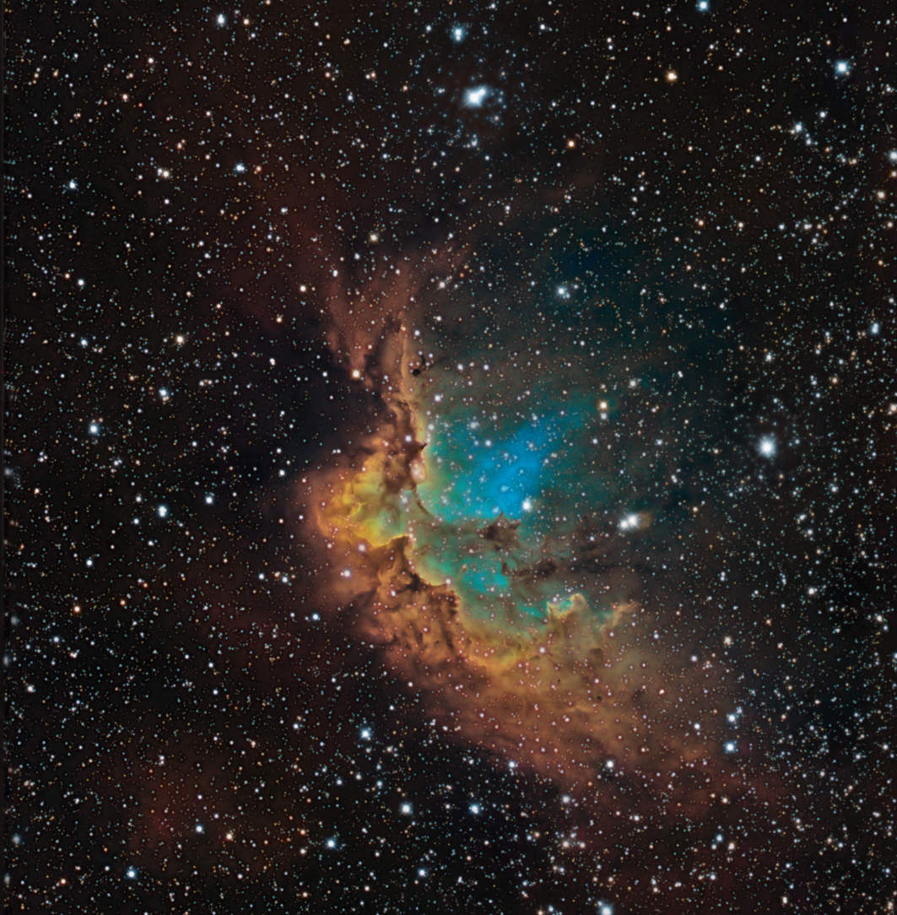
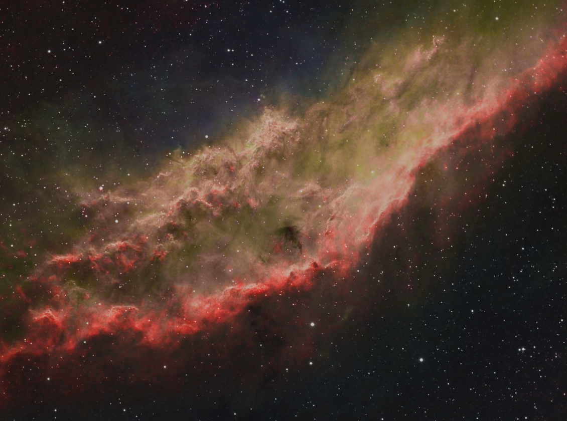

Slide 13
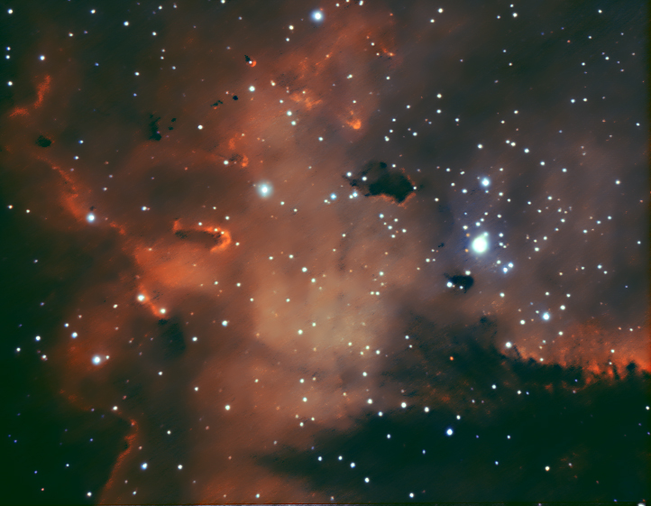

Slide 14
Dark Nebula
Also known as an Absorption Nebula
Dust and molecular particles obscure light from behind them.
Contains organic molecules like Carbon Dioxide, Ammonia, and Formaldehyde.

Slide 15
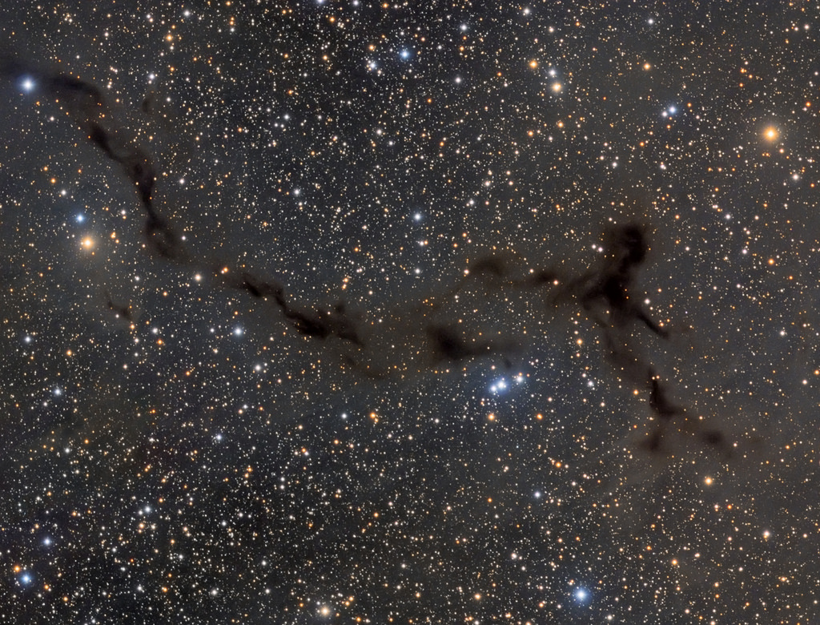

Slide 16
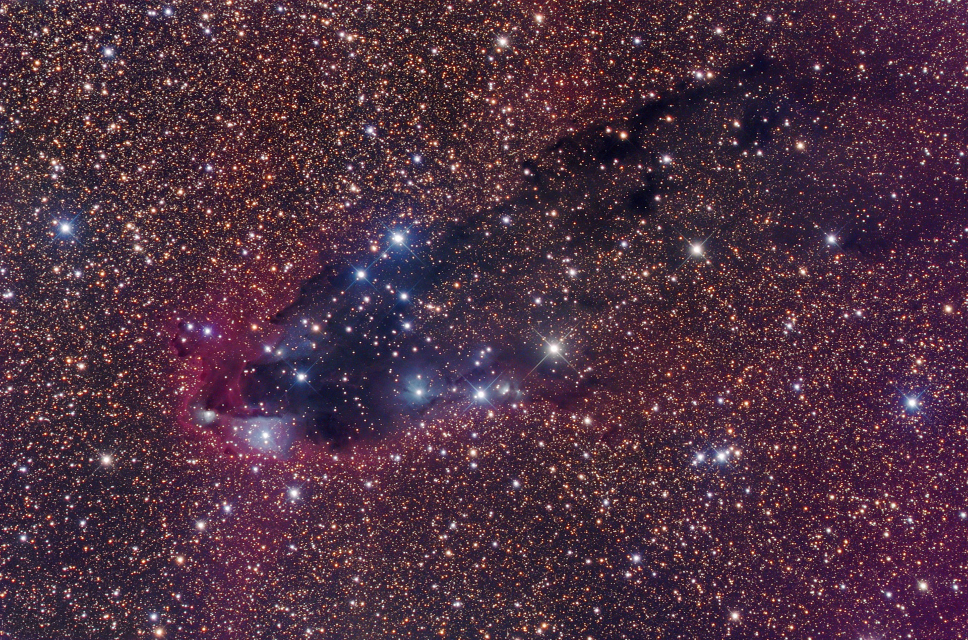

Slide 17
Supernovae Remnants
When a supernova occurs the gas in a star rushes towards the core. It hits the core and explodes outwards.
The gas expands outwards as a cloud of ionized gas.

Slide 18
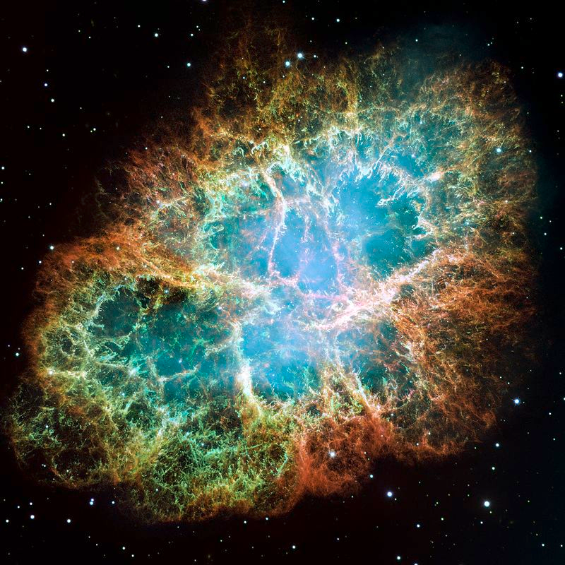

Slide 19
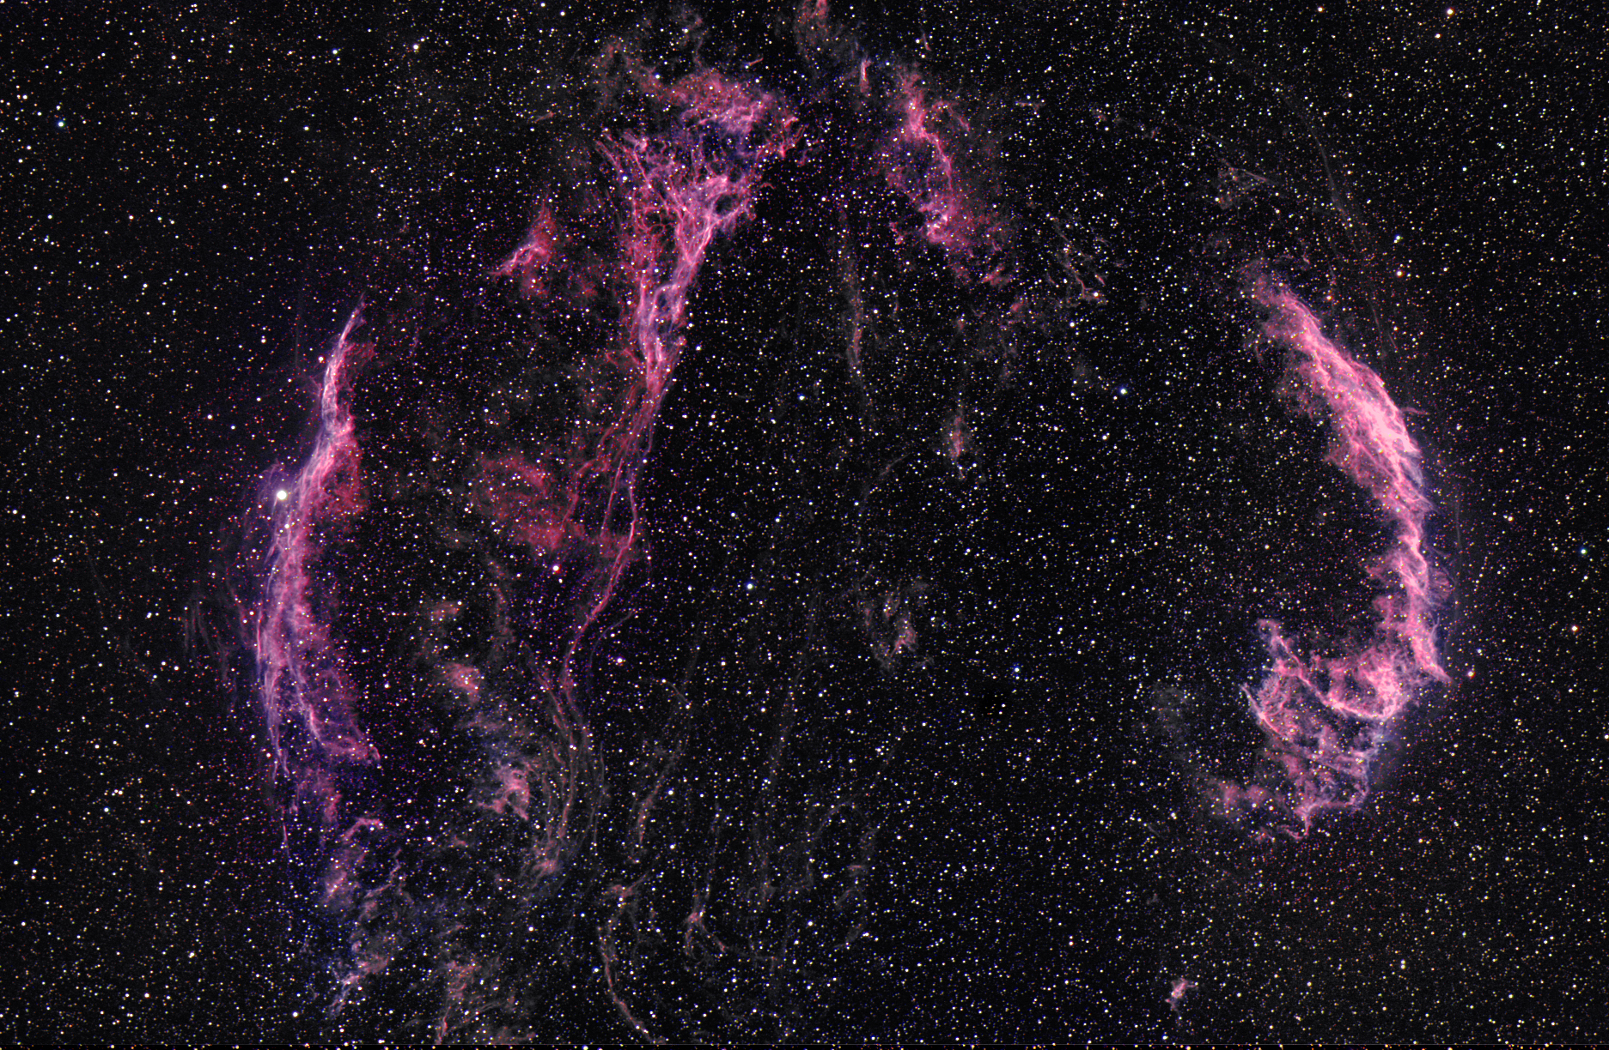

Slide 20
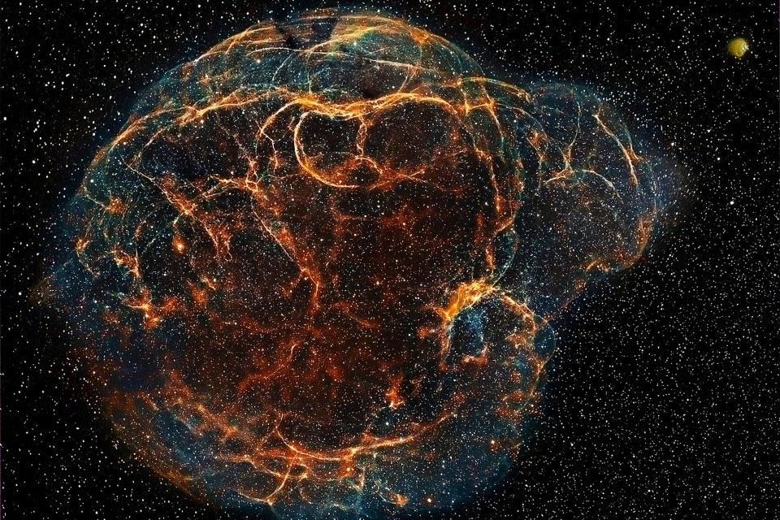

Slide 21
Variable Stars
The majority of stars have a constant brightness.
Others change their brightness. These can be divided into 5 classes
Rotating stars
Pulsating Stars
Eclipsing Binaries
Explosive (Cataclysmic) Stars
Planet Transits

Slide 22
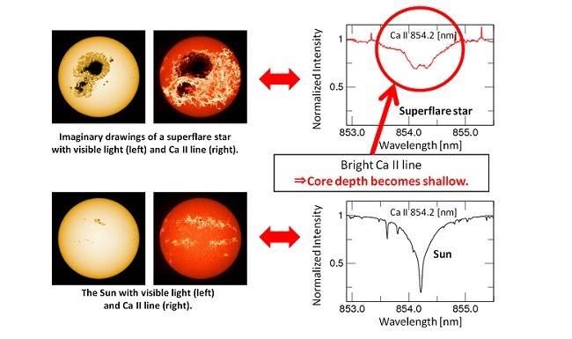
Rotating Stars
Star spots may rotate into and out of view, changing the star’s brightness.

Slide 23
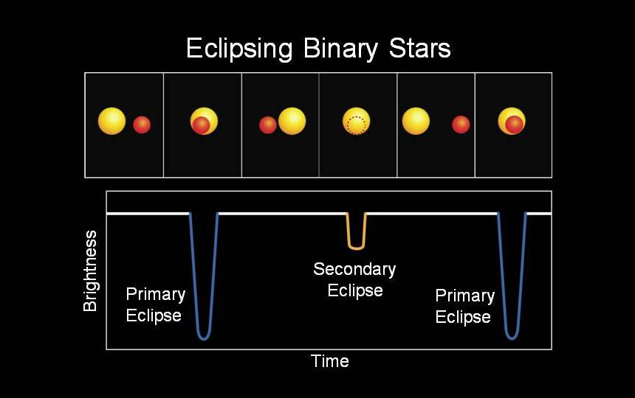
Eclipsing Stars
Two stars rotate around a common center of mass will regularly eclipse each other.

Slide 25
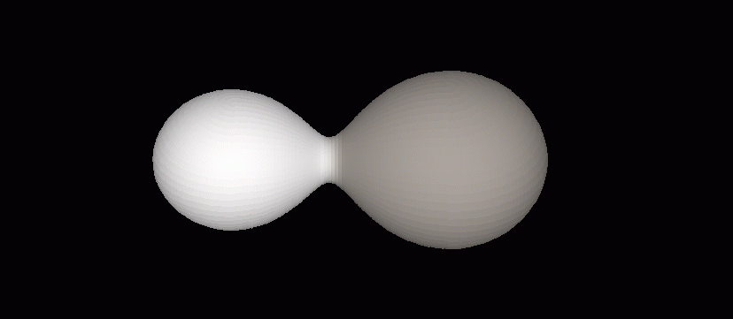

Slide 26
Pulsating Stars
These stars swell and shrink
When the star get larger they get brighter
Usually have regular changes in brightness
First type discovered is known as a Cepheid Variable Star.
Intrinsic Brightness may double during the period.

Slide 28
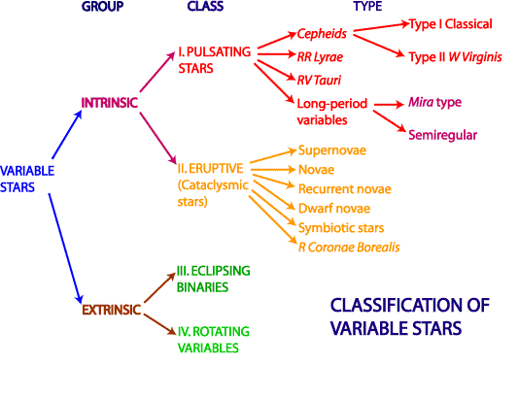

Slide 29
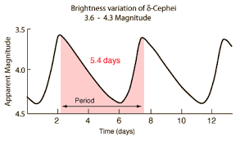

Slide 30
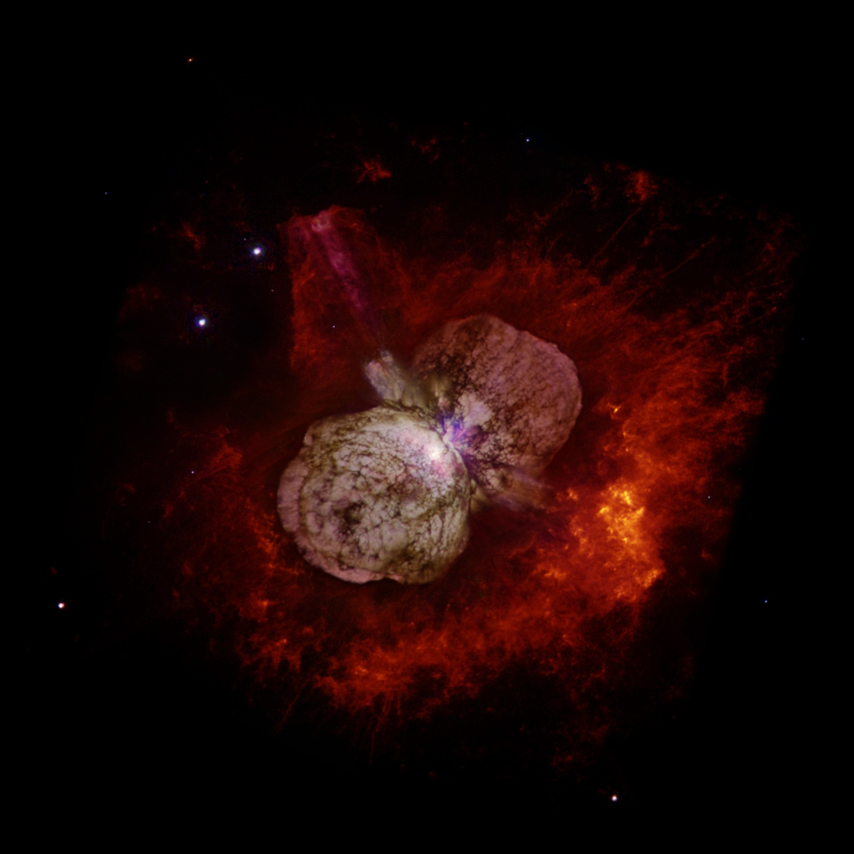

Slide 32
Explosive Stars
Nova or Supernovas are the most dramatic type of variable stars
Supernovas are among the most energetic events in the universe.
During the explosion the star may emit as much energy as an entire galaxy. (Billions of times brighter)
Supernovas destroy the original star

Slide 33
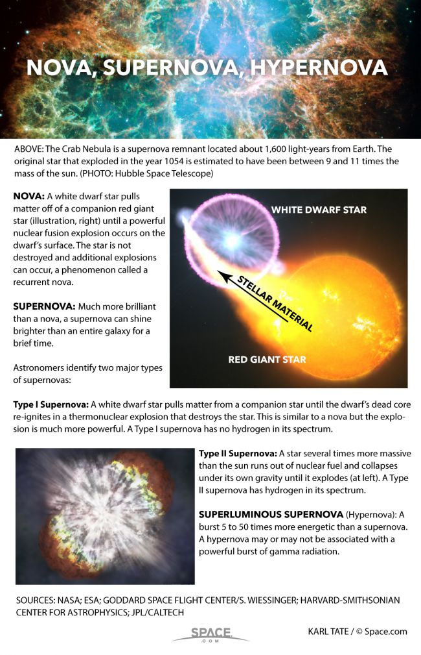

Slide 34
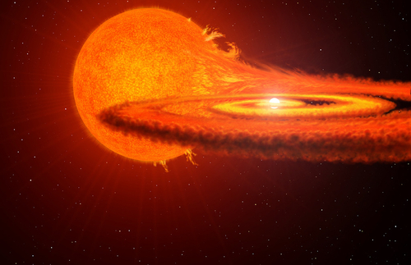

Slide 35
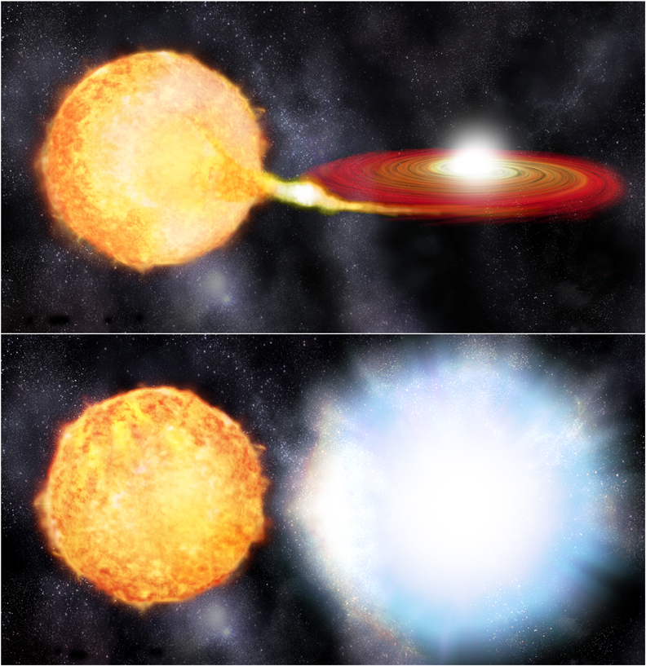

Slide 36
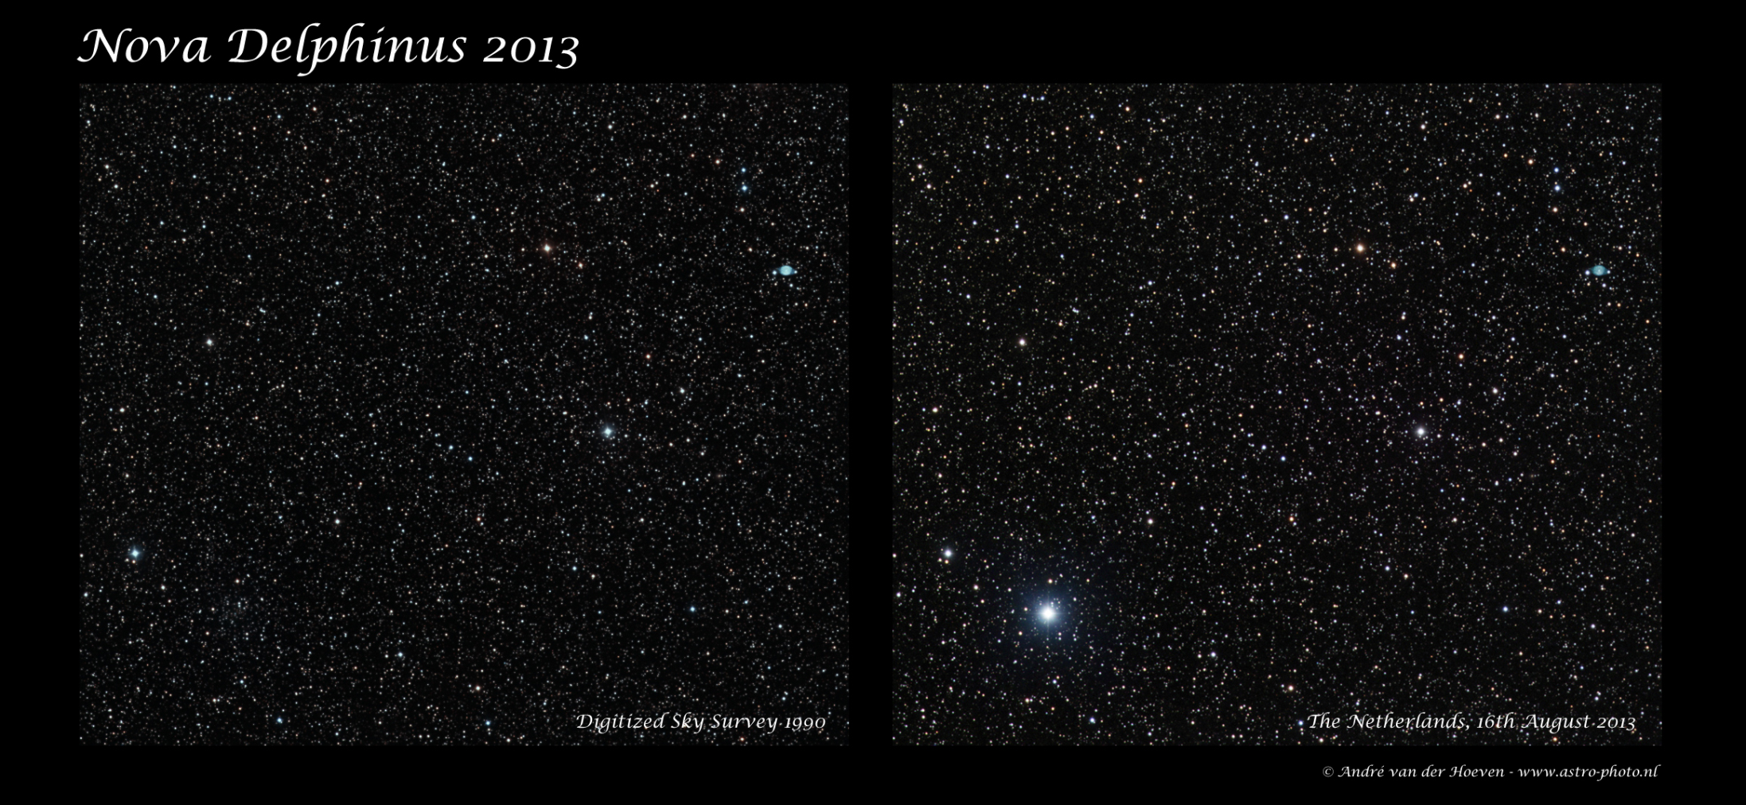

Slide 38
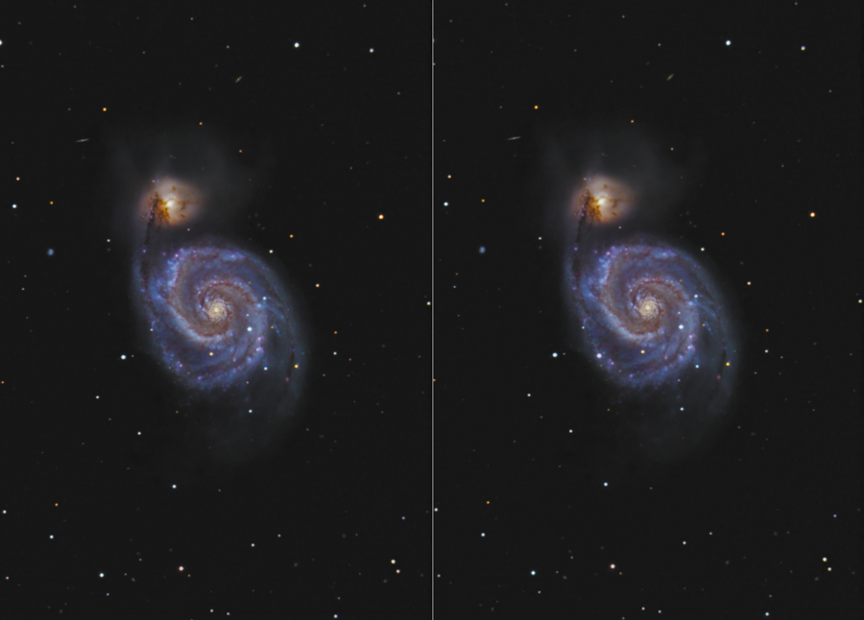

Slide 39
