Slide 1
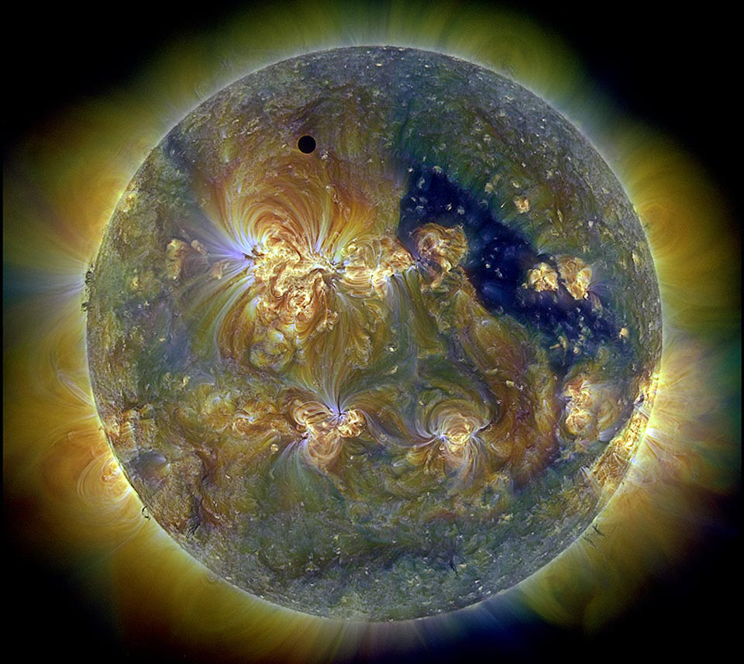
Fingerprints in Sunlight Understanding Spectroscopy

Slide 2
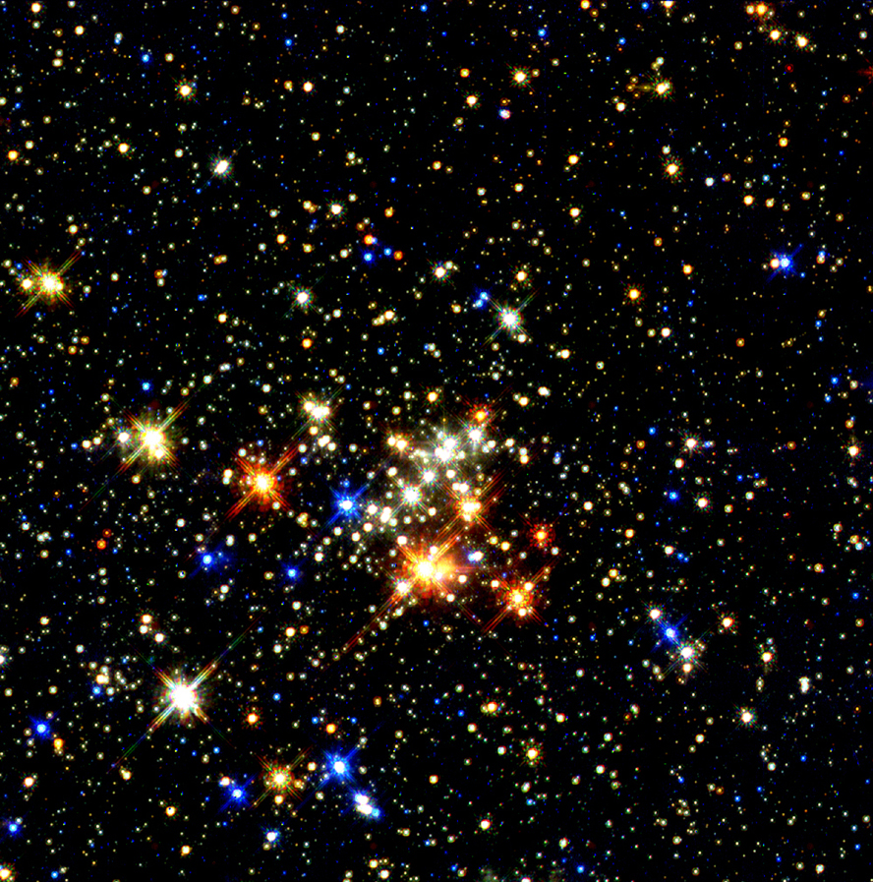
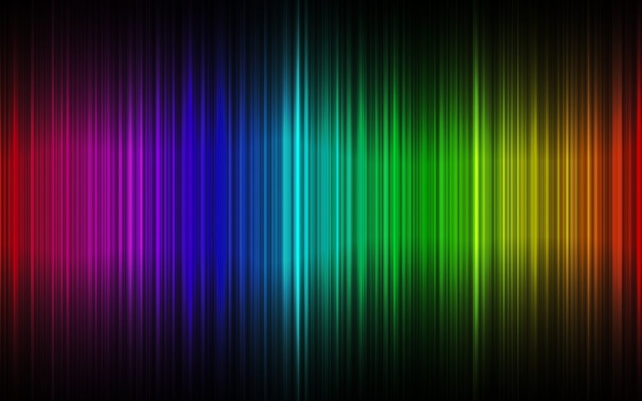
What is light?
Notes:
Light is energy. We perceive visible light as white, but see its colors when it is broken up in a rainbow. Some colors are invisible. The “color” of light depends upon its amount of energy.

Slide 3
Light is a form of energy, the electromagnetic spectrum.
Notes:
Light is part of the electromagnetic spectrum -- and the light humans see is only a very small part of that. This spectrum encompasses all forms of radiation – energy that moves through space. The term “visible light” refers to the part of the spectrum we can see.
The reason astronomers study light with different wavelengths and energies is because this technique illuminates the universe in ways that would otherwise remain hidden. We cannot “see” radio waves, but we can detect and learn from them. The more light that astronomers can “see”, the better we can understand the cosmos.

Slide 4
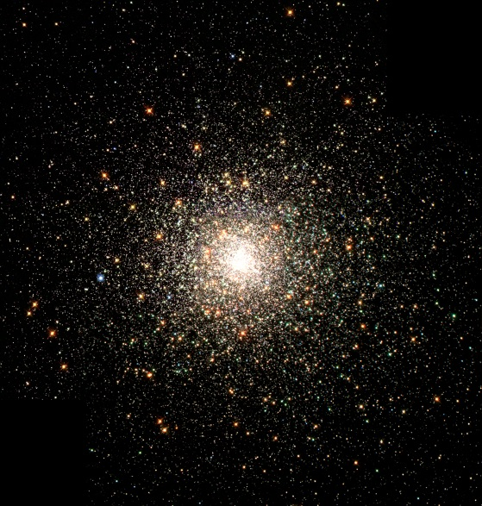
How can we can study the stars?
No matter how good your telescope, a star is only a point of light
We can’t get there from here
Only/primary way of learning about distant objects is through their light (electromagnetic spectrum)
Light has ‘fingerprints” which provide information about it
How can we “read” these fingerprints and what do they tell us about the star?

Slide 5
What is the spectrum of light?
Anything hotter than absolute zero
radiates/emits energy, i.e. light
Sun & stars emit a continuous spectrum (meaning all the colors of visible light). They also emit radio, microwaves, infrared light, ultraviolet light, X-rays, and/or gamma rays
Our eyes see “white” light, which is made of the spectrum of colors visible in a rainbow
Spectrum = the “colors” of light emitted by an object
Notes:
Image from http://climate.met.psu.edu/www_prod/data/frost/frosttraining.php

Slide 6
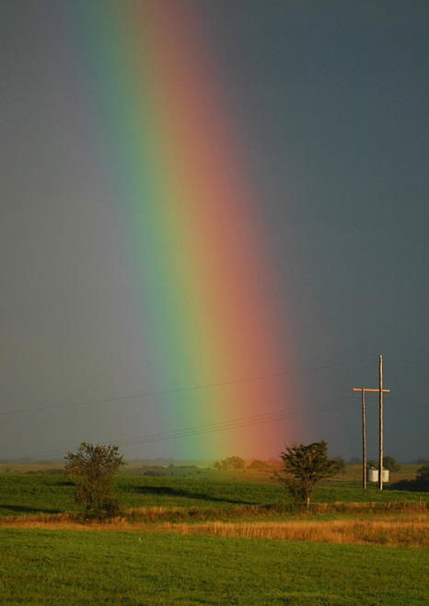
What is a spectrograph?
A relatively simple-to-understand scientific instrument to look at a spectrum
Like a prism – breaks light into its colors
Thin, rectangular slit produces a rectangle of light
Example output from a spectrograph

Slide 7
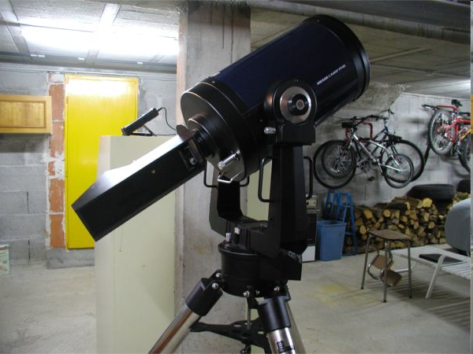
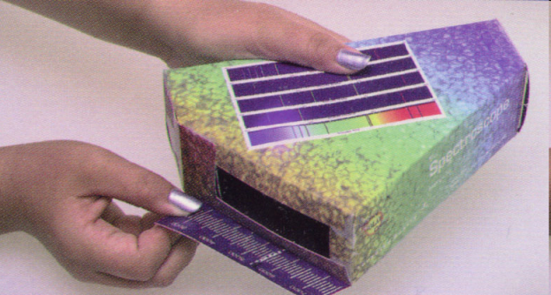
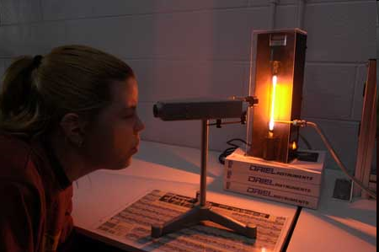
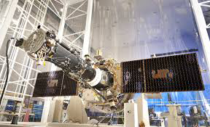
Most astronomy is done with spectrographs!
Stanford Solar Center punch-out spectrograph
Home-made spectrograph attached to telescope
Student spectrograph & gas lamp
NASA‘s Solar Dynamics Observatory (SDO)
NASA’s IRIS mission
Notes:
Home-made spectroscope attached to telescope: http://www.astrosurf.com/aras/dearden/SGSpectro1.htm

Slide 8
Our Simple Spectrograph
Diffraction grating
(similar effect to prism
or CD)
Slit & light source
Scale (optional)
Eye or instrument
for viewing
Notes:
Have teachers experiment with their spectrographs by locating the key parts, then observing various light sources such as reflected sunlight, incandescent bulbs, fluorescent bulbs, whatever is available.

Slide 9
What can we learn with a spectrograph?
Sometimes there are extra bright colors
Sometimes there are missing colors
To ultraviolet
To infrared

Slide 10
Fingerprints in Light
The extra or missing colors indicate certain chemical elements (e.g. hydrogen, helium, gold, etc.) have affected the light
Each chemical element changes the spectrum either by making certain colors brighter or removing certain colors
Each chemical element has a different and unique pattern of colors, hence the “fingerprints”

Slide 11
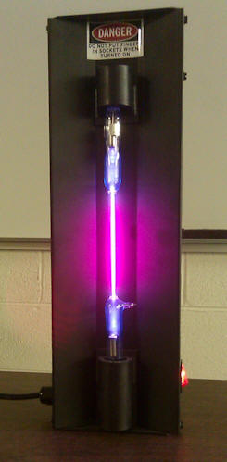
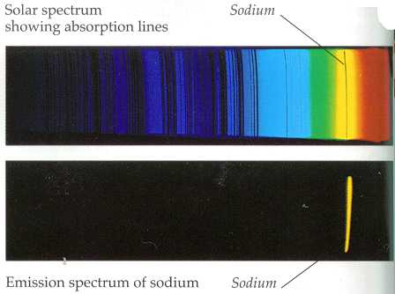
Example fingerprints
Hydrogen
Helium
Sodium

Slide 12
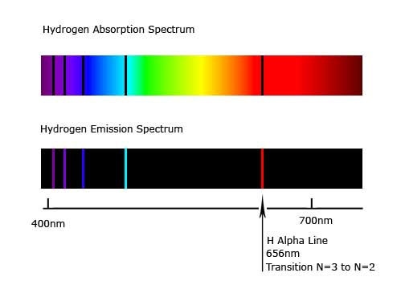
Absorption vs. Emission?
Absorption lines – appear dark and are produced when a chemical element has absorbed energy
Emission lines – appear extra bright and are produced when a chemical element has emitted energy
Whether something produces an absorption or emission spectrum depends upon its temperature, the temperature of any gas between it and the observer, and the observer’s line of site.

Slide 13
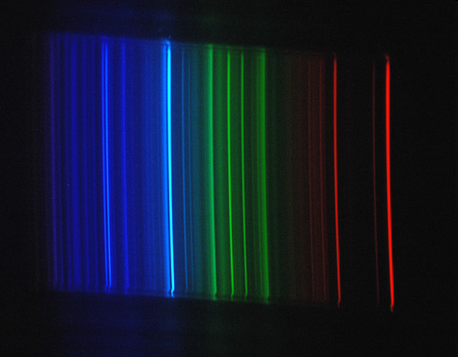
Some Elements on the Sun
Hydrogen (H)
Helium (He)
Sodium (Na)
Oxygen (O₂₎
Iron (Fe)
Notes:
The Fraunhofer C, F, G', and h lines correspond to the alpha, beta, gamma and delta lines of the Balmer series of emission lines of the hydrogen atom. The D1 and D2 lines form the well-known "sodium doublet", the centre wavelength of which (589.29 nm) is given the designation letter "D".
Note that there is disagreement in the literature for some line designations; e.g., the Fraunhofer d-line may refer to the cyan iron line at 466.814 nm, or alternatively to the yellow helium line (also labeled D3) at 587.5618 nm. Similarly, there is ambiguity with reference to the e-line, since it can refer to the spectral lines of both iron (Fe) and mercury (Hg). In order to resolve ambiguities that arise in usage, ambiguous Fraunhofer line designations are preceded by the element with which they are associated (e.g., Mercury e-line and Helium d-line).

Slide 14
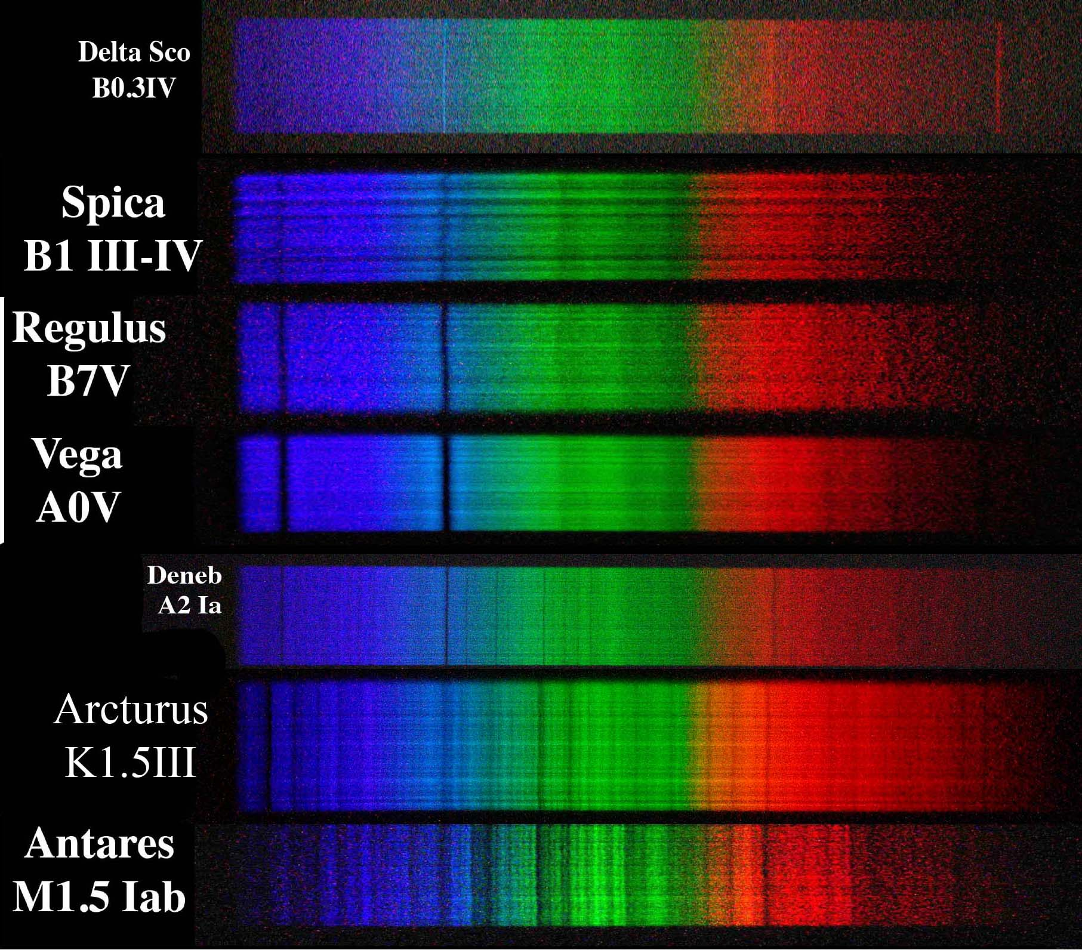
Different types of stars have different spectra

Slide 15
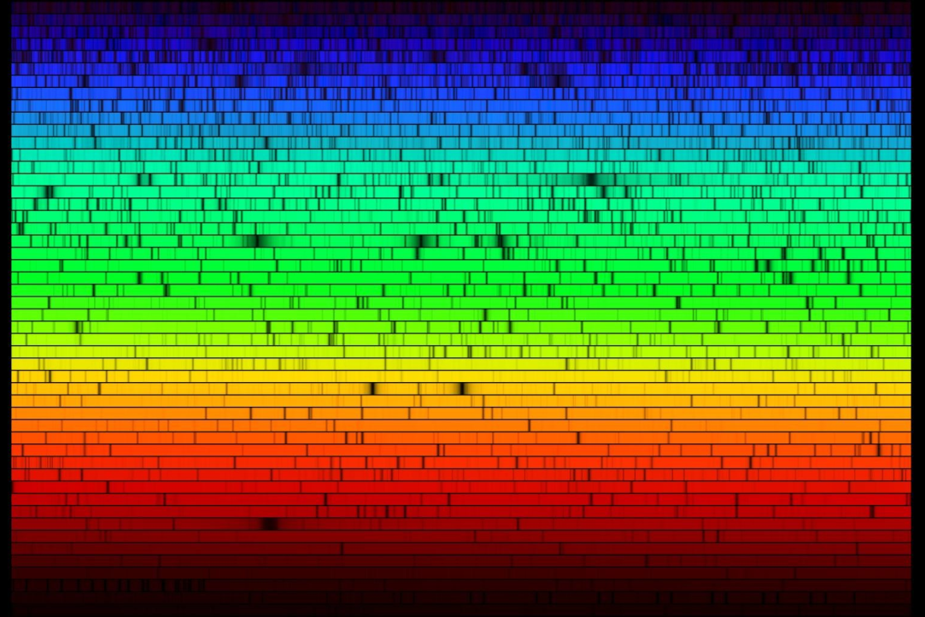
What secrets do spectra tell us?
Chemical Composition
Temperature
Movement
Magnetic fields

Slide 16
Spectra tell us about composition
Am emission or absorption line means a specific chemical element has been involved with the light you are seeing
Careful, though. The element could be from the source, or from an intervening plasma or gas cloud
16

Slide 17
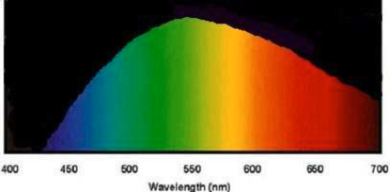
Spectra tell us temperatures
If you look at the strongest colors or wavelength of light emitted by a star, then you can calculate its temperature
Specific spectral lines are only produced at certain temperatures, so if you see them you know what temperature you are looking at
17

