Slide 1
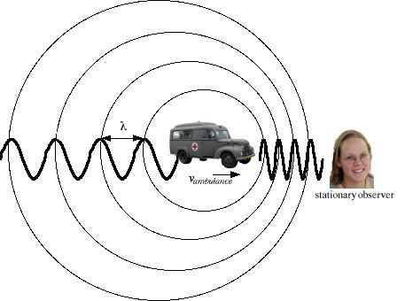
How do spectra tell us about movement?
A Doppler shift happens when an object is moving towards or away from us, as in a siren coming towards us
Wavelength is influenced by the movement
It works with sound, with light, with any wave

Slide 2
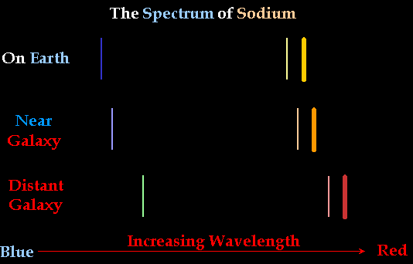
Doppler, continued
Motion away from us results in a “red shift”
Motion towards us results in a “blue shift
Why don’t they call it a violet shift?
Notes:
We are not sure why scientists don’t call it a violet shift. Perhaps it is because human eyes do not see violet very well. Scientists usually refer to the visible light spectrum as red, yellow, green, and blue.

Slide 3
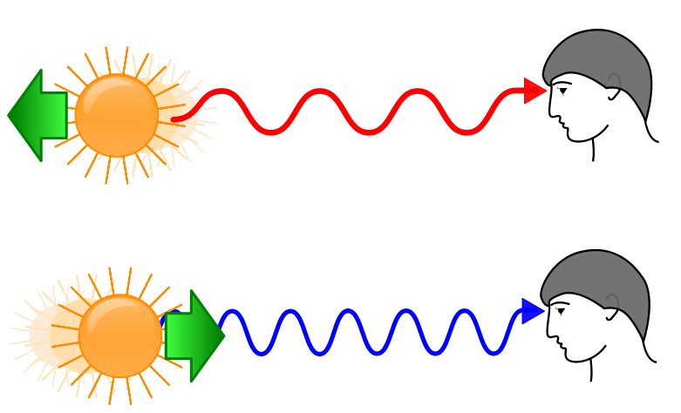

Slide 4
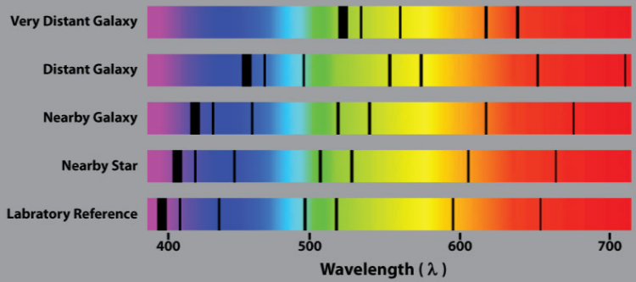

Slide 5
Expanding Universe
The farther away a Galaxy is, the more its light is red shifted.
The faster it is moving away from us.

Slide 6
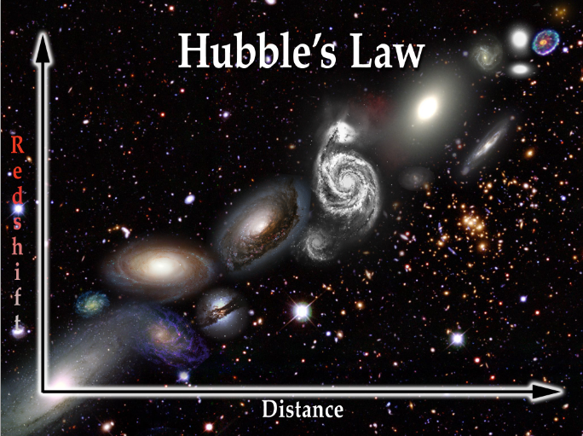

Slide 7
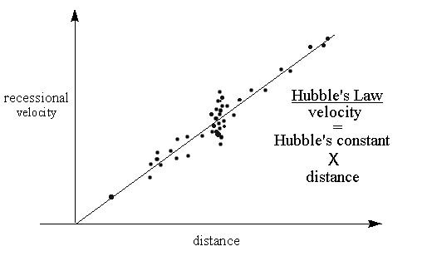

Slide 8
Hubble’s Law
v = velocity in km/s
H_{o} = Hubble’s constant (68 km/s /MPc)
d = Distance in Megaparsec (1 MPc = 1,000,000 Pc = 3,262,000 Light Years

Slide 9
Example
How fast would a galaxy that is 100 MPc be moving away from us?
A galaxy has a measured recessional velocity of 100 km/s. How far away is it?

Slide 10
Size of the Universe
The cosmic horizon is the boundary of what we can see. Objects this far away will be receding at the speed of light. If the speed of light is 300,000 km/s, use Hubble’s Law to approximate the radius of the universe.

Slide 11
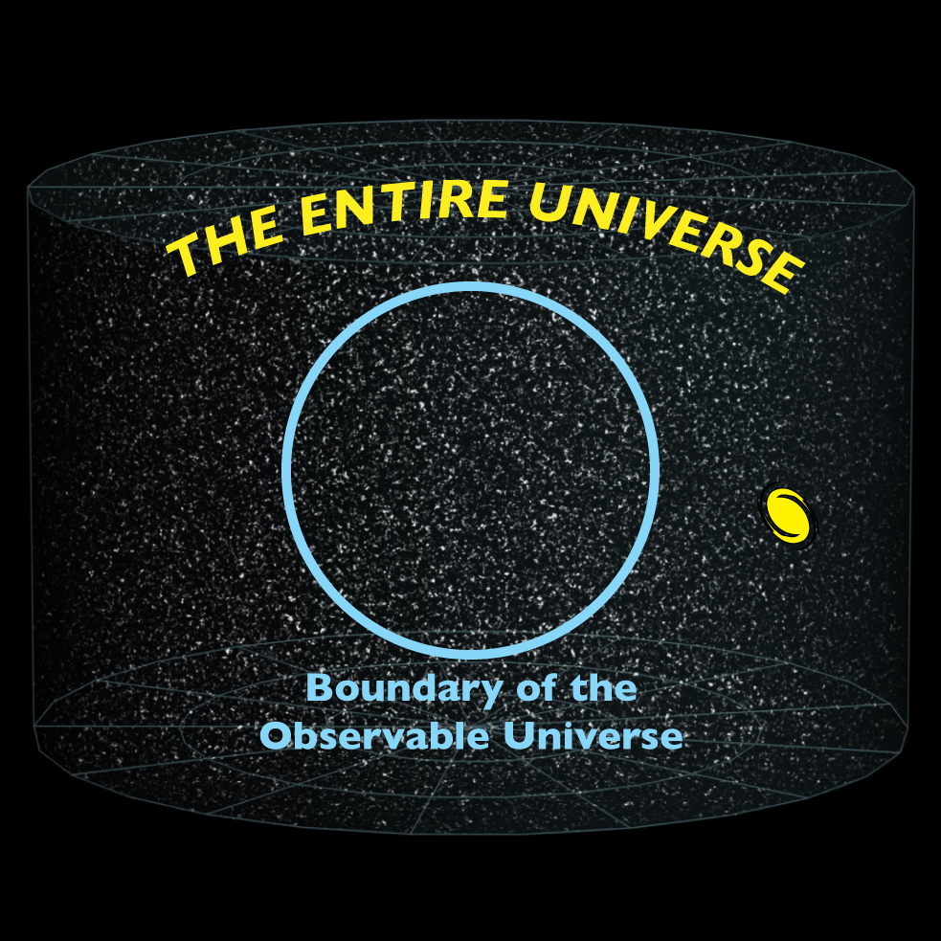

Slide 12
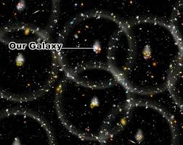

Slide 13
