Slide 2
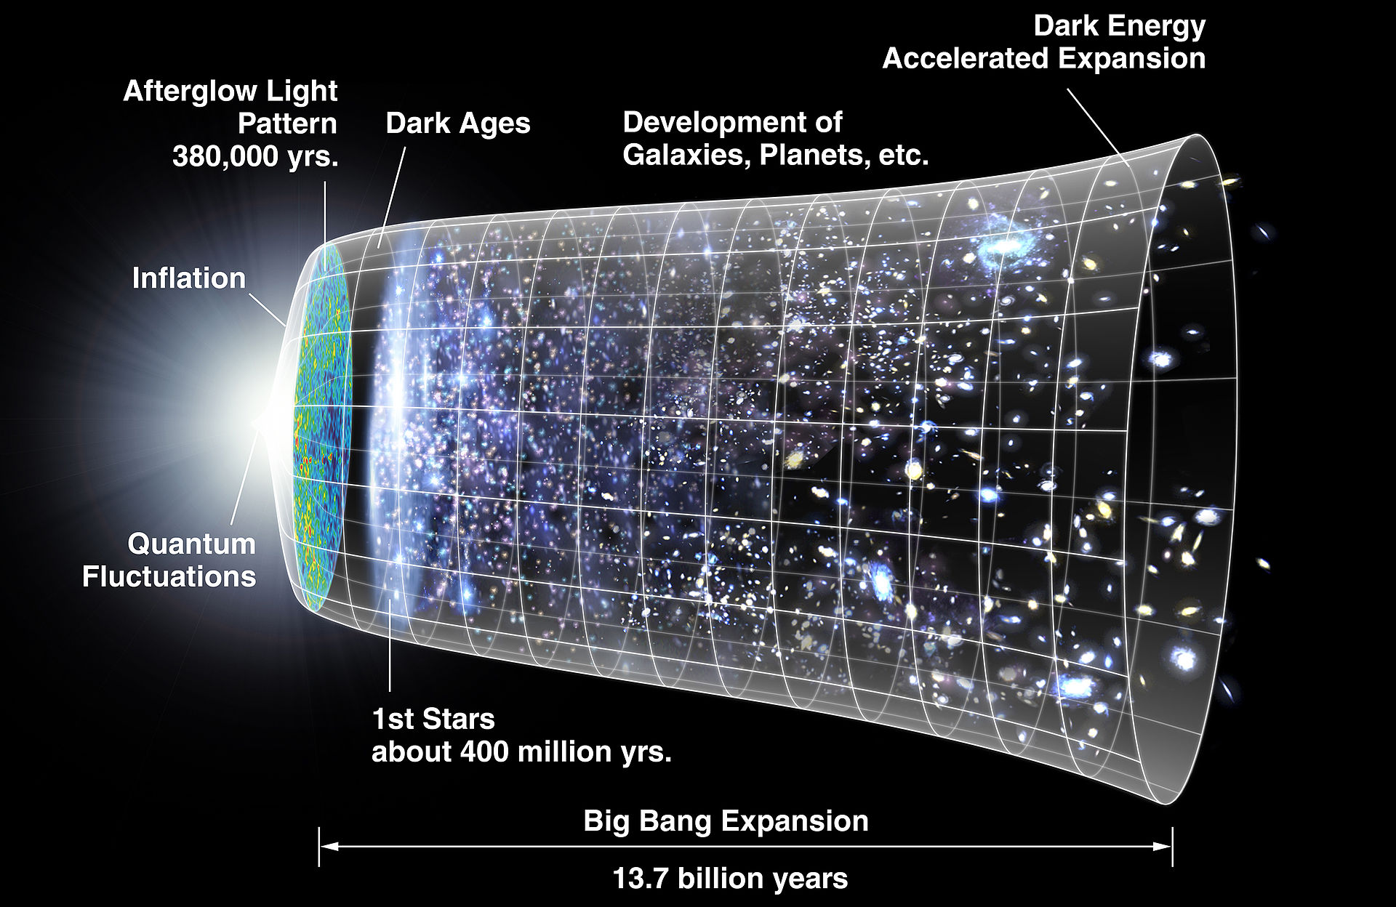
The universe began in a cataclysmic explosion about 13.6 billion years ago.

Slide 3
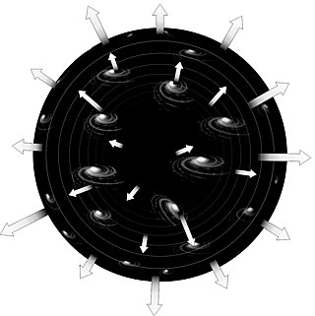
How do we know this?
Galaxies are all moving apart. Earlier in time they must have been closer together.

Slide 6
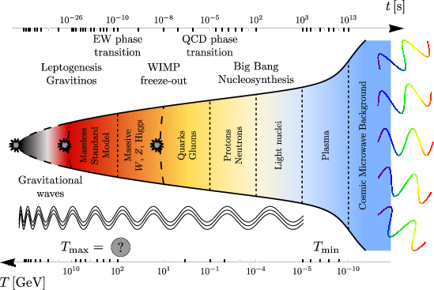
Thermal Expansion of Universe
The universe is cooling
The current temperature is -270.3 ºC

Slide 7
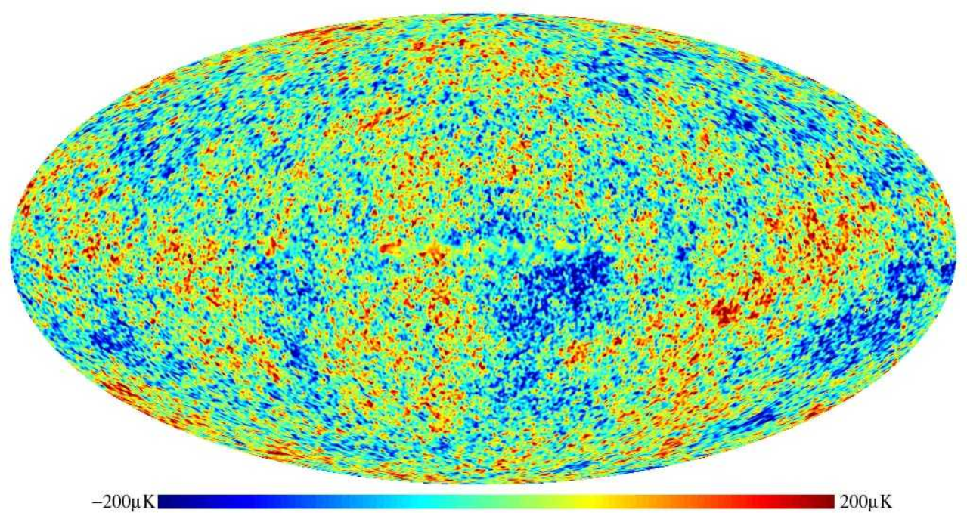
Cosmic Microwave Background Radiation

Slide 8
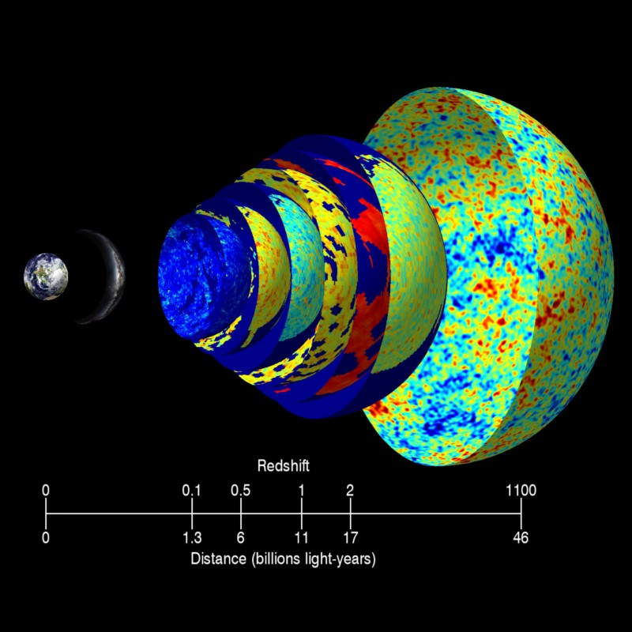

Slide 9
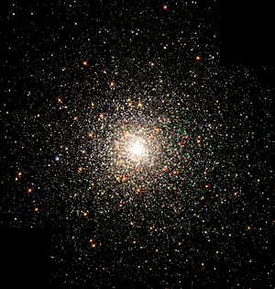
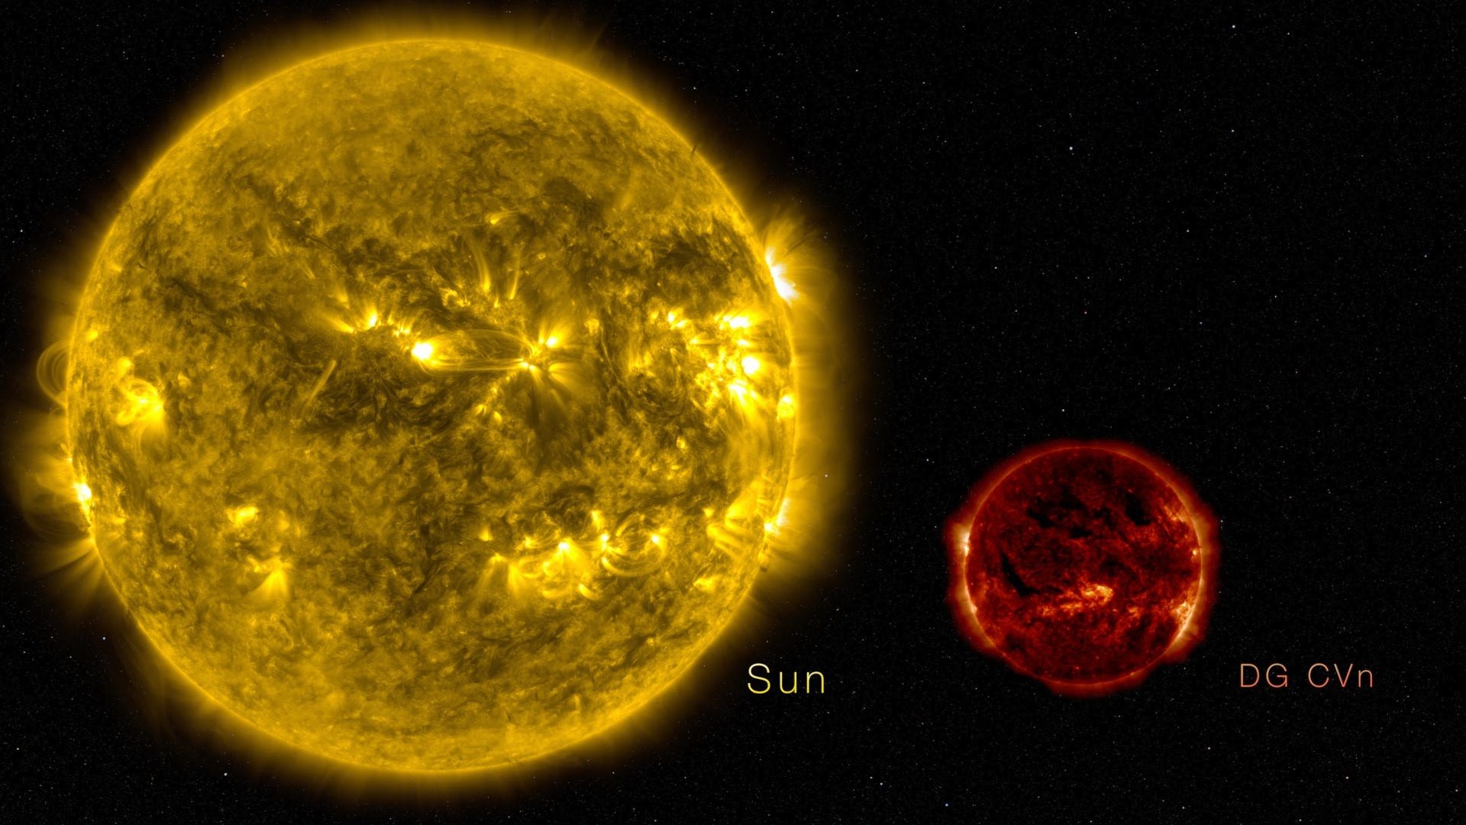
Oldest Stars
Globular Clusters contain some of the oldest stars in the universe
None are older than 13.3 billion years old.

Slide 10
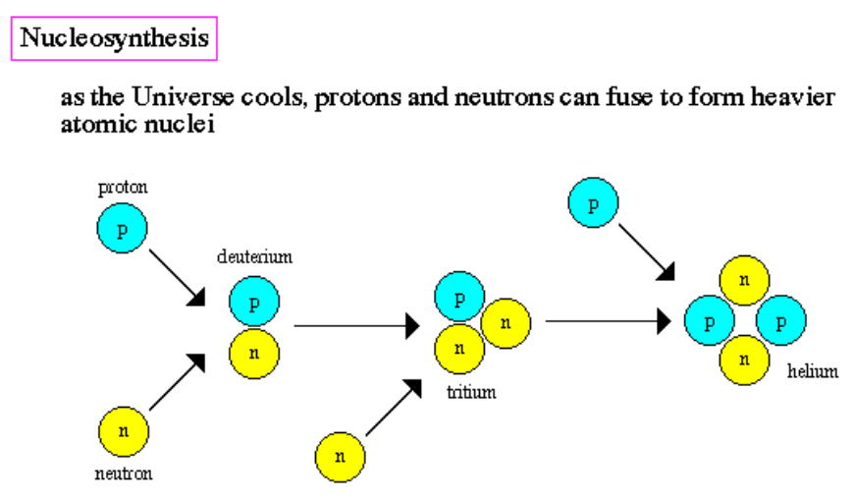
Primordial Elements
The Big Bang Theory predicts that the abundance of elements in the universe will be approximately 74% Hydrogen, 25% Helium with all other elements making up less than 1%
In perfect agreement with what we see.

Slide 11
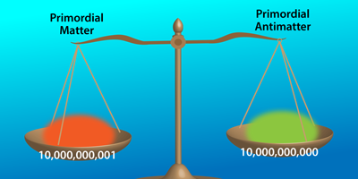
Problems with the Big Bang
Where is the antimatter?

Slide 12
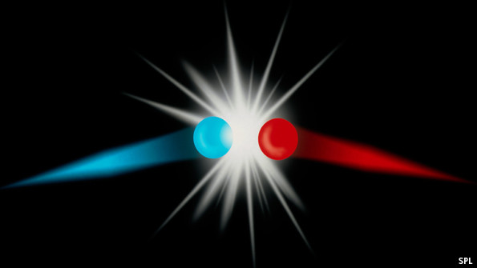

Slide 13
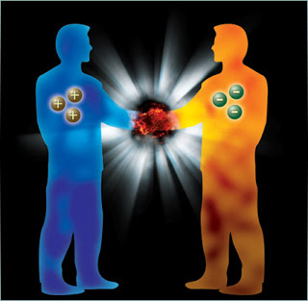

Slide 14
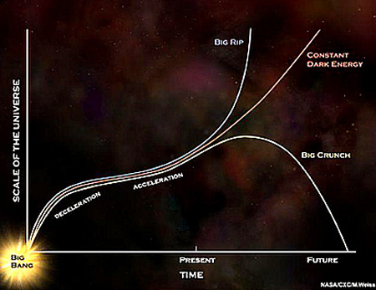
Will the universe continue expanding?

Slide 15
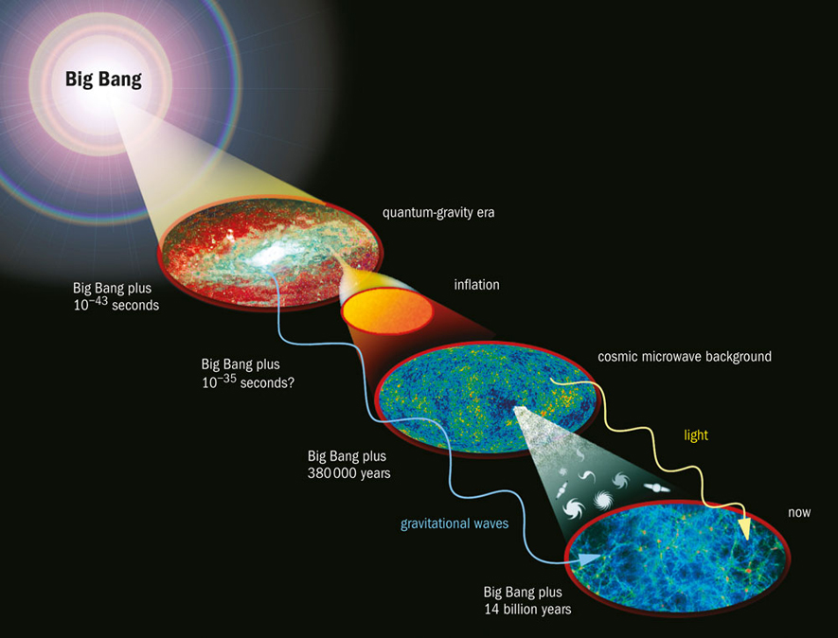
What was there ‘before’ the Big Bang?

Slide 16
Ultimate fate of the Universe
Big Crunch
Gravity pulls the universe back into a single point
Big Freeze
Universe expands and gradually cools
Big Rip
Expansion of the universe continues to accelerate until everything is ripped apart.

Slide 17
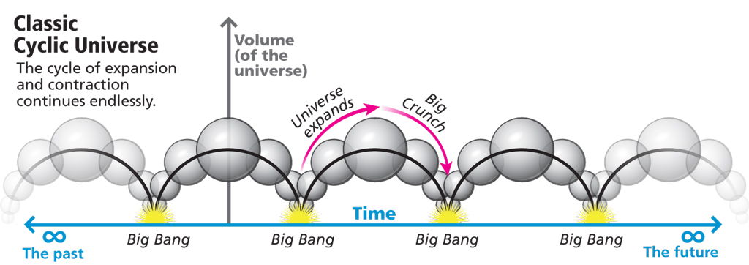

Slide 18
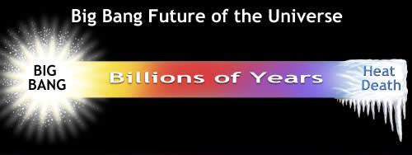

Slide 19
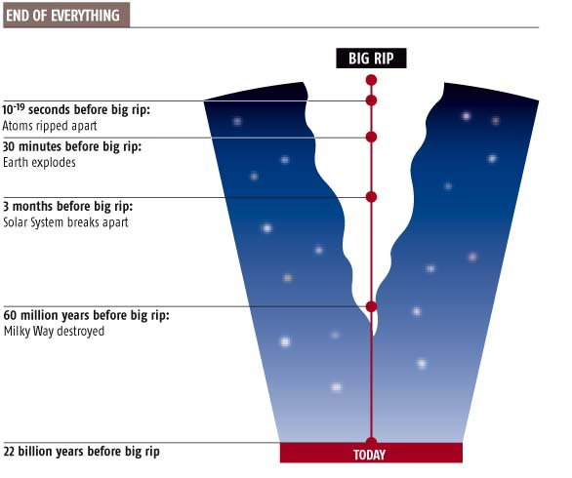

Slide 20
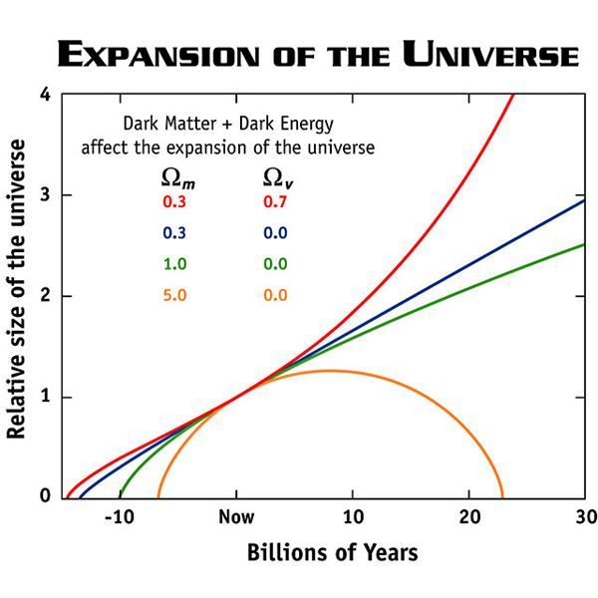

Slide 21
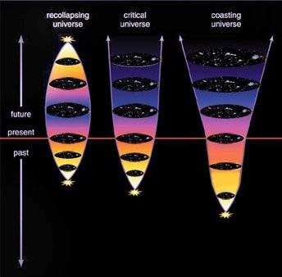

Slide 22
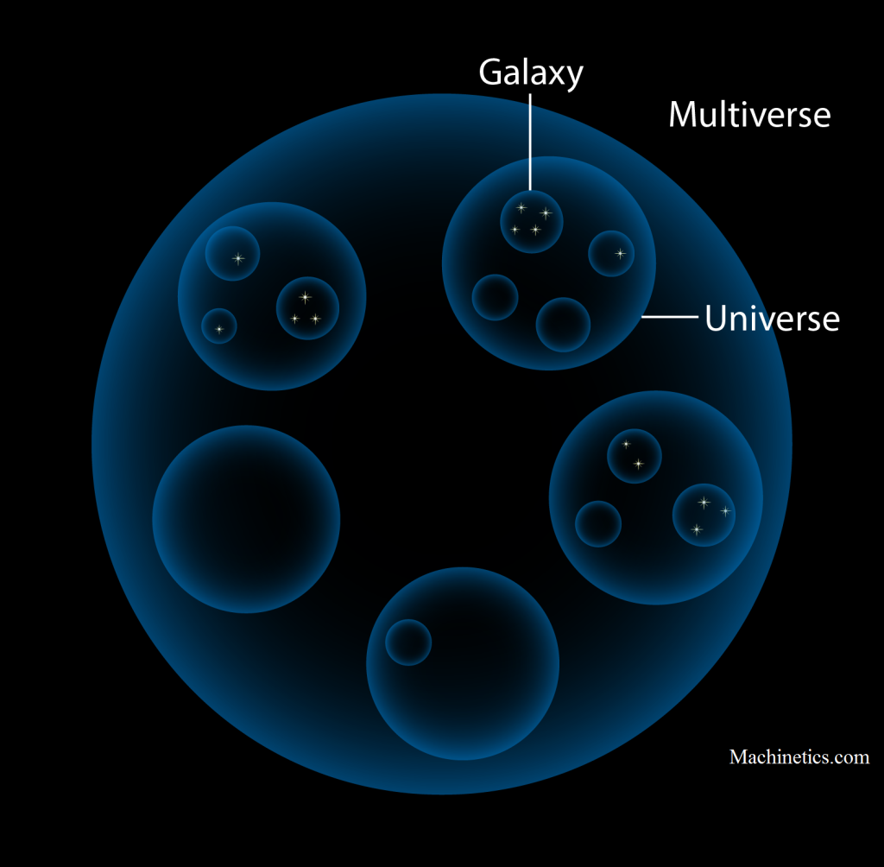
Multiverse

Slide 23
Summarize the evidence for the Big Bang Theory.
What is meant by an open universe? A closed universe? Does current evidence support an open or closed universe?

