Slide 1
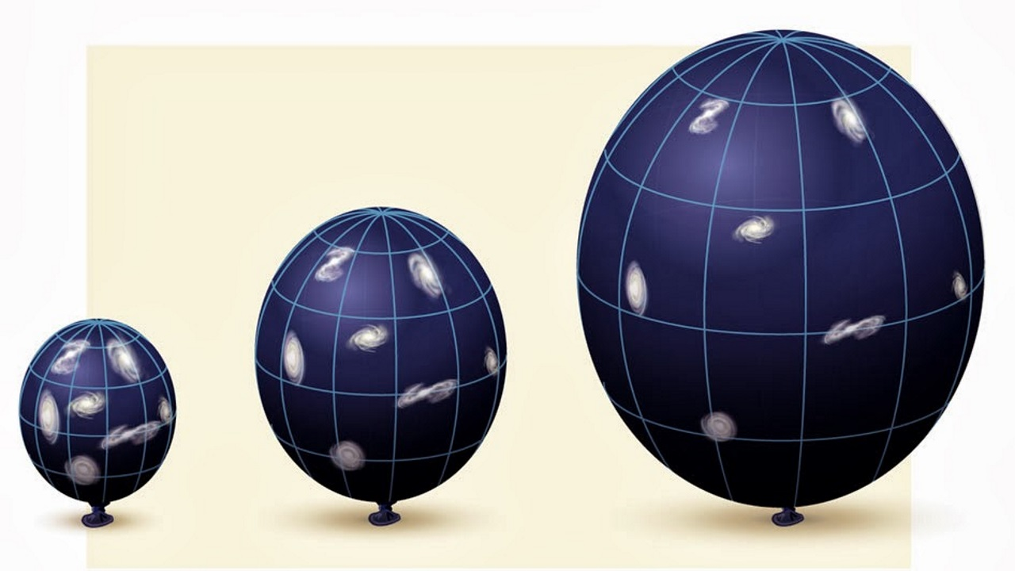
Distances to Galaxies

Slide 2
How can the distance to far away galaxies be determined?

Slide 3
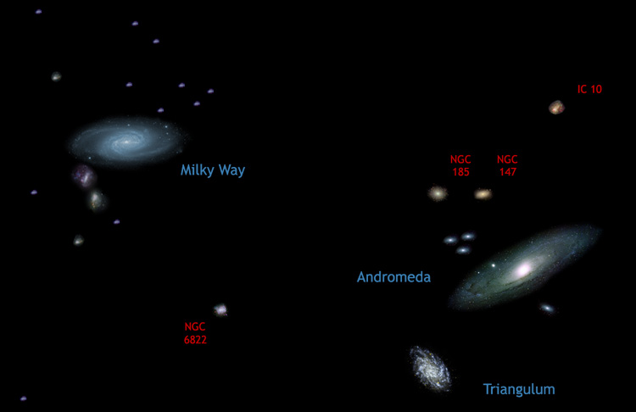
What about galaxies closer to the Milky Way?
Galaxies in the local group don’t follow Hubble’s Law

Slide 4
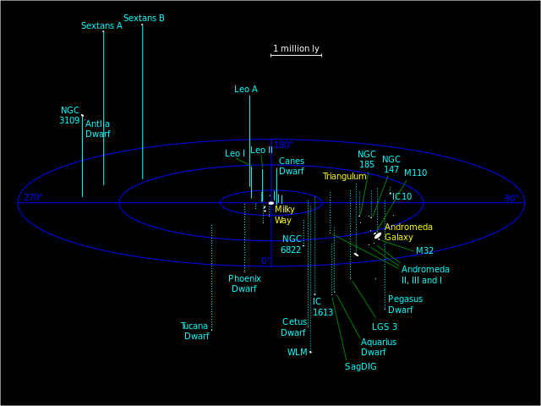

Slide 5
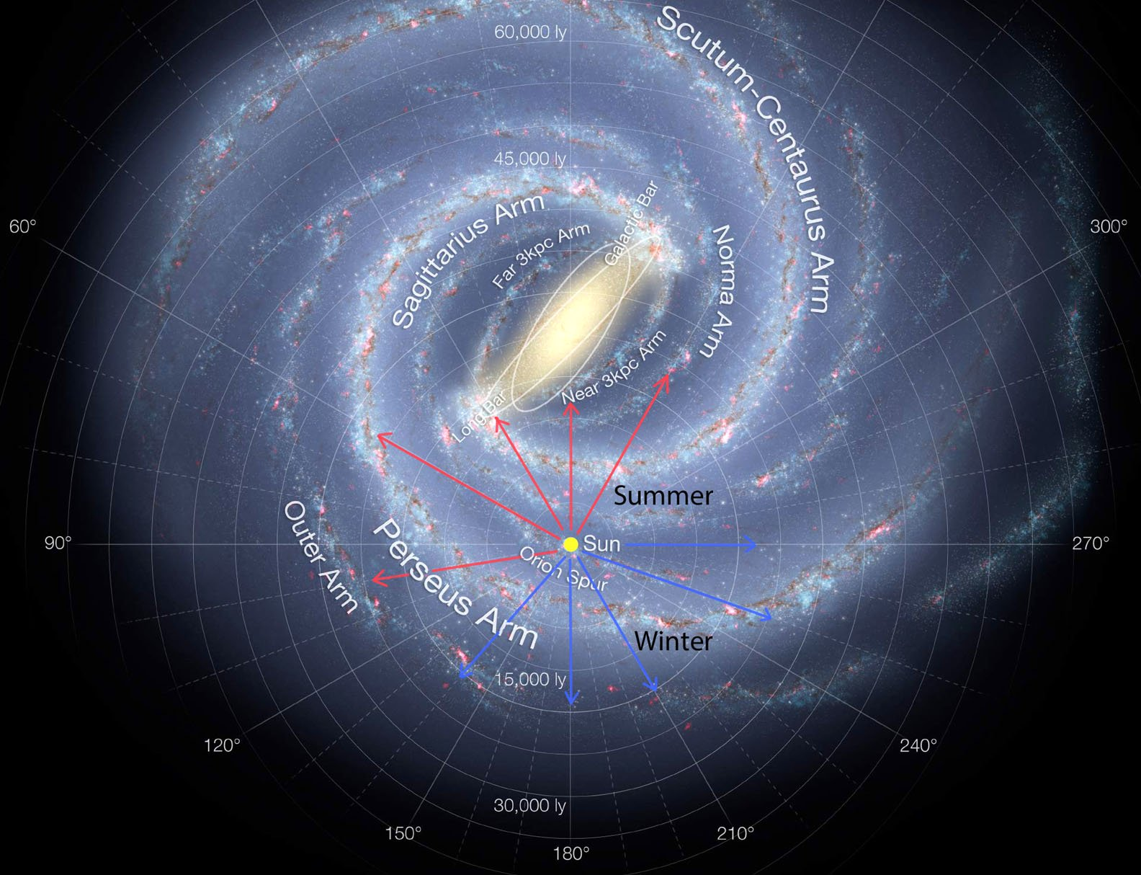
What about a star in our own galaxy that is 15000 light years away?
At this distance the parallax angle would be 0.00022”

Slide 6
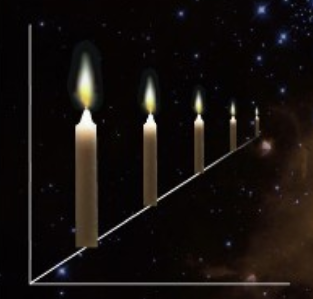
Standard Candles
If the star (or galaxy) has the same strength of light, the distance can be determined from its apparent brightness.

Slide 7
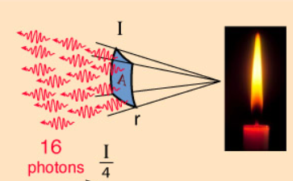
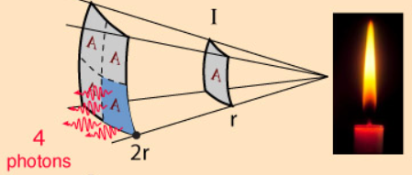
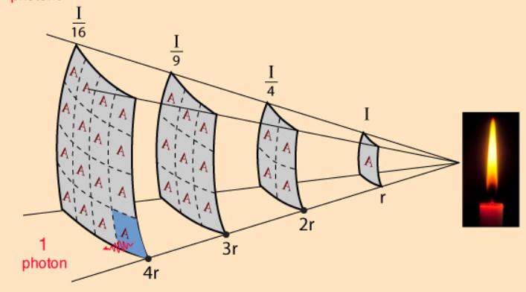

Slide 8
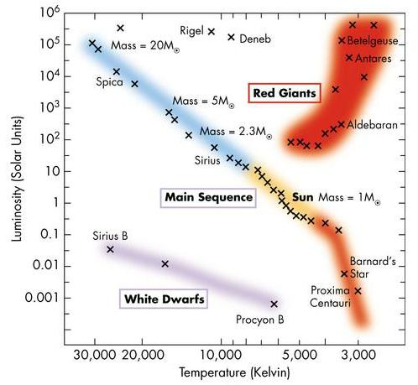
Main Sequence Fitting
Stars with similar colour and spectra will have similar brightness.
Main sequence stars with the same colour as the sun will have approximately the same intrinsic brightness.
Can be easily identified within our galaxy or neighboring galaxies. (100,000 Pc)

Slide 9
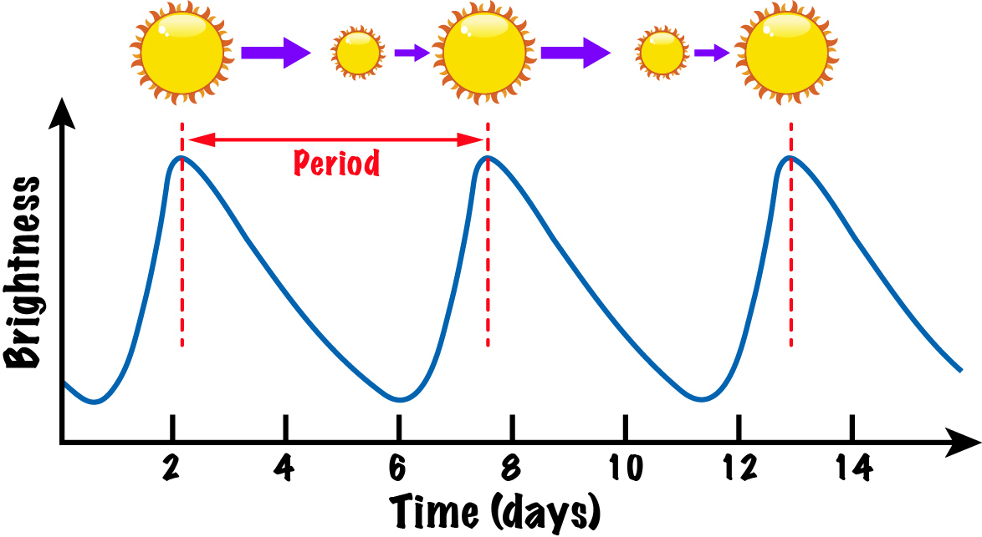
Cepheid Variables
These are pulsating stars
The period of pulsation is directly related to their brightness.
Observing the period of pulsation tells us how intrinsically bright it is.

Slide 10
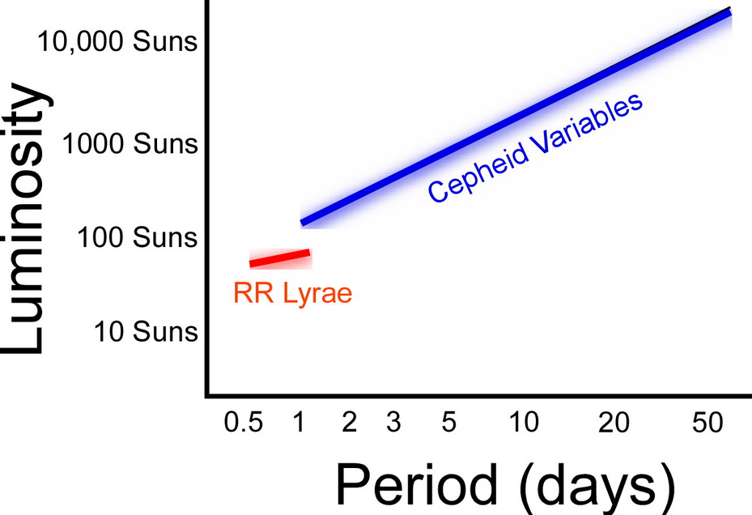

Slide 11
Can be seen in galaxies further away than main sequence stars (~5 MPc)

Slide 12
Type Ia Supernova
A white dwarf has a maximum mass of 1.4 solar masses
If a white dwarf gains mass from a companion star and goes over this limit it explodes as a Type Ia Supernova.
This type of supernova always has the same brightness.
Because Supernovas are so bright they can be seen across the universe (> 100 MPc)

Slide 13
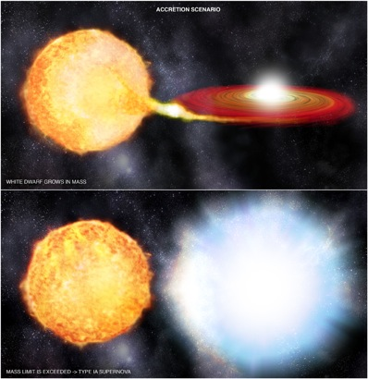

Slide 14
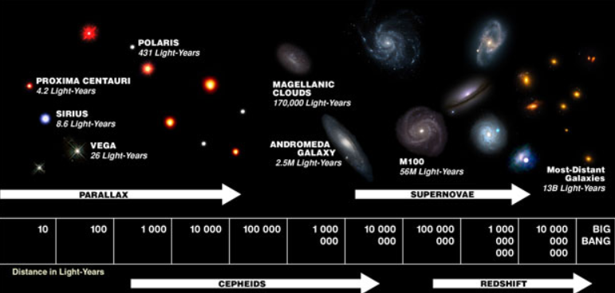

Slide 17
What is the farthest object we can see?
What was the most recent, visible supernova?
How often do type IIa Supernova occur?
What is the difference between a supernova and a hypernova?

