Slide 1
Spectrum, Colours & The Universe

Slide 3
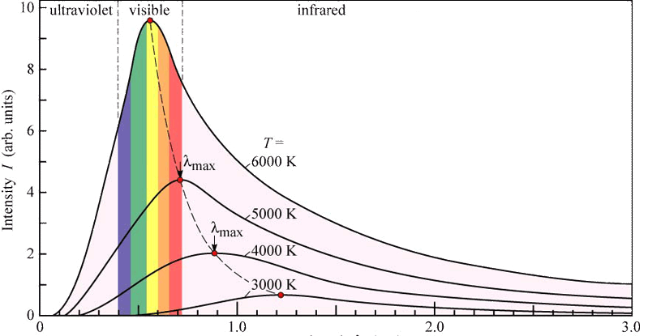
Blackbody Radiation
Anything above absolute zero (ie everything) radiates electromagnetic radiation.

Slide 4
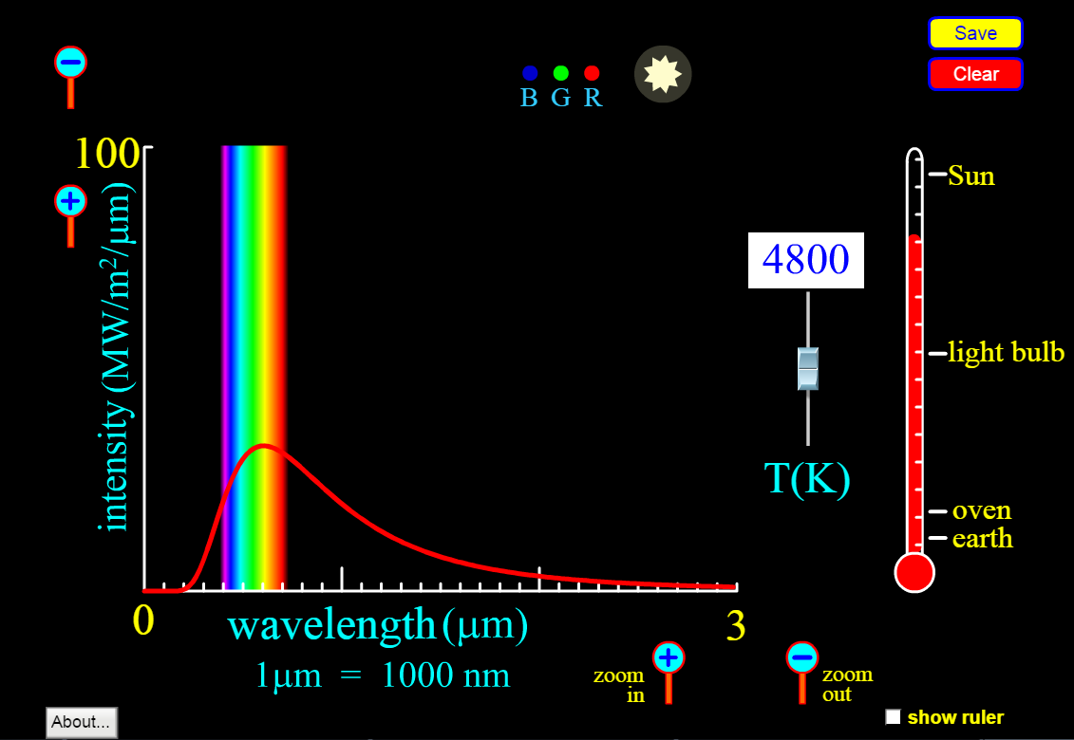

Slide 5
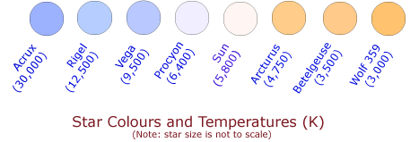

Slide 7
Red hot stars glow cooler than white hot stars
Blue stars don’t emit just blue light. Just mostly blue light.
Hotter stars burn quicker than cooler stars; large O-type stars only last a few million years.
Cooler red dwarf stars can last for trillions of years.

Slide 8
Temperature and fusion
Colour depends on Temperature
Temperature is determined by fusion
Fusion is determined by gravity
Gravity is determined by mass

Slide 9
