Slide 1
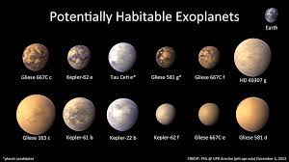
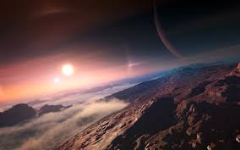
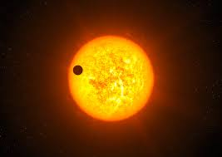
Exoplanets

Slide 2
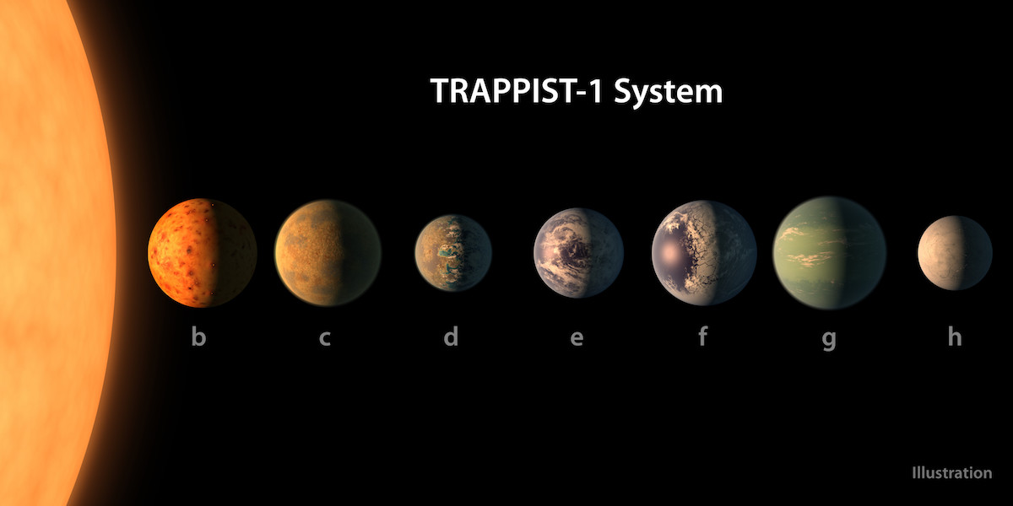
Trappist 1

Slide 3
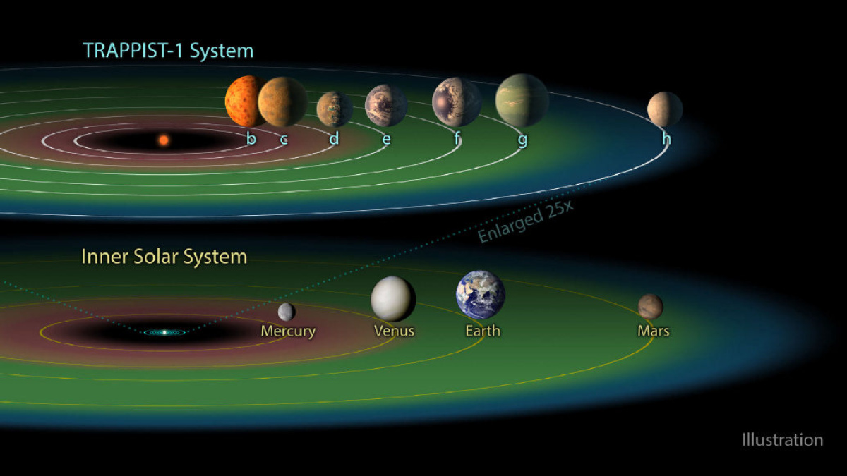

Slide 4
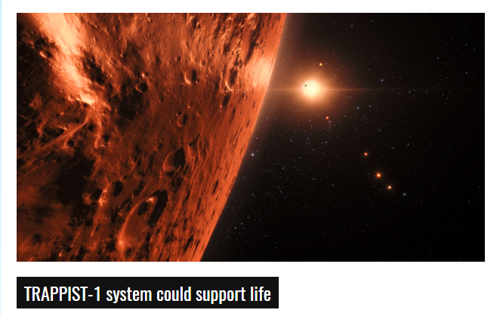

Slide 6
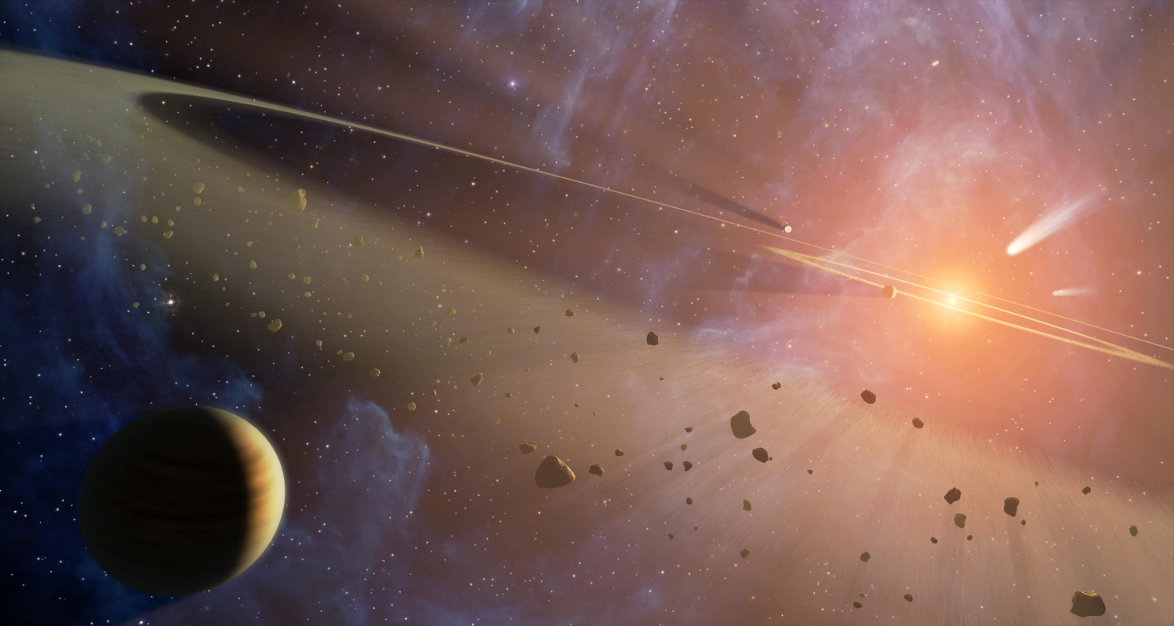
Exoplanets
Over 3500 confirmed exoplanets
Like more than 1 trillion in the Milky Way!

Slide 7
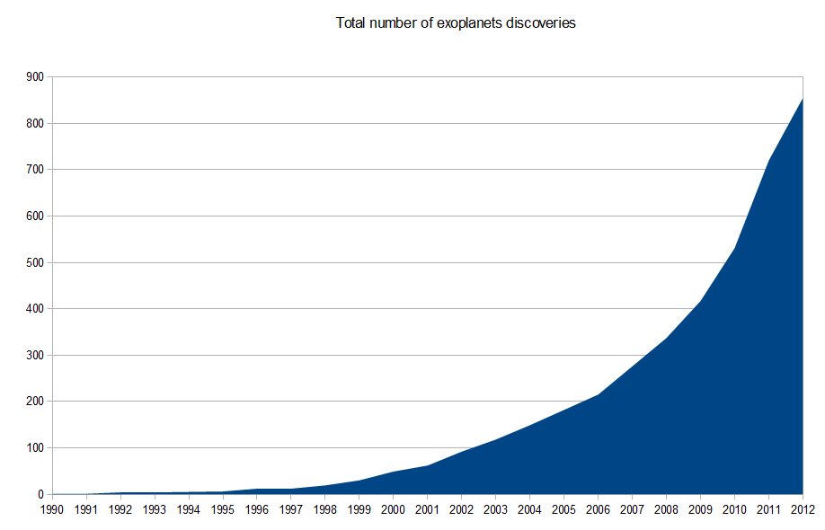

Slide 8
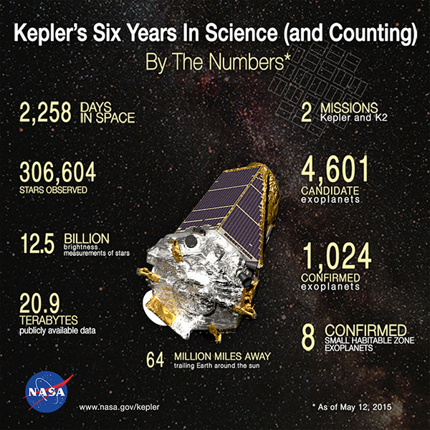

Slide 9
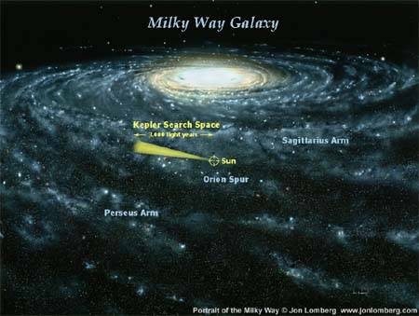

Slide 10
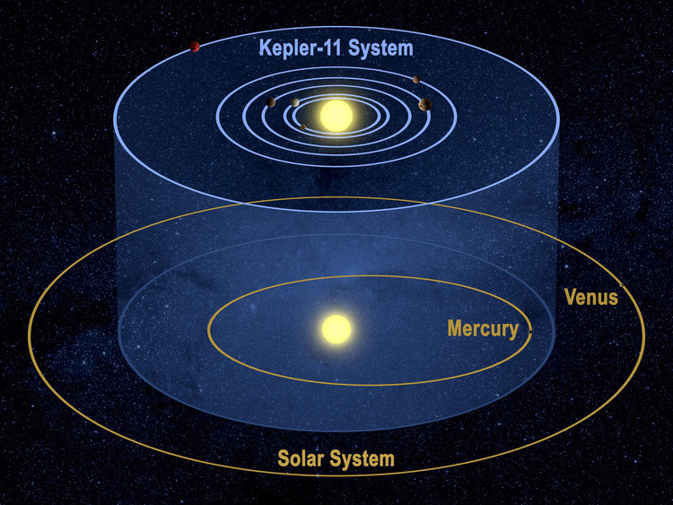

Slide 11
How do we find exoplanets?
Direct Imaging
Gravitational Effects
Transit Photometry

Slide 12
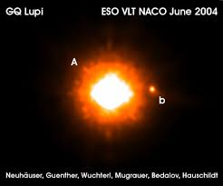
Direct Imaging
Taking a picture of an exoplanet and parent star.
Stars are millions of times brighter than planets.
Exoplanet must be large and relatively far from the star.

Slide 14
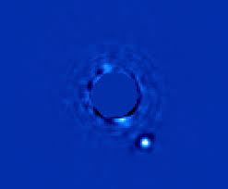

Slide 15
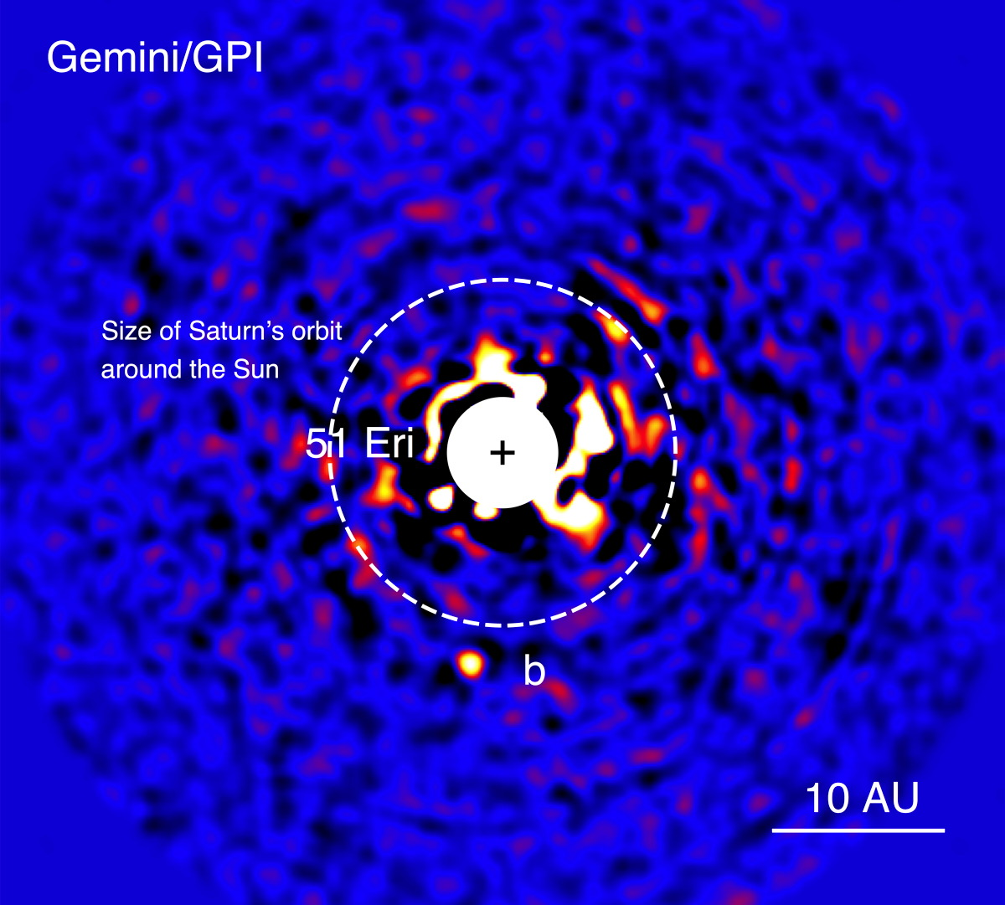

Slide 16
Gravitational Effects
Although much smaller than stars, exoplanets pull on the stars and cause them to move in a (small) circle.
Detecting a star wobbling back and forth may indicate an exoplanet.
Works best with a large planet near the star

Slide 19
Transits
If a exoplanet passes in front of a star it will cause the star to dim slightly.
Typically less than 2% dimming.
Easiest to find large planets close to star.
Like looking for a fly in front of a flood light.

Slide 21
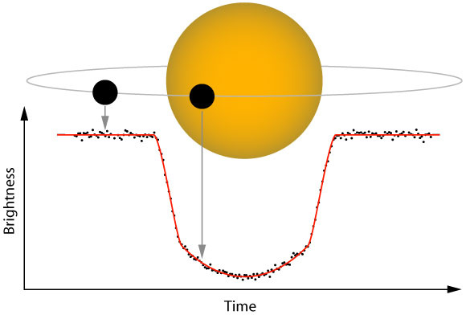

Slide 22
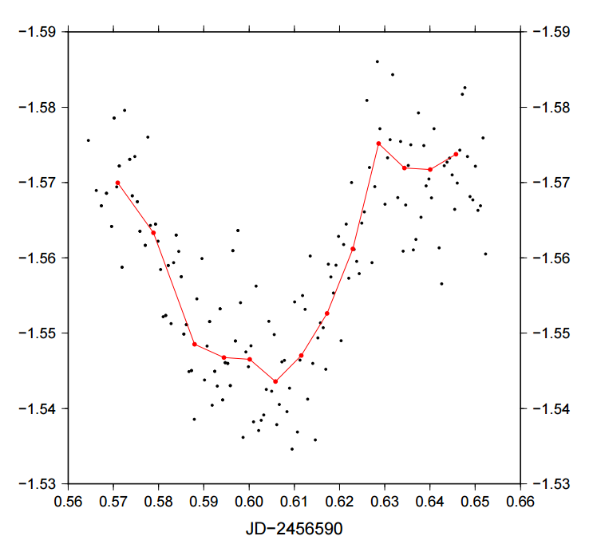

Slide 23
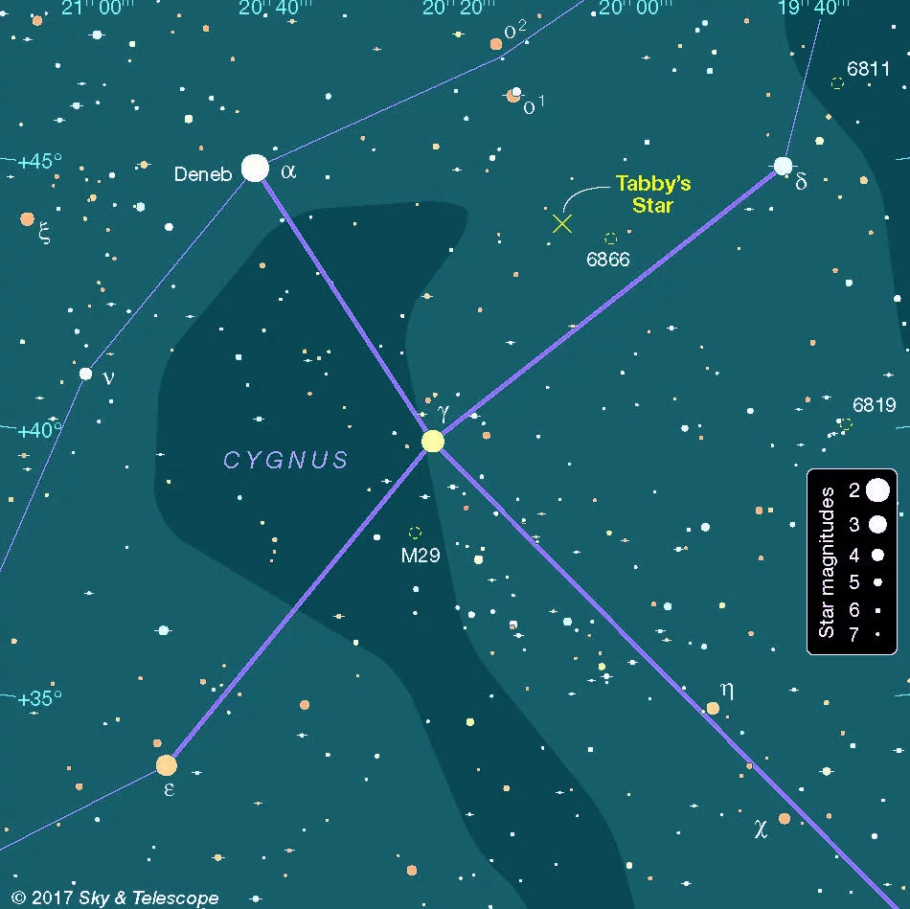
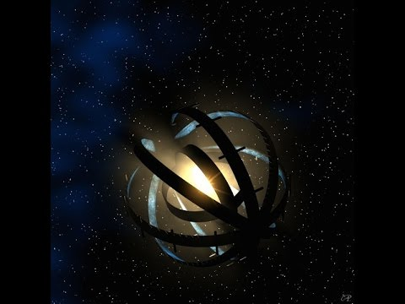
KIC 8462852
(aka Tabby’s Star)

Slide 24
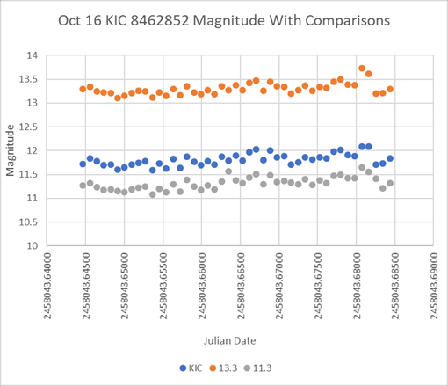

Slide 25
Habitable Exoplanets?
If a planet is not too close or too far from its parent star its in the ”Goldilocks Zone” where liquid water can form.
Must also be similar size to the Earth and made of rock.

Slide 26
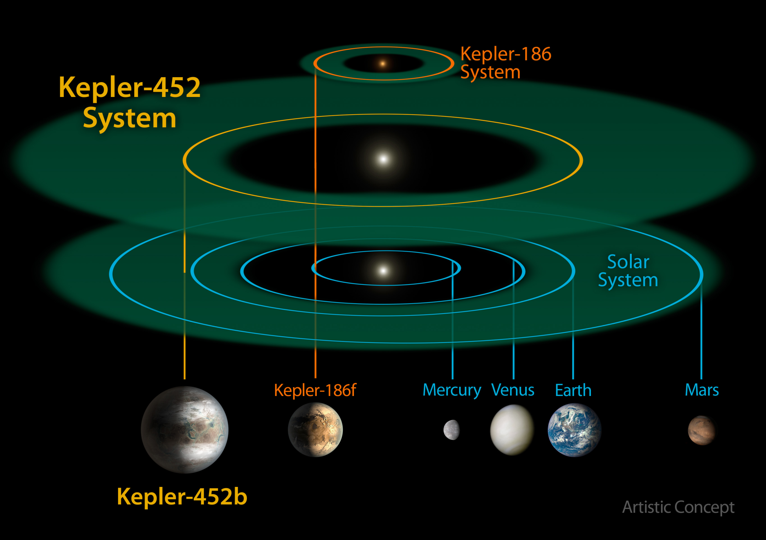

Slide 27
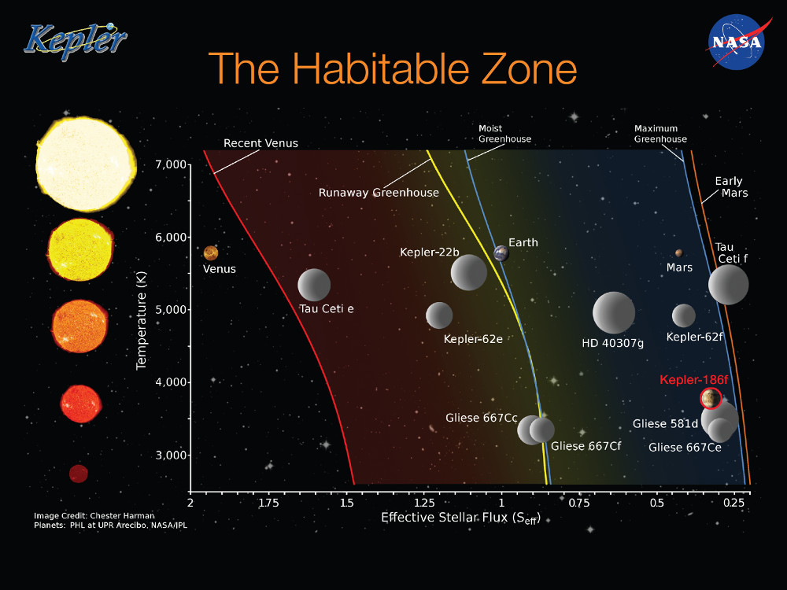

Slide 28
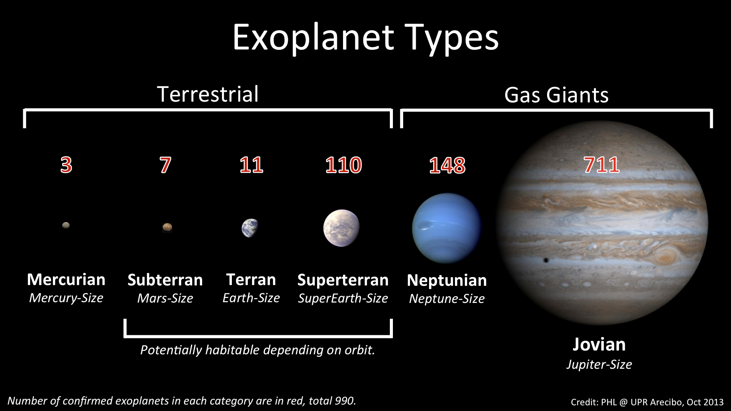

Slide 29
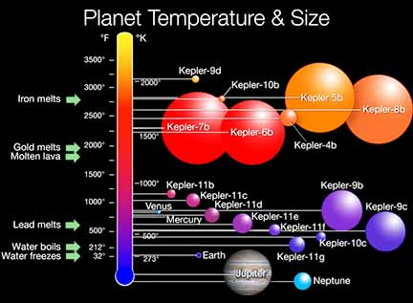

Slide 30
Homework
Discover an Exoplanet using Planethunters.org

