Slide 1
Properties of Telescopes

Slide 2
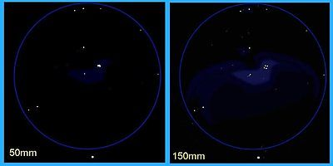
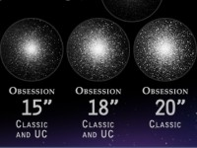
Light Gathering
More light means brighter views
The amount of light collected depends on the area of the objective lens/mirror.
A = πr²

Slide 3
Example
What is the light gathering area of a telescope with a primary lens that has a radius of 3 inches?
How many times brighter will an object appear in a telescope with a primary mirror diameter of 20” vs 10”?

Slide 4
The largest telescope under construction is the 30 m telescope (It will have a radius of 15 m when completed). Compare its light gathering ability with the human eye (pupil radius is 1.5 mm).

Slide 5
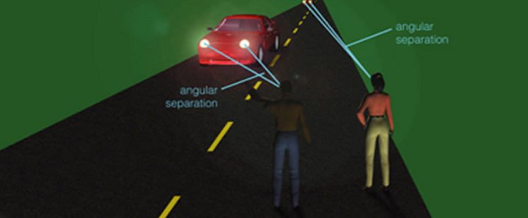
Resolution
Resolution refers to how much fine detail can be seen.
As the telescope diameter increases, the resolution increases.

Slide 6
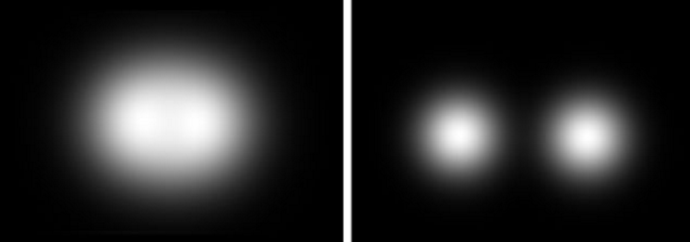

Slide 7
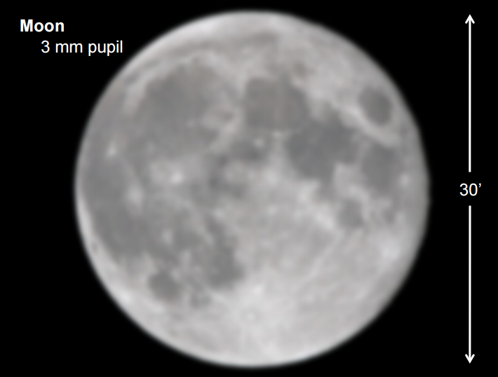

Slide 8
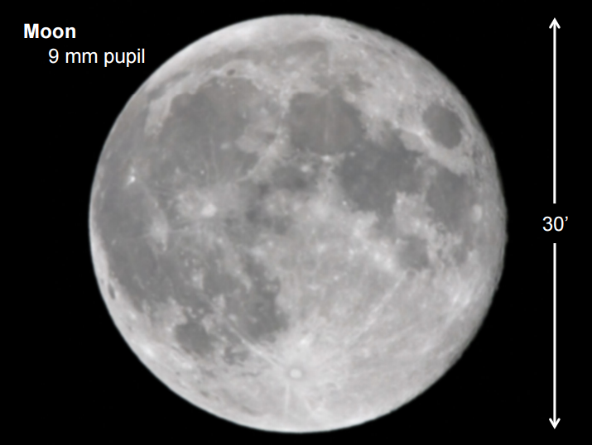

Slide 9
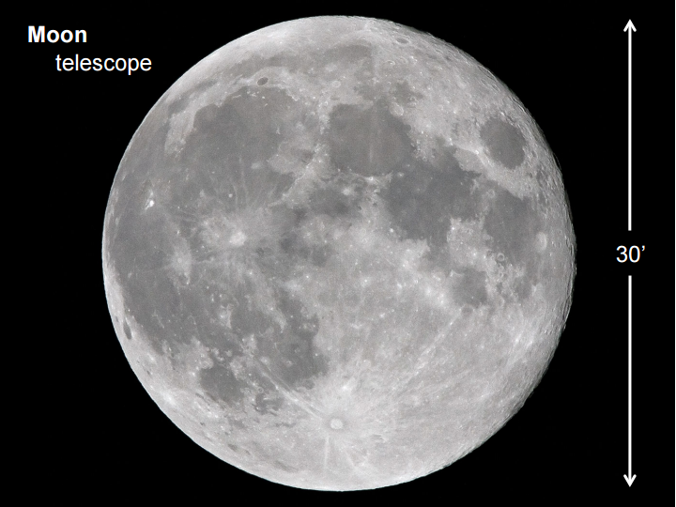
8”

Slide 10
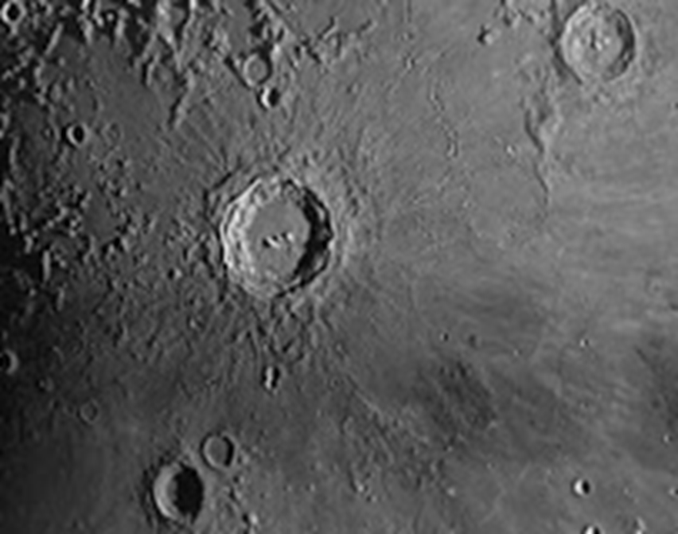
16”

Slide 11
Magnification
The magnification of a telescope depends on the focal length of the Primary Mirror/Lens and the focal length of the eye piece.
Magnification = Object FL
Eyepiece FL
Note: Bigger isn’t always better (magnification)!! For objects like nebulae or galaxies, higher magnification means a lower field of view; the object won’t all fit in the FOV. Also, the higher the magnification, the lower the brightness.

Slide 12
Example
Mr. Putnam’s 8” (203.2 mm) telescope has a focal length of 2700 mm.
Determine how many times brighter objects will appear in the telescope than with the naked eye (8 mm diameter).
How many times will objects be magnified with a 40 mm eyepiece? With a 3 mm eyepiece?

