Slide 1
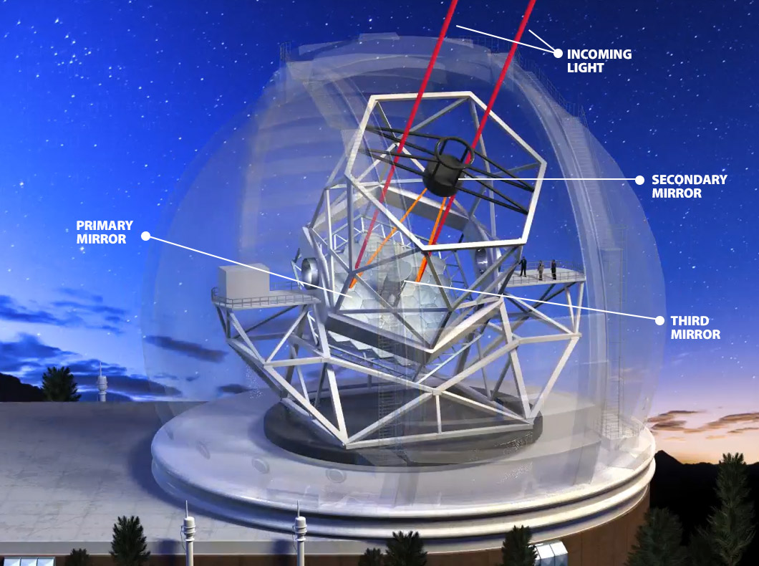
Reflecting Telescopes

Slide 2
Refracting telescopes suffer from chromatic aberration and are difficult and expensive to built.
They don’t often have an objective with a diameter larger than 6” or 7” inches.
Focusing can also be done with mirrors which are easier and cheaper to build.

Slide 3
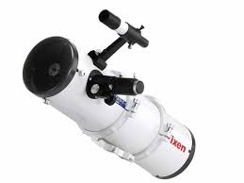
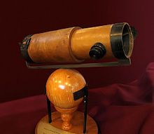
Newtonian Telescopes
Isaac Newton designed the first reflecting telescope in the mid 1660s.
Use parabolic mirrors to focus light

Slide 4
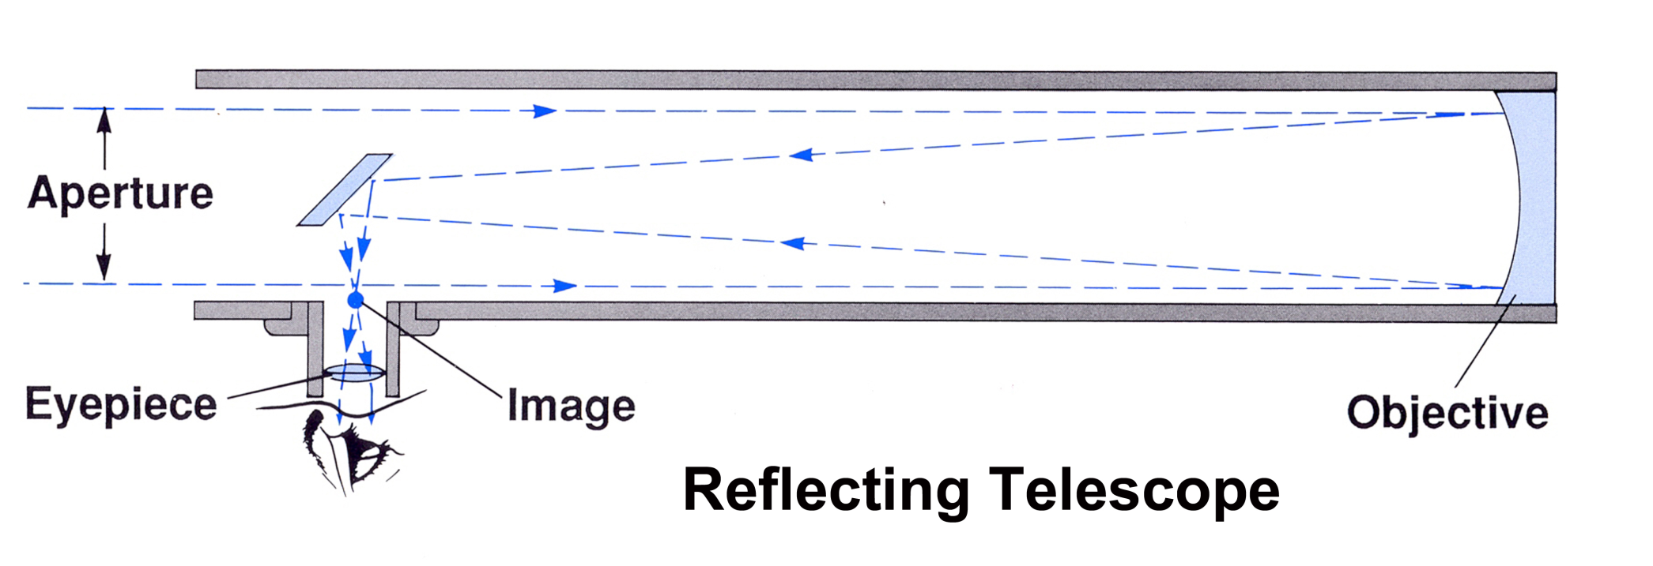

Slide 5
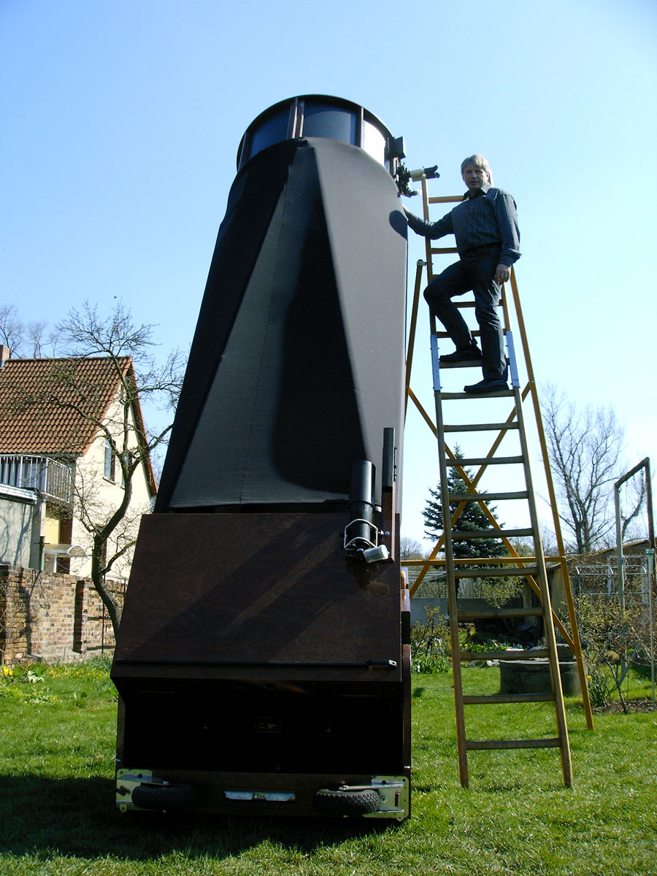
The parabolic mirror is much easier to construct. Telescopes with 20” – 30” diameter object lens are not uncommon.

Slide 6
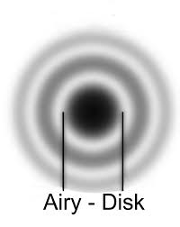
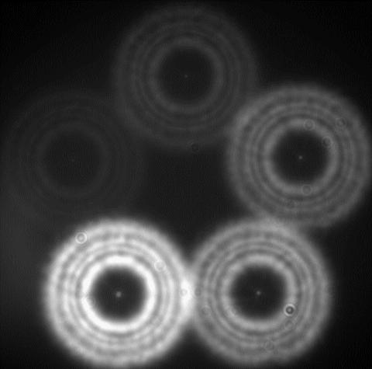
Drawbacks
Secondary mirror reduces light gathering.
Telescope must be the same length as the focal length.

Slide 7
Schmidt Cassegrain Telescope
In the 1950s and 1960s a new telescope design was developed using both mirrors and lens.
Light is folded back through the tube twice.
Known as a Schmidt Cassegrain (SCT) telescope.

Slide 8
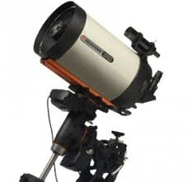

Slide 9
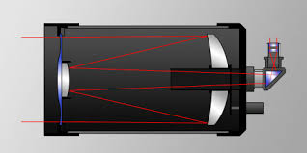

Slide 10
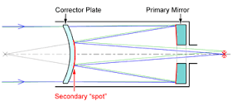
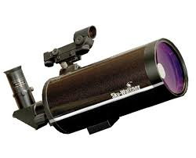
Maksutov Cassegrain Telescope
Uses a curved corrector plate instead of a flat plate.

Slide 11
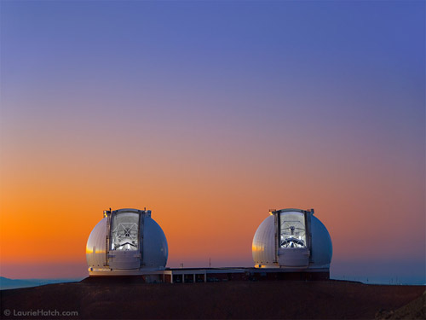
Extremely Large Telescopes

Slide 14
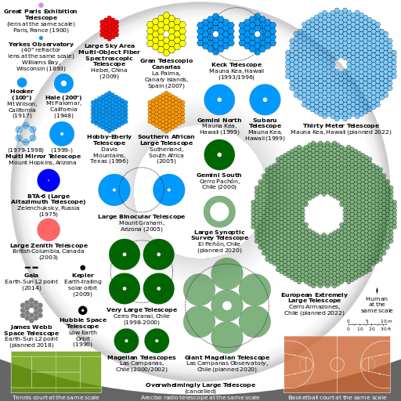

Slide 15
Using the internet, read about the telescopes below. If you could buy one of those telescopes, which one would it be and why?
Celestron 8” SCT
Skywatcher Esprit 120 mm
Obsession 20”
Meade ETX125

