Slide 1
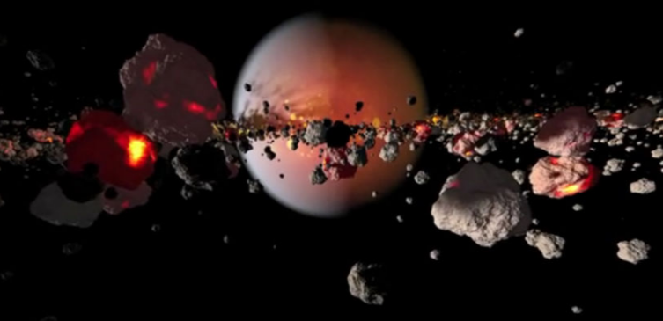
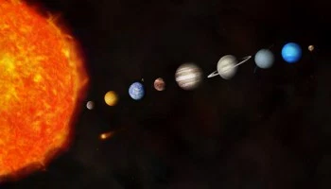
The Solar System

Slide 3
Dating the Solar System
Radioactive dating can be applied to rocks all over the Earth (and solar system).
Most rocks are 100s or 1000s of millions of years old. The oldest are roughly 4 billion years old.
Oldest rocks in the solar system are meteorites – 4.56 billion year old.

Slide 4
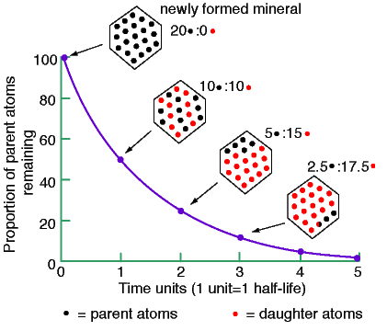
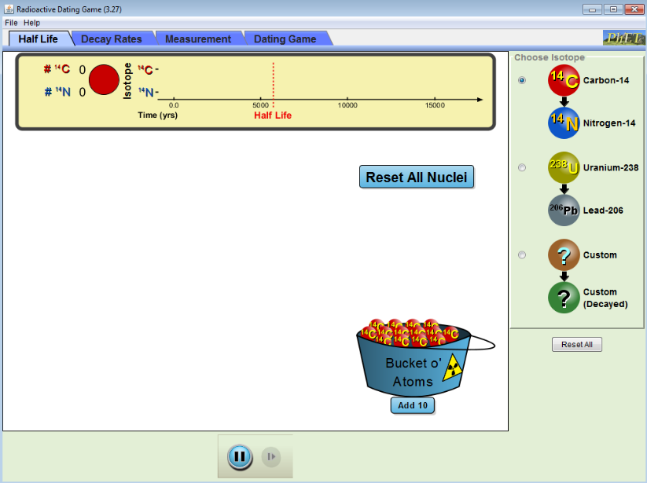

Slide 5
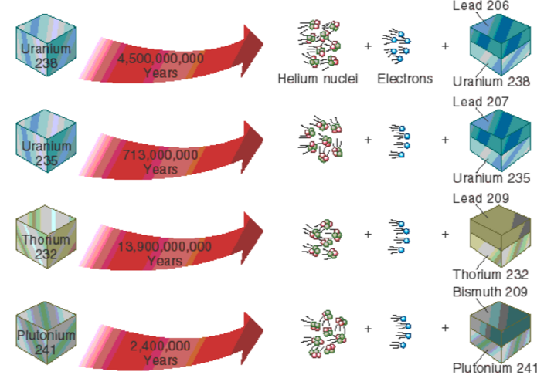

Slide 6
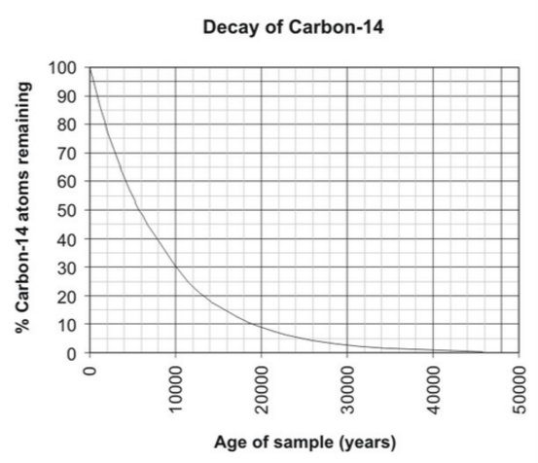
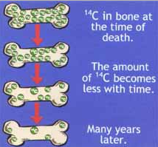
Carbon Dating

Slide 7
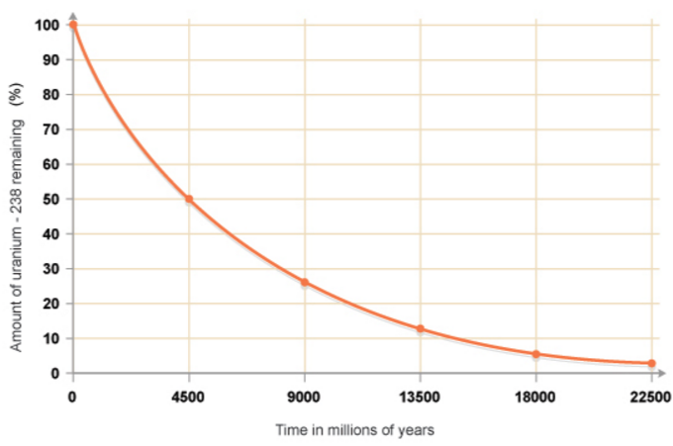

Slide 8
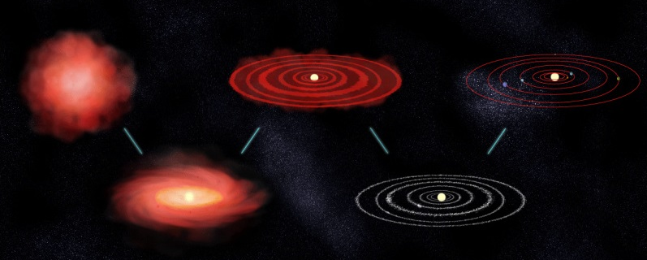
Nebular Hypothesis
As early as the 1700s Immanuel Kant and Pierre-Simon de Laplace suggested the entire solar system formed from an immense cloud of rotating dust and gas.
This is known as the Nebular Hypothesis

Slide 9
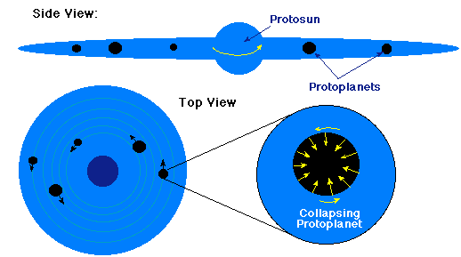
Gravity gradually causes the gas cloud to contract.
As it contracts the cloud flattens and begins to rotate rapidly.
A proto-sun forms at the center
Powered by gravitational heating rather than fusion.

Slide 10
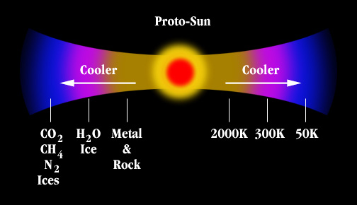
Planet Formation
Once enough dust and gas was captured in the Sun nuclear fusion started.
The temperature of the solar nebula depended on distance from the early sun.

Slide 11
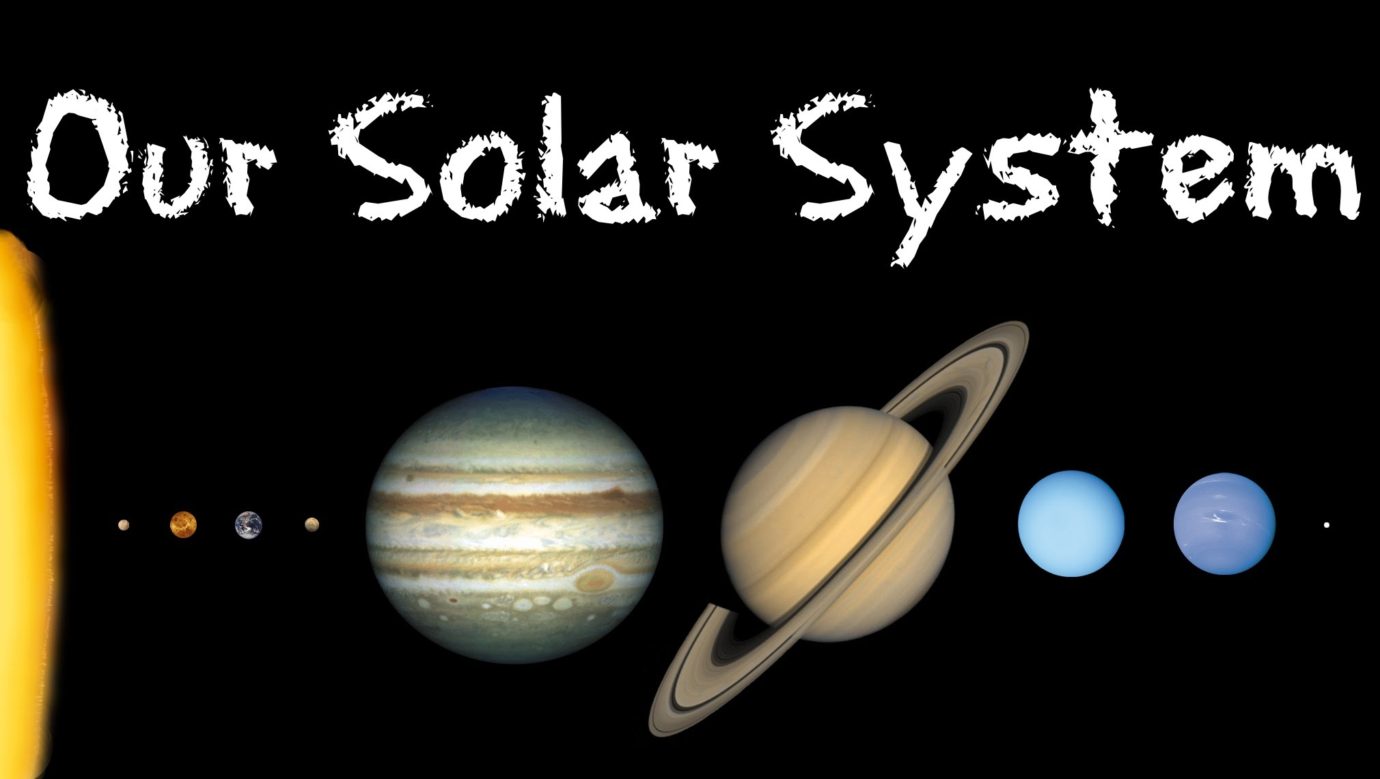

Slide 12
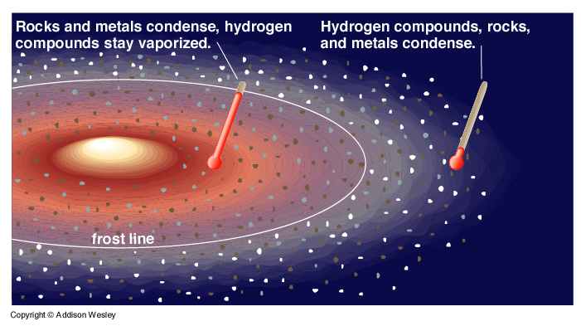
Close to the sun only heavy metals (Iron, Tungsten, Gold etc) could form solids.
Further way water could condense
Further still Ammonia, CO₂, Hydrogen and Helium condensed.

Slide 13
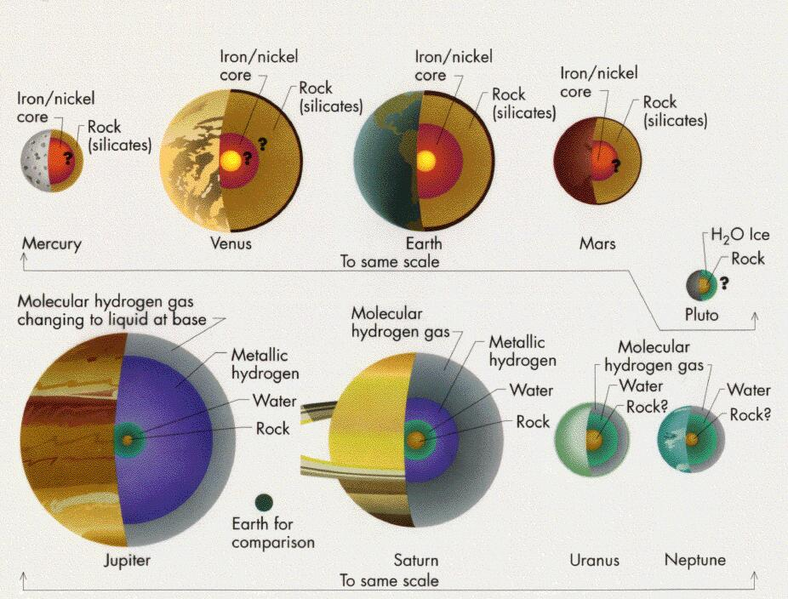

Slide 14
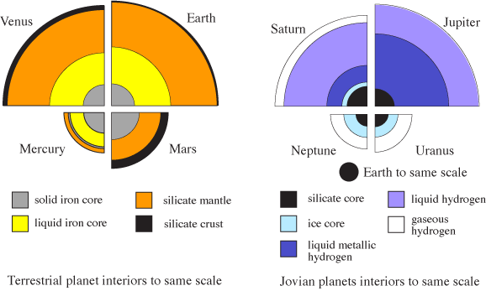

Slide 15
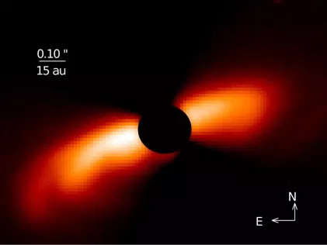
Early Solar Systems
T Tauri Stars

Slide 16
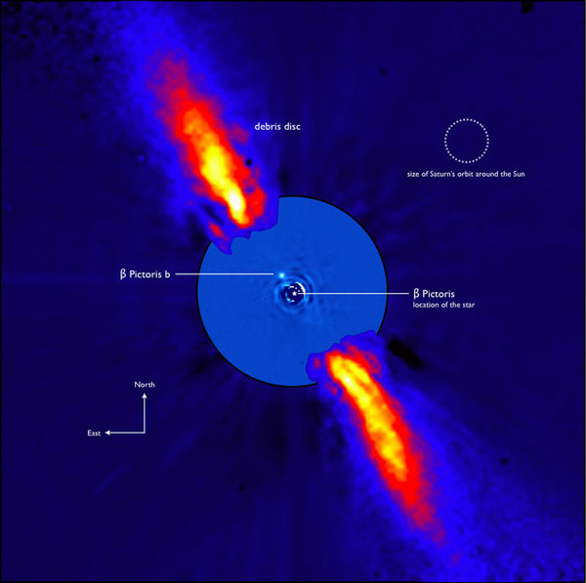

Slide 17
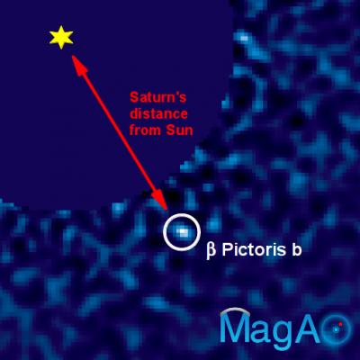

Slide 18
https://www.youtube.com/watch?v=8oebhE6xP4I

