Slide 1
Constellations & Star Positions

Slide 3
On a dark night you can see roughly 6000 stars with the naked eye.
Ancient people looked at the sky and imagined groups of stars traced out pictures.
Today we call these pictures constellations.

Slide 4
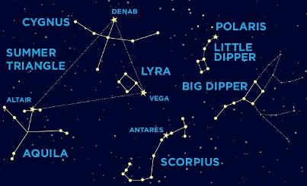

Slide 6
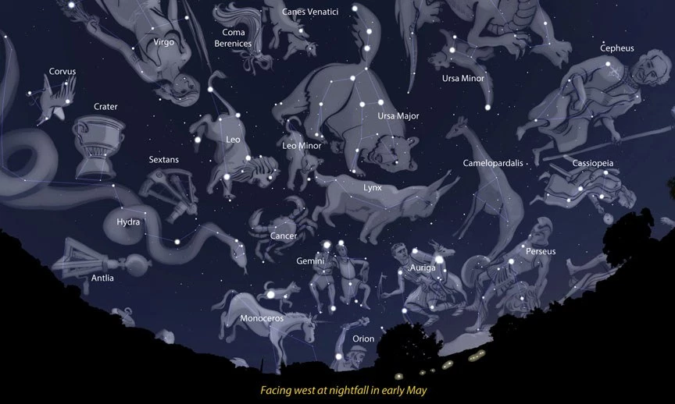

Slide 7
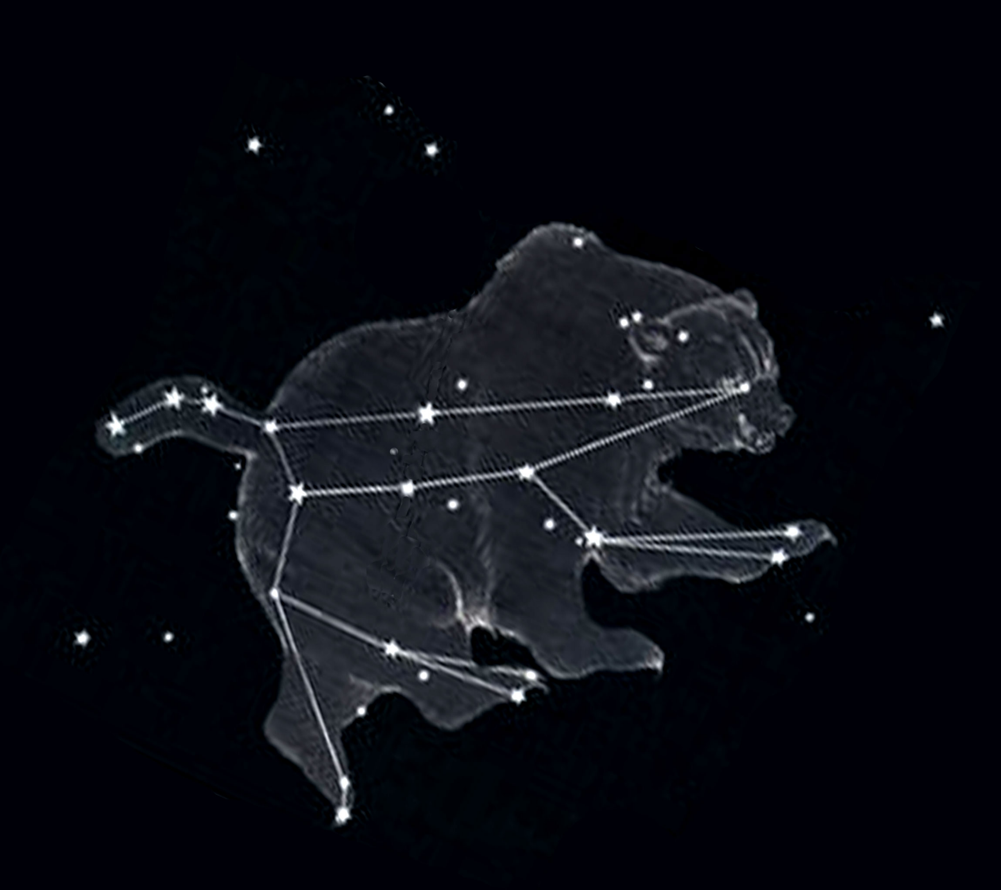

Slide 8
Stars within a constellation are not necessarily close together.
Some stars may be nearby while others are far away even though they lie along the same line of sight.
Asterisms are collections of stars that are easily recognizable but not a constellation.
The Big Dipper

