Slide 1
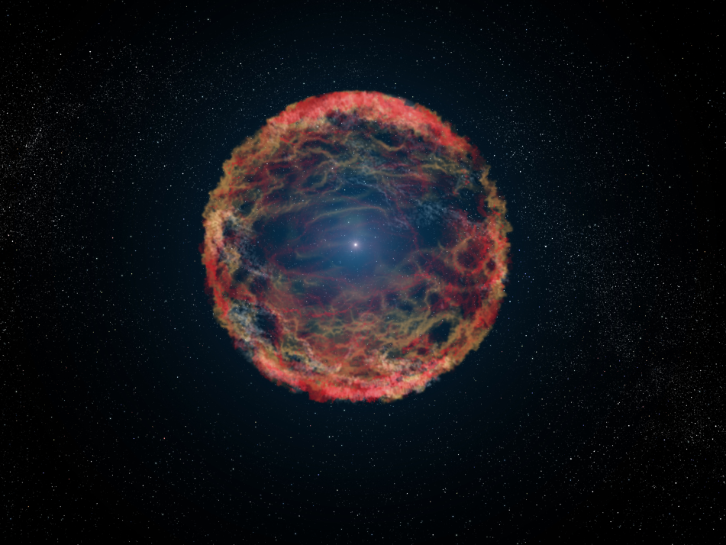
Brightness and Actual Motion of Stars

Slide 2
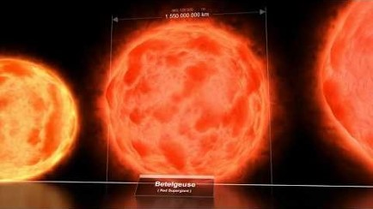
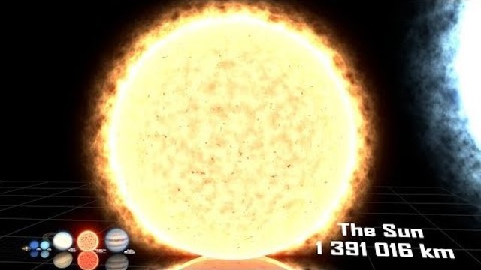
Size Comparison of Objects in the Universe!

Slide 4
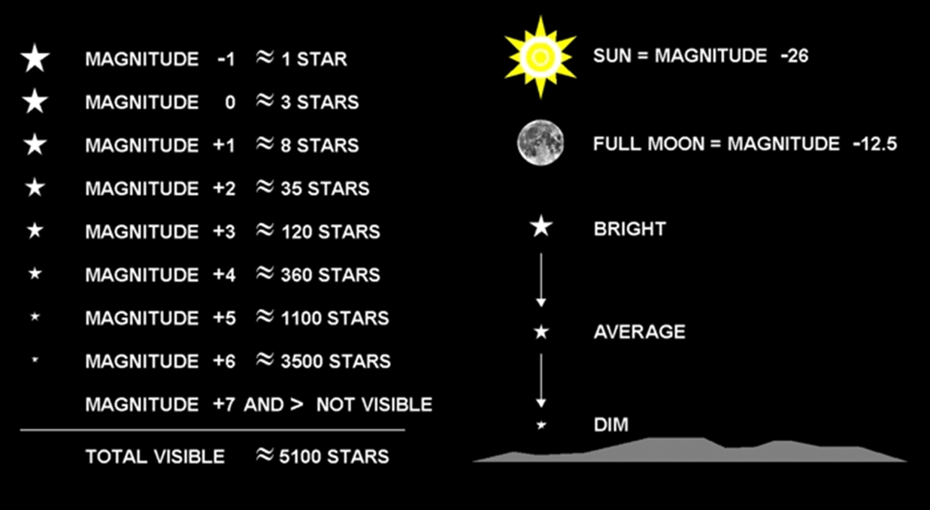
Brightness of Stars
Different stars have widely different brightness.
Brightness depends on temperature and size.

Slide 5
Apparent magnitude is a measure of how bright a celestial object appears to be.

Slide 6
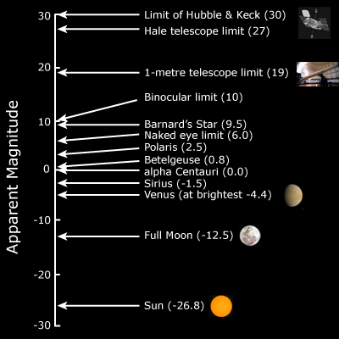

Slide 7
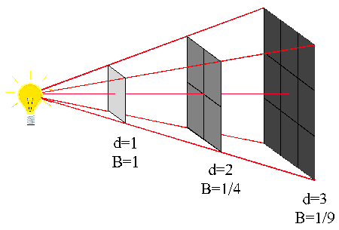
Apparent Brightness depends on 2 things:
Intrinsic brightness of object
How far away it is

Slide 8
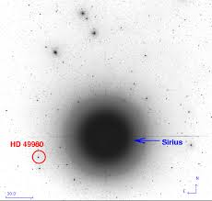

Slide 9
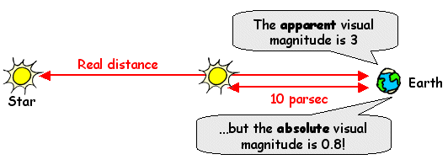
Absolute Brightness
Absolute Magnitude is a measure of how bright a celestial object would be if it were 32.6 light years away.

Slide 10
Celestial Object | Apparent Magnitude | Absolute Magnitude
Sun | -26.74 | 4.83
Polaris | 1.98 | -3.6
Arcturus | -2.25 | -0.30
Alpha Centauri | 0.01 | 5.71
Andromeda Galaxy | 3.44 | -21.5
Quasar 3C 273 | 12.9 | -26.7

Slide 11
Distance Modulus
The difference between apparent and absolute magnitude can be used to determine the distance to a star.

Slide 12
Movement of Stars
Stars are always moving.
The sun is orbiting around the Milky Way at roughly 225 km/s, taking about 200,000,000 years to make one complete trip.
All stars move relative to each other. This is called Proper Motion.

Slide 13
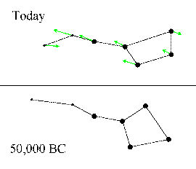

Slide 14
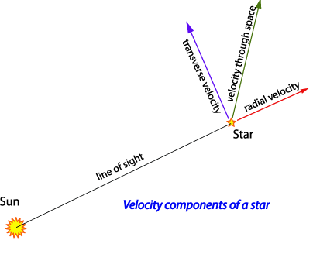

Slide 15
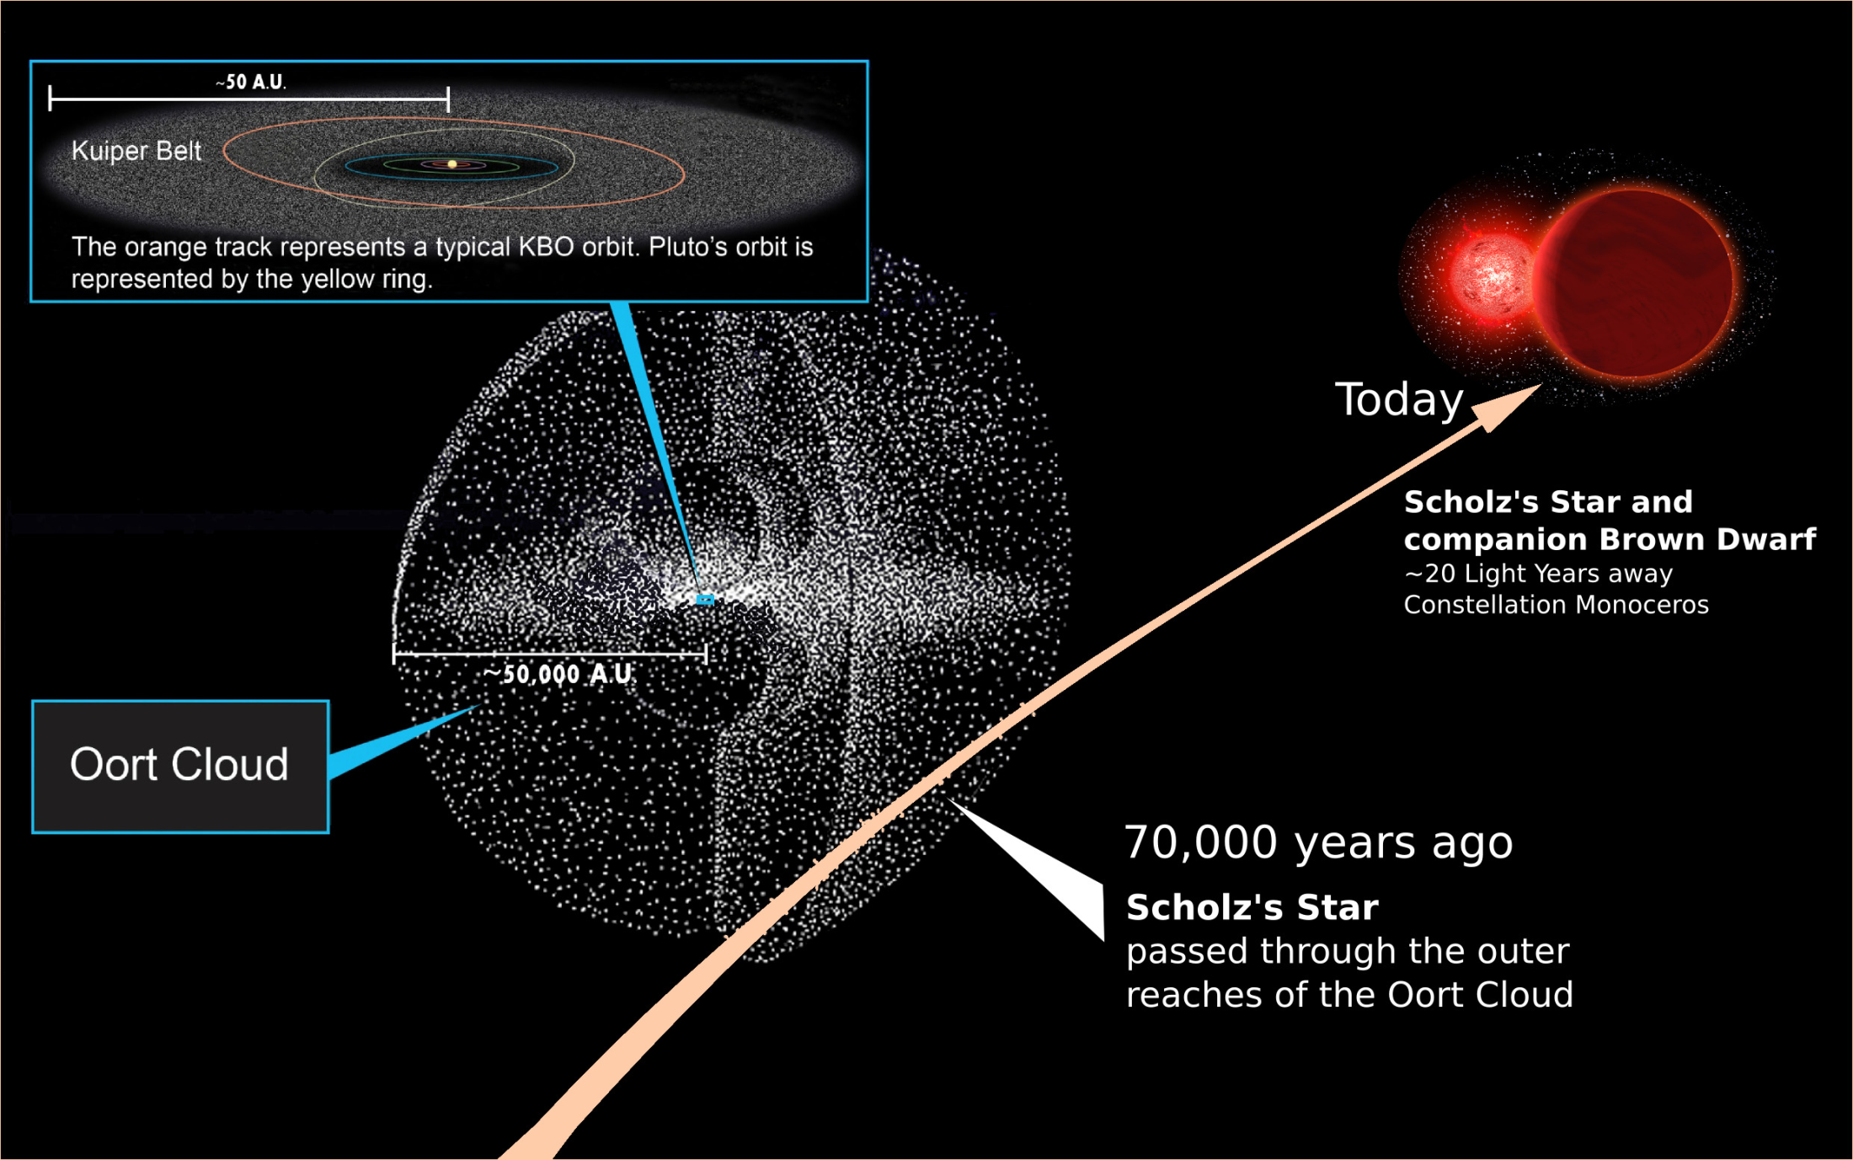

Slide 16
Scholz Star
Roughly 20 light years away in the constellation Monoceros
Red Dwarf with a mass of 15% of the Sun
Apparent Magnitude of 18.3 and absolute magnitude of 19.4
70,000 years ago it passed through the Oort cloud (roughly 0.82 light years from the Sun)
Disturbed comets in the Oort cloud, likely sending some of orbits toward the inner solar system

