Slide 1
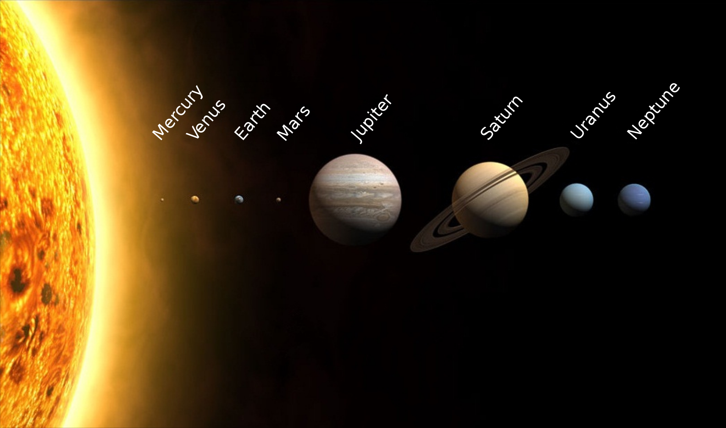
Planet, Asteroid & Comet Motion

Slide 2
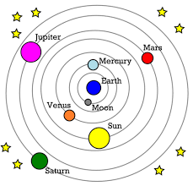
Geocentricity

Slide 3
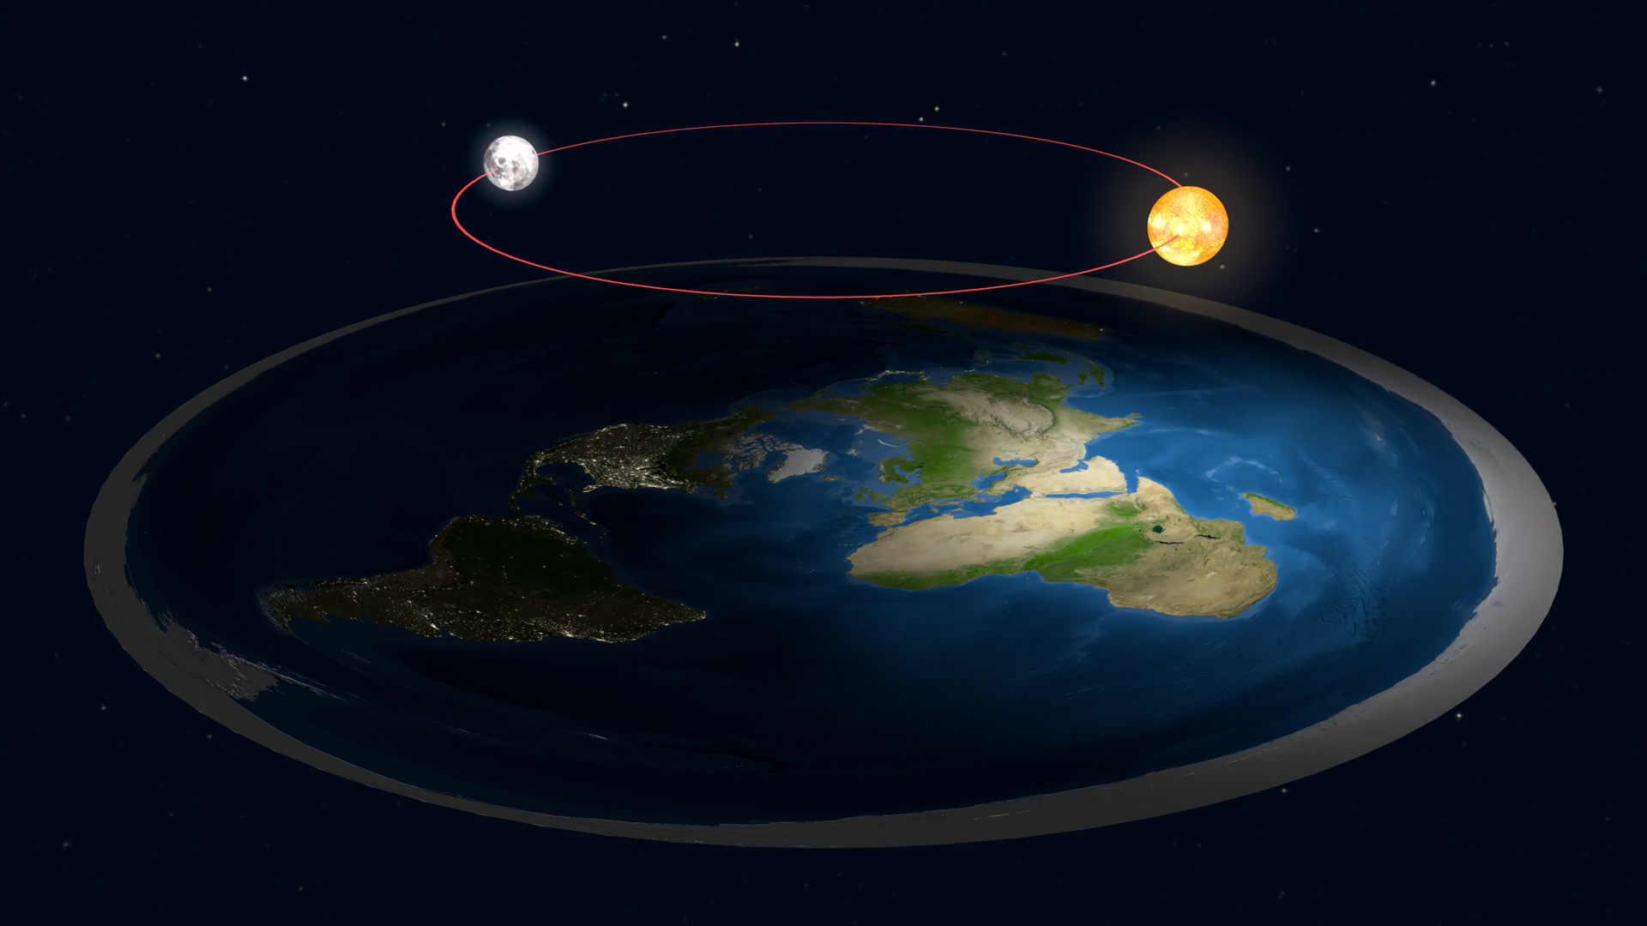

Slide 4
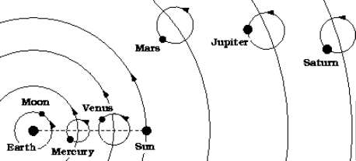

Slide 5
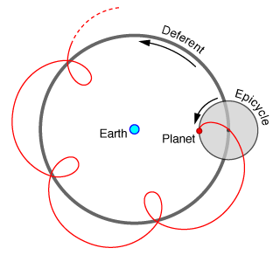

Slide 7
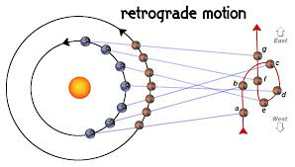

Slide 8
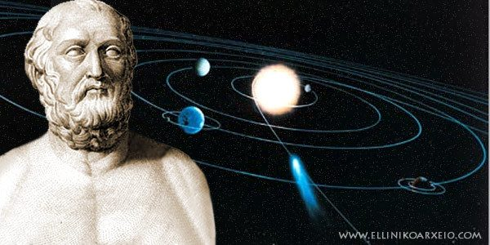
Aristarchus
Was the first on record to suggest a Heliocentric model of the universe (approx. 230 BC)
His hypotheses included:
the fixed stars and the sun remain unmoved in a universe much bigger than originally thought
the Earth revolves about the sun in the circumference of a circle, with the Sun in the middle of the orbit
The orbit of Earth is so great that there should be a observable difference in the location of stars based on viewpoints from Earth (introducing the idea of parallax)

Slide 9
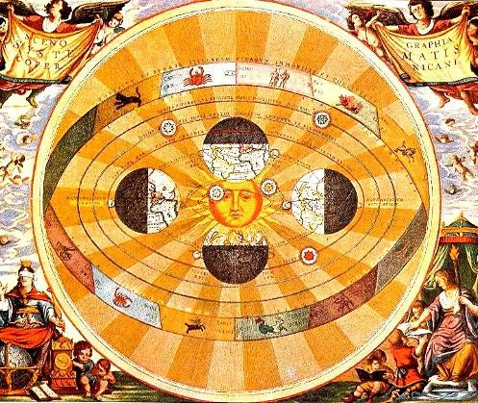
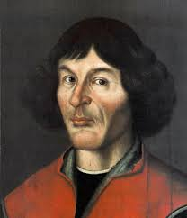
Copernicus – 16th Century

Slide 10
Arrangements of Planets
Mercury and Venus are always observed near the sun.
Their orbits must be smaller than Earth’s
Inferior planets
Mars, Jupiter and Saturn can appear on the side of the Celestial Sphere opposite the sun.
Their orbits must be larger than the Earth’s
Superior planets

Slide 11
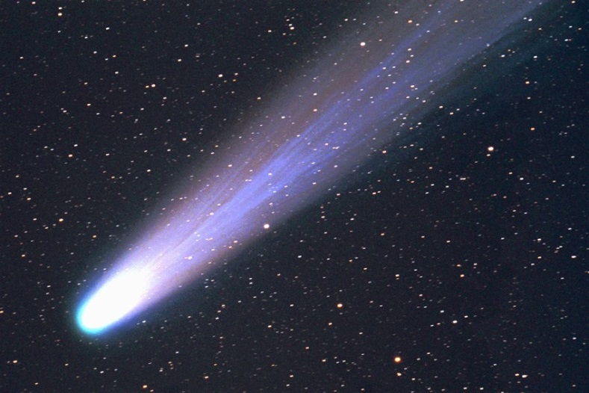
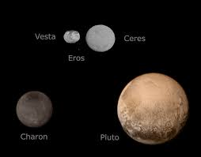
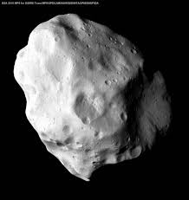
Non-Planets
Asteroids
Comets
Dwarf Planets

Slide 12
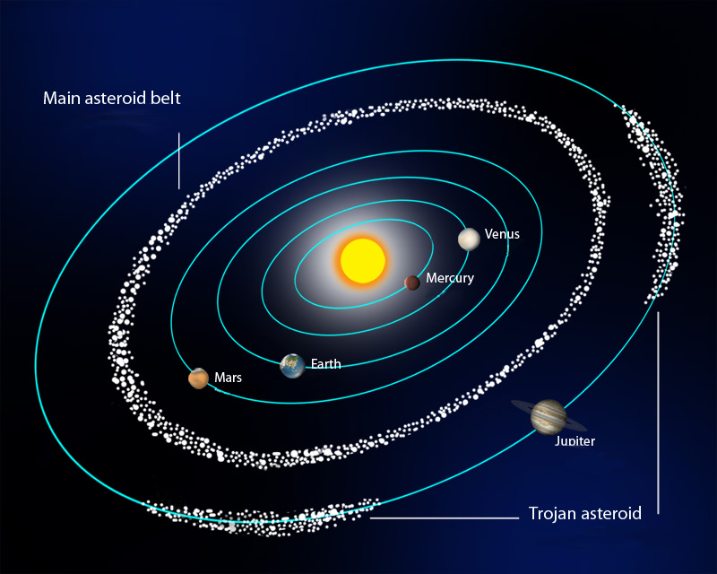

Slide 13
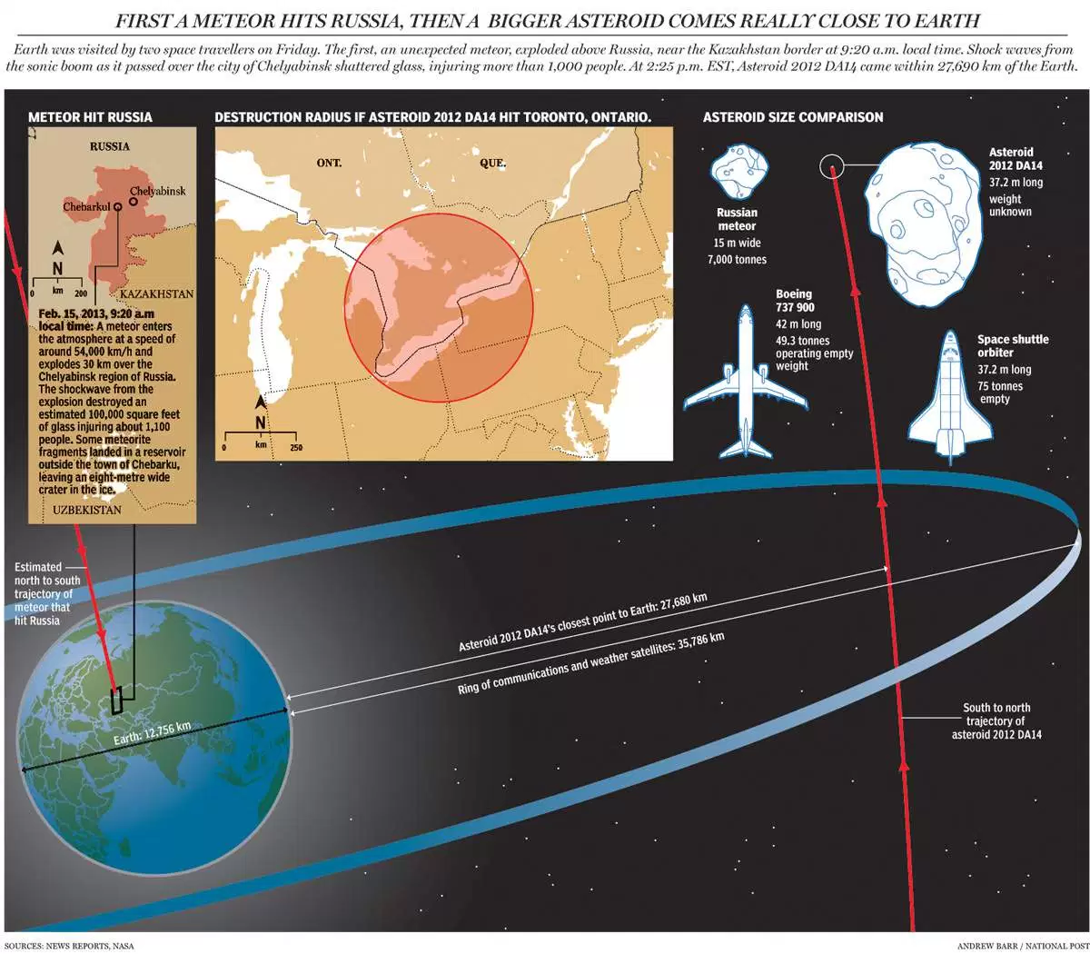

Slide 14
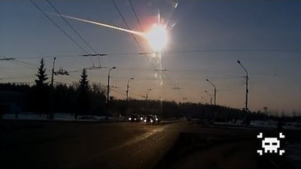
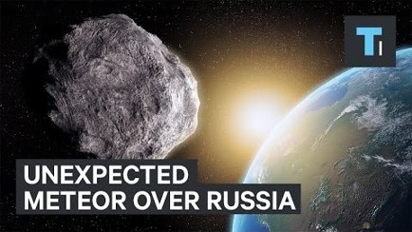

Slide 15
Asteroid Exploration

Slide 17
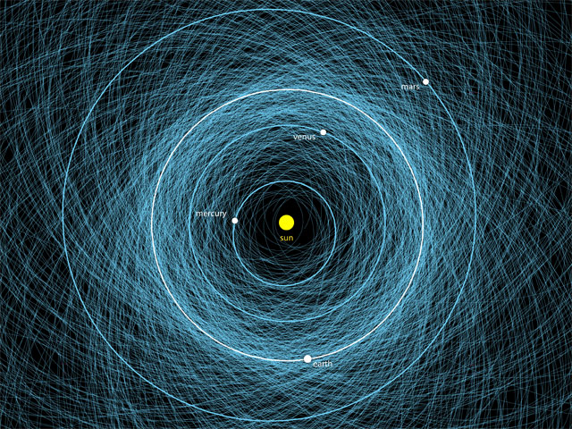

Slide 18
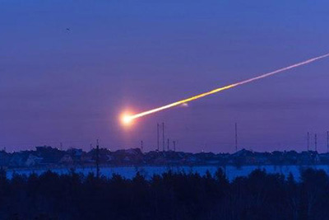

Slide 19
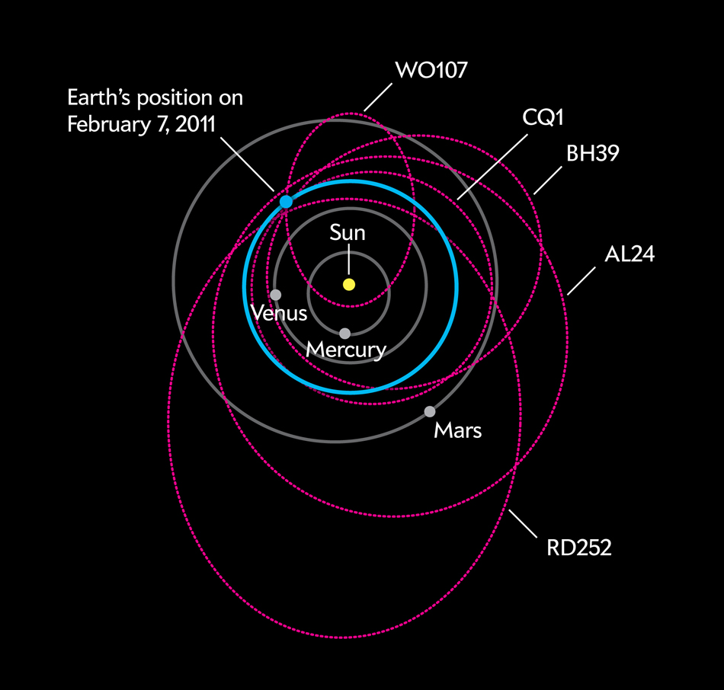

Slide 20
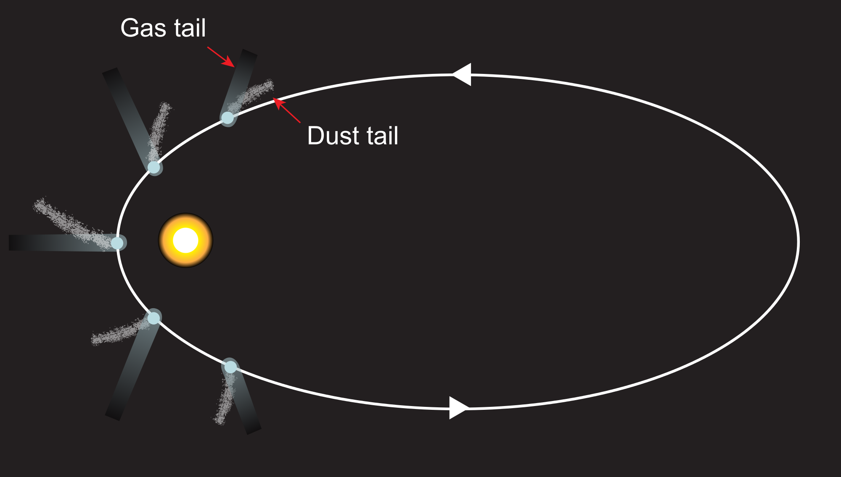

Slide 21
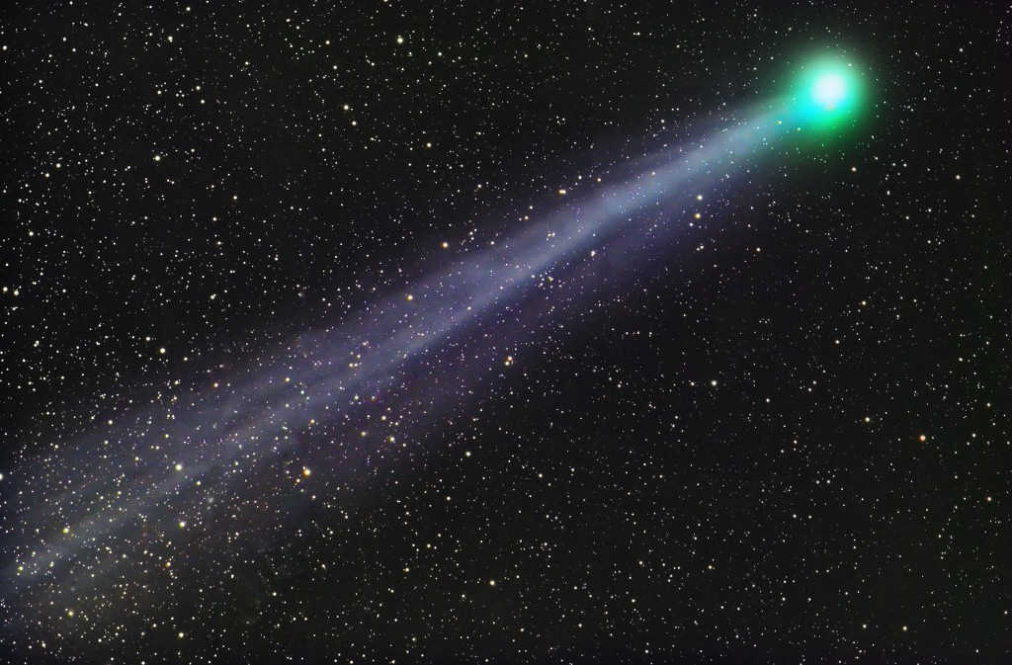
Comet Wirtanen
Easily Visible November through January in Auriga and Taurus.

Slide 22
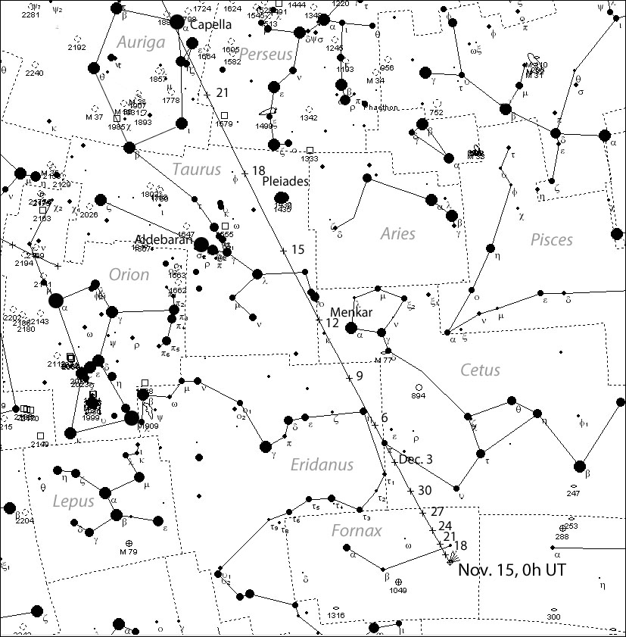

Slide 23
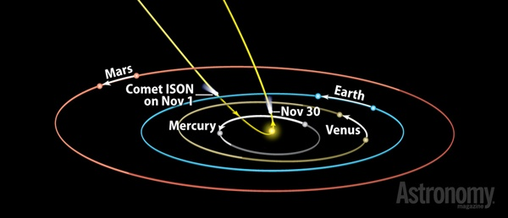

Slide 24
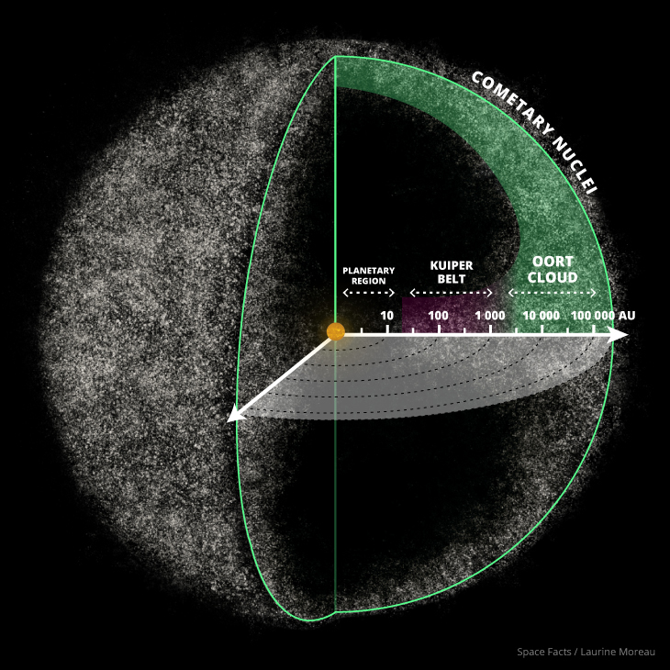

Slide 25
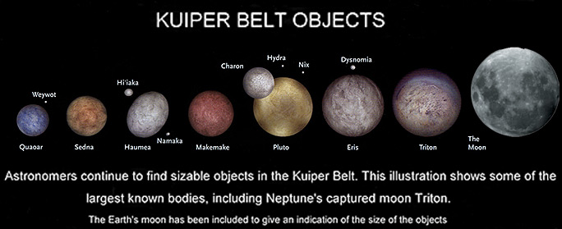

Slide 26
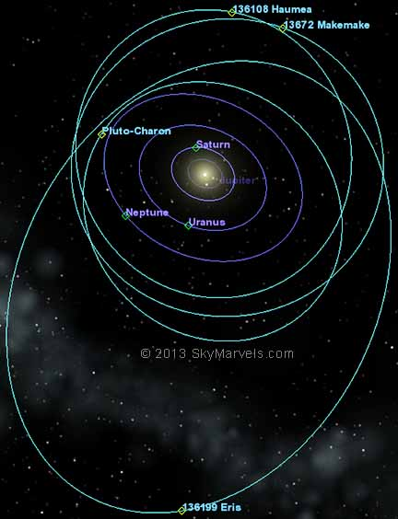

Slide 27
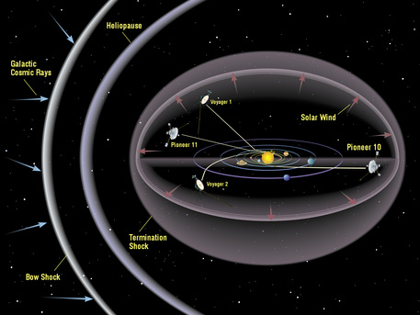

Slide 28
