Slide 1
Telescope Basics

Slide 2
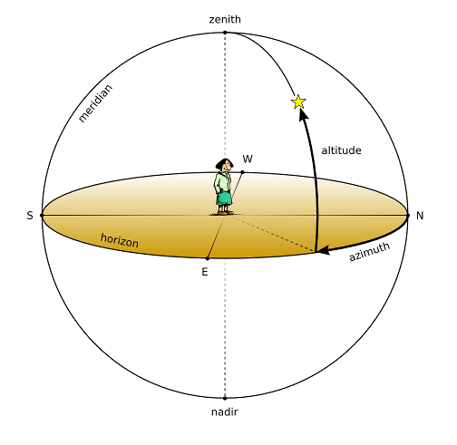
Altitude & Azimuth
Altitude – Angle above the horizon relative to an observer
Azimuth – Angle from an observer measured from North or South

Slide 3
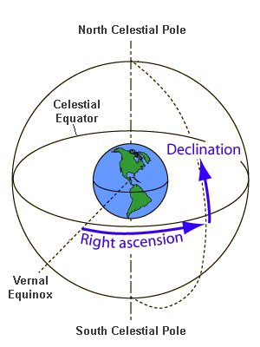
Right Ascension & Declination
Right Ascension - the angular distance measured eastward along the celestial equator from the vernal equinox
Declination - the angular distance of a point north or south of the celestial equator

Slide 4
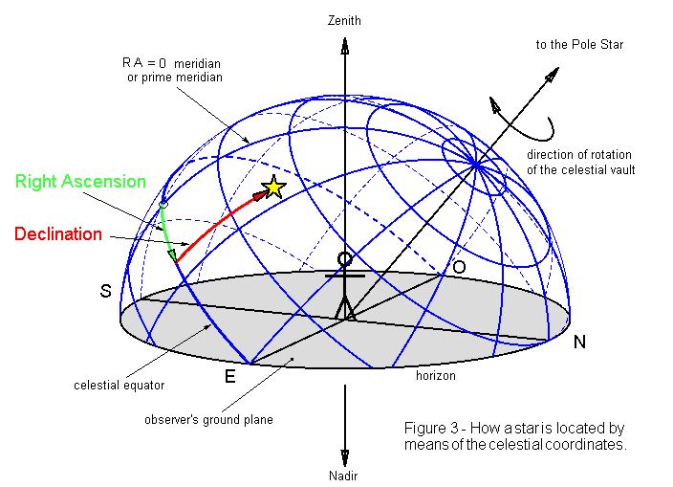

Slide 5
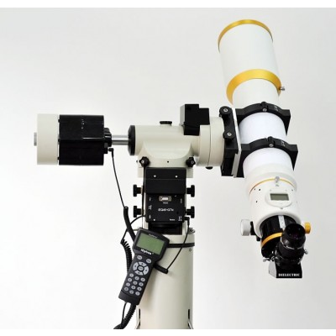
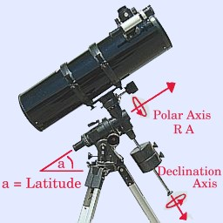

Slide 6
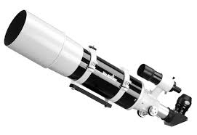
Refractor
Uses Lenses to bend and focus light.

Slide 7
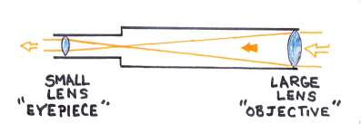

Slide 8
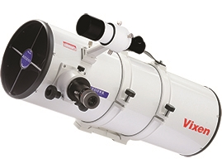
Newtonian TElescope
Uses a parabolic mirror to focus light.
Has a secondary mirror to redirect light.

Slide 9
