Slide 1
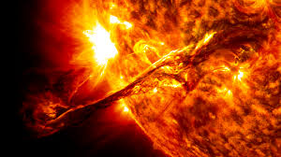
Observing the Sun

Slide 2
Looking at the sun (even without telescopes or binoculars) can severely damage your eyes.

Slide 3
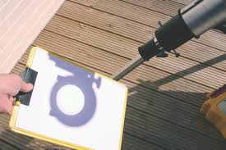
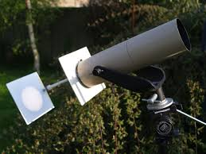
Safely observing the sun
Solar Filters
Dense glass that blocks 99.99% of the light (including all UV)
Number 13 or 14 Welders glass works well
Projection Astronomy
Projecting the disc of the sun through a telescope and onto a piece of paper.

Slide 4
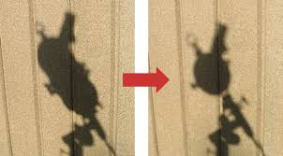

Slide 5
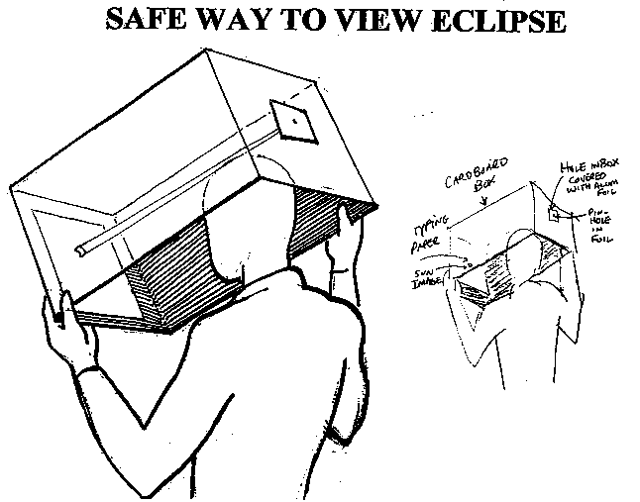
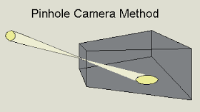
Pin-hole projection

Slide 6
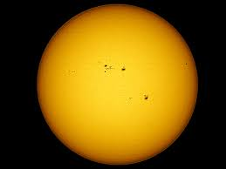
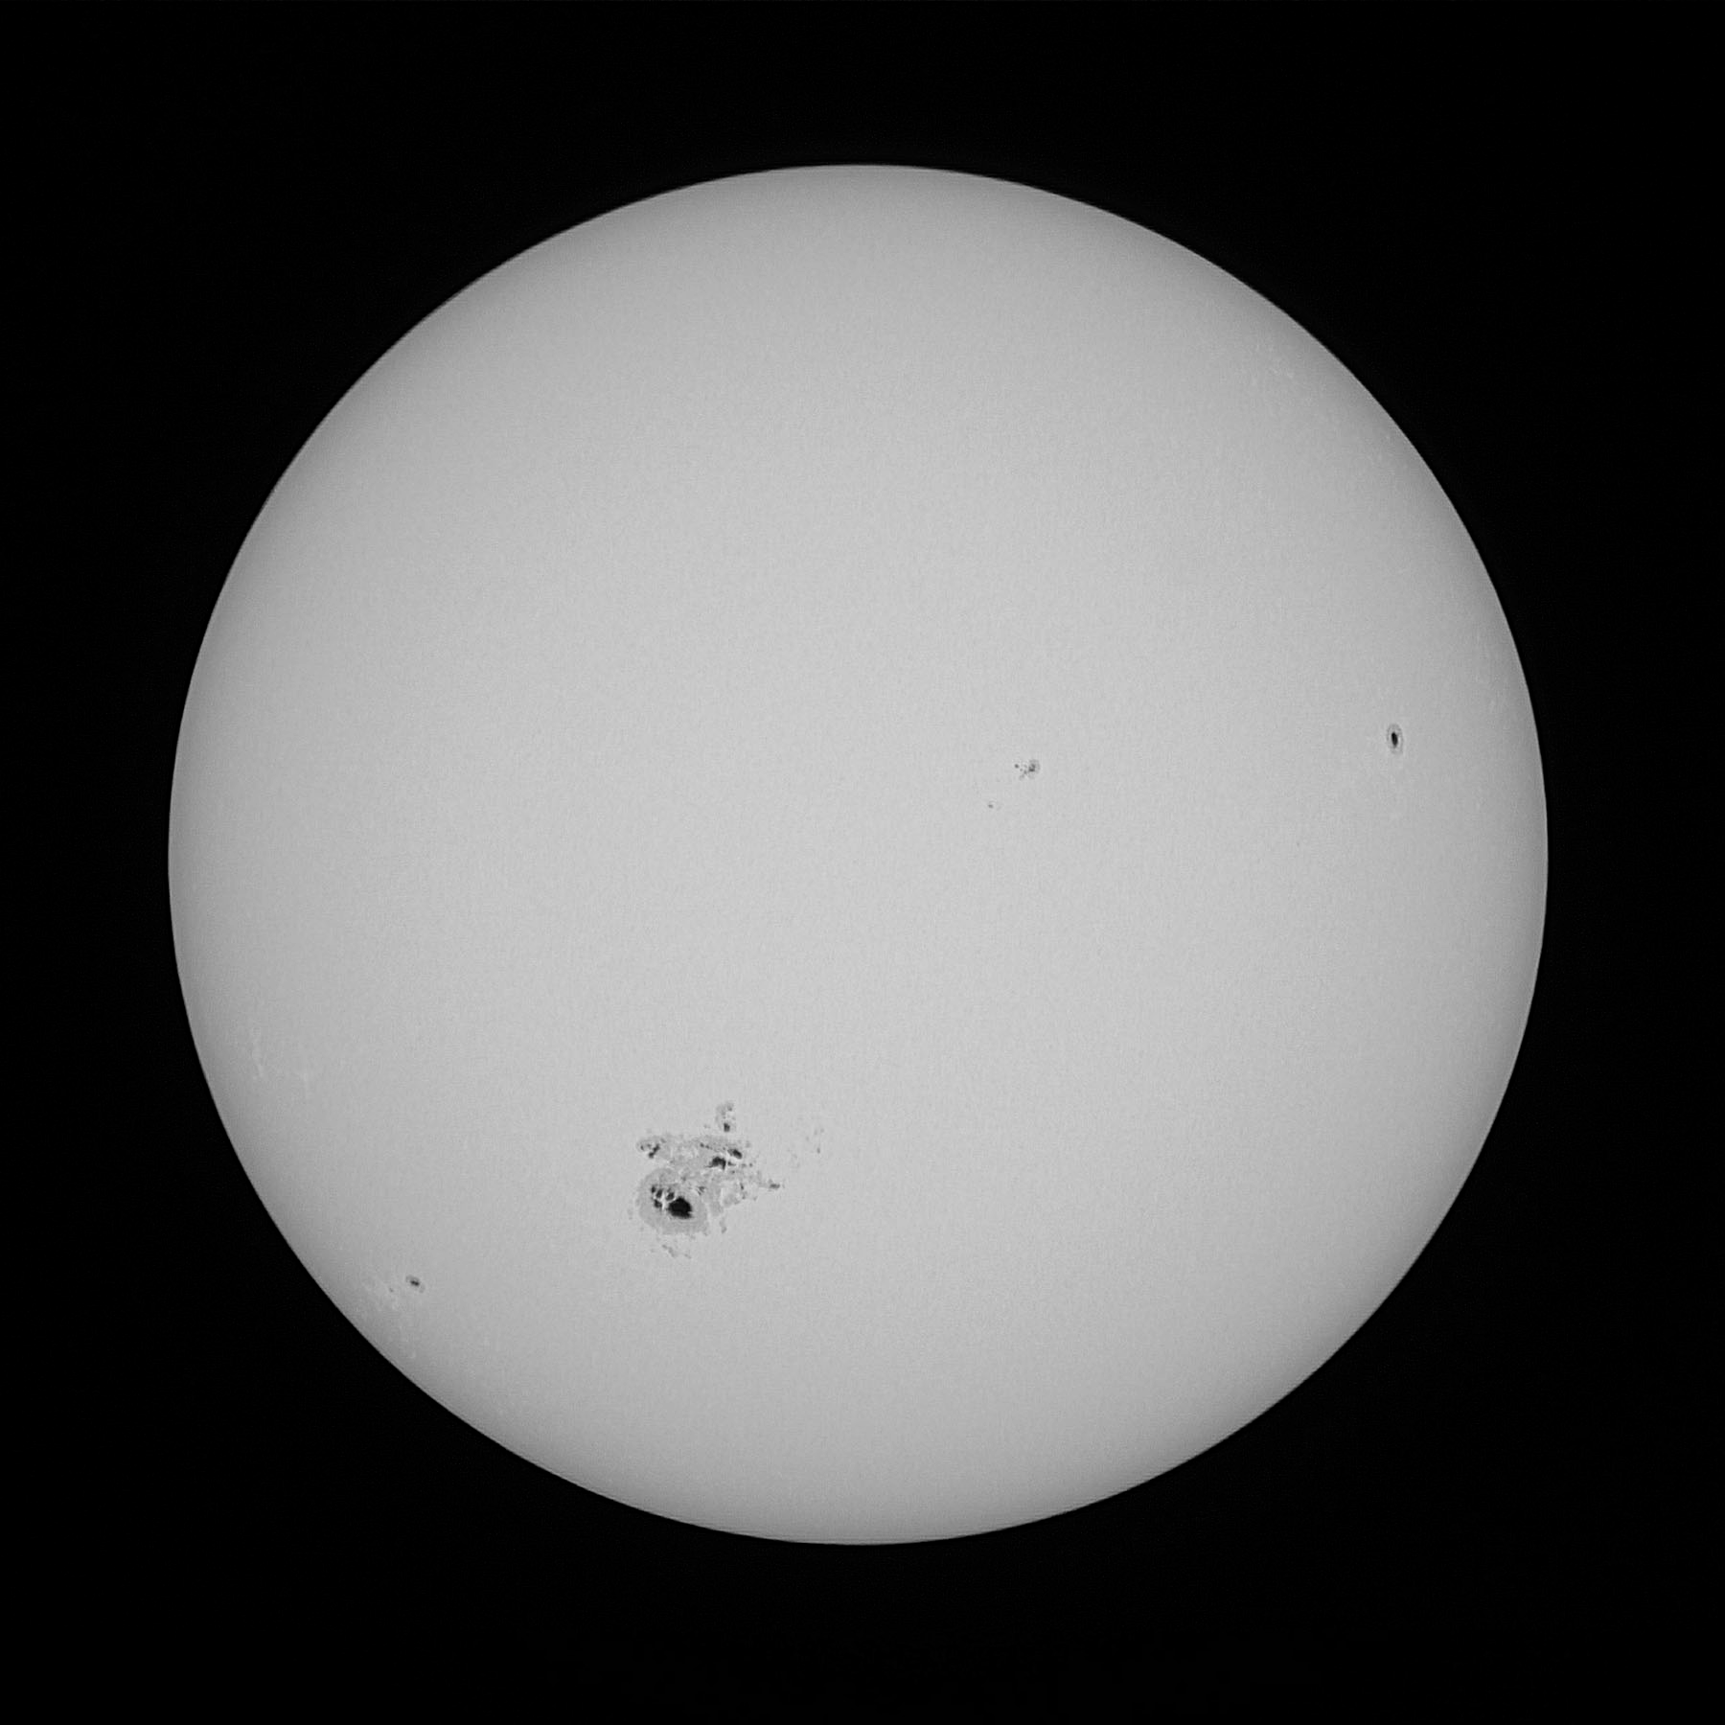
White Light viewing

Slide 7
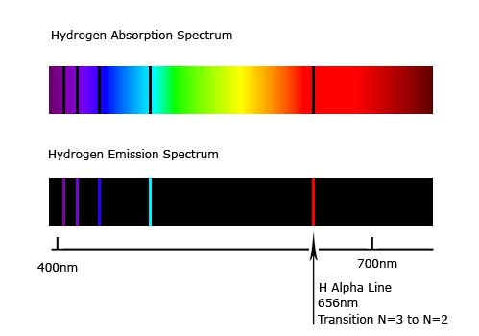
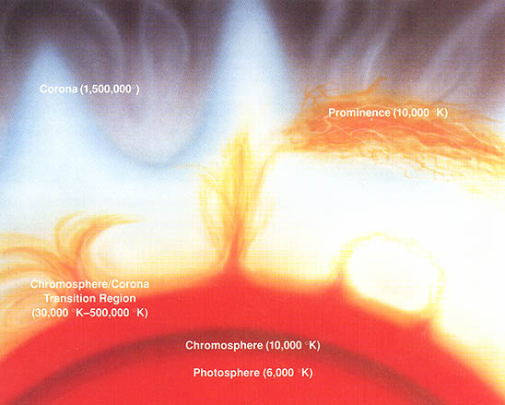
Hydrogen Alpha Light

Slide 8
